Slide 1
SIMPLE PAST TENSE
GEÇMİŞ ZAMAN

Slide 2
Simple Past Tense ( Geçmiş Zaman )
Geçmişte olan olayları anlatmak için kullanıyoruz.

Slide 3
Olumlu cümle kurarken fiillerin 2. hallerini kullanıyoruz.
1- Regular Verbs
2- Irregular Verbs

Slide 4
Regular Verbs ( Düzenli Fiiller)
Sonuna –ed eki alan fiiler
1- Eğer kelimenin sonu sadece ‘-e’ harfi ile bitiyorsa sadece –d ekini ekliyoruz.
Arrive – arrived
I arrived home at 7 in the evening yesterday.
Close – closed
She closed all the Windows.
Like – liked
He liked fishing when he was 9.

Slide 5
2- Eğer fiilin sonu sessiz harf ile bitiyorsa –ed ekini ekleriz.
Watch – watched
The children watched a cartoon yerterday.
Pick- picked
My father picked flowers for me on Sunday.
Climb – climbed
I and my brother climbed a tree yesterday afternoon.

Slide 6
3- Eğer kelimenin sonu sessiz harf+y ile bitiyorsa o zaman y harfi düşer yerine –ied eklenir.
Cry ( kelimenin son iki harfine bakalım. r sessiz harf, son harf y . Demek ki kuralımıza uyuyor.)
Cry – cried
My little sister cried all day.
Study – studied
I studied English yesterday.
DİKKAT!
Play-played
We played snowball on Friday.
Enjoy – Enjoyed
We enjoyed making a snowman.

Slide 7
Irregular Verbs( Düzensiz Fiiller)
Swim – swam
My family swam in the lake on holiday.
Go – went
We went sightseeing tour in Italy last year.
Read- read
My sister read a lot of books on summer holiday.
Have – had
We had a huge breakfast yesterday morning.

Slide 8
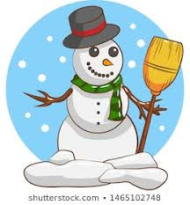
What did you do yesterday?
make a snowman
( Make – made )
I made a snowman.

Slide 9

What did you do yesterday?
Read – read
We read a book.

Slide 10
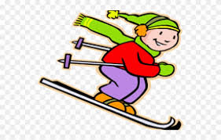
What did you do on your last holiday?
go skiing – went skiing
We went skiing.

Slide 11

What did your sister do on Sunday?
do – did
She did her homework.

Slide 12
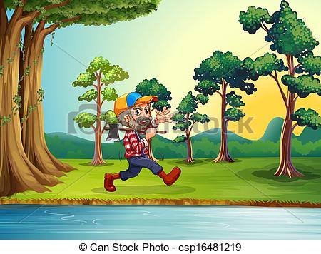
What did your father do at the weekend?
Walk by the river – walked by the river
He walked by the river.

Slide 13
GİZEM ŞEYDA KAYALI

