Slide 1



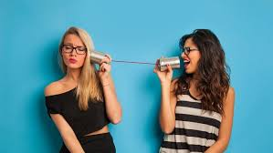



Slide 2

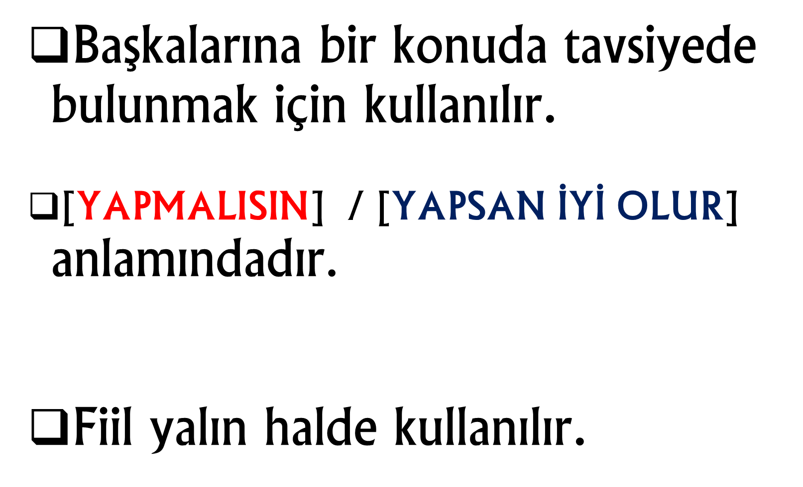


Slide 3

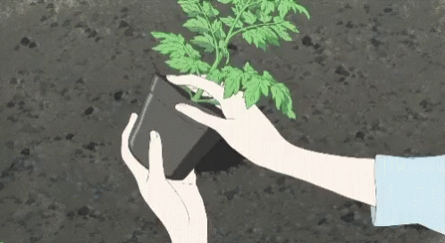
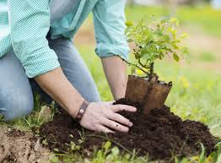
[Biz, ağaç dikmeliyiz.]

Slide 4
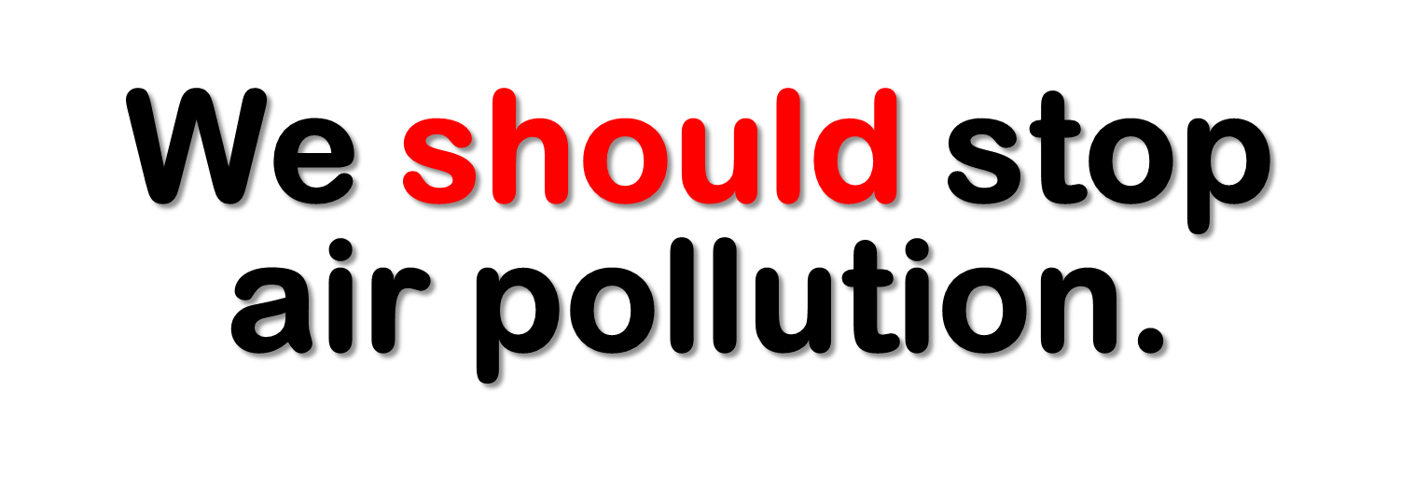
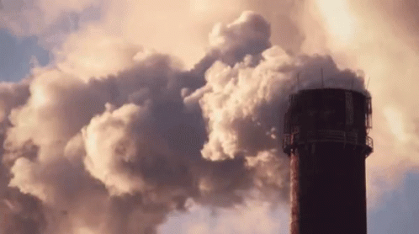
[Biz, hava kirliliğini durdurmalıyız.]

Slide 5

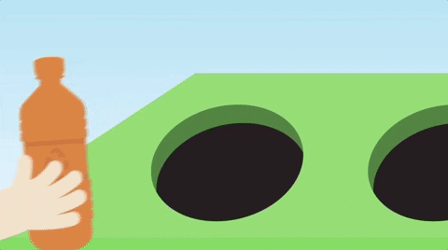
[Sen kağıdı, plastiği ve camı geri dönüştürmelisin.]

Slide 6

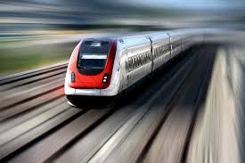
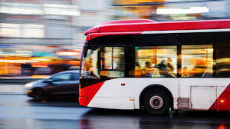
[İnsanlar, toplu taşıma araçlarını kullanmalıdır.]

Slide 7

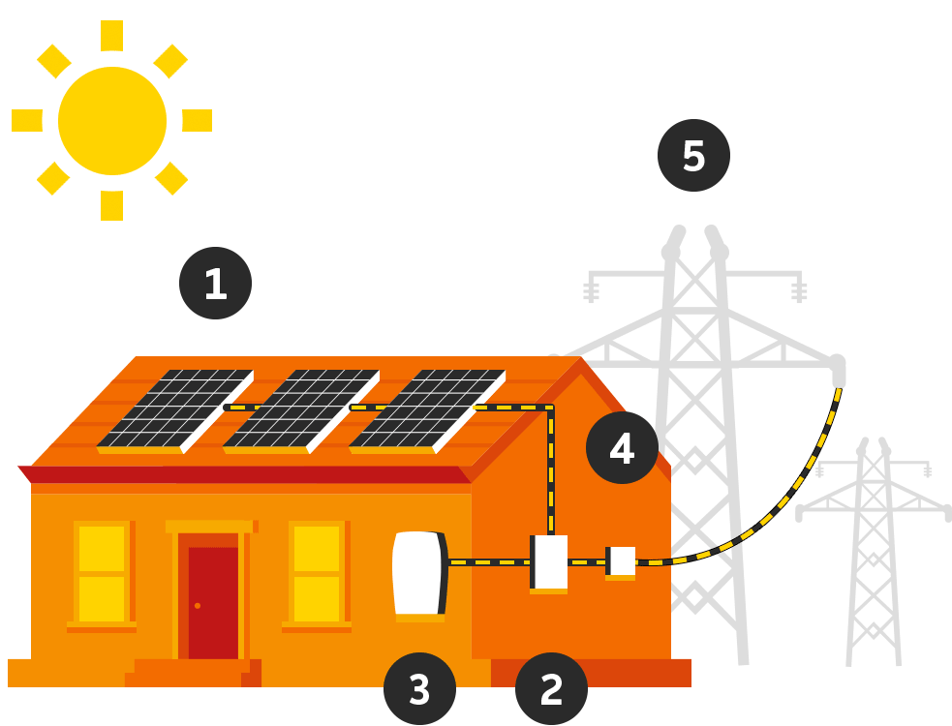
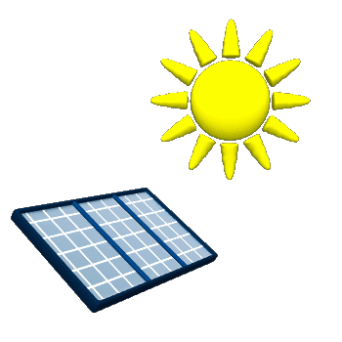
[Biz, güneş enerjisi kullanmalıyız.]

Slide 8
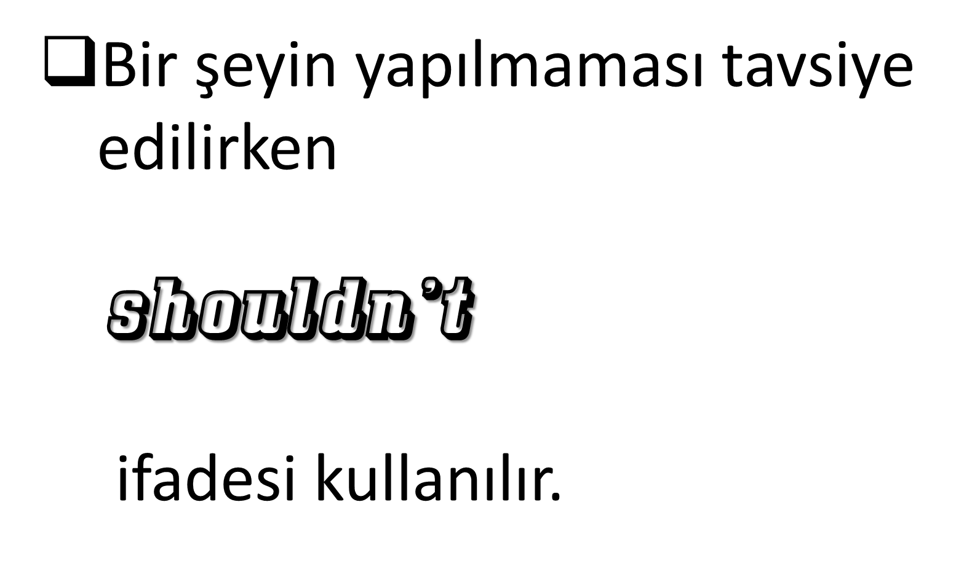



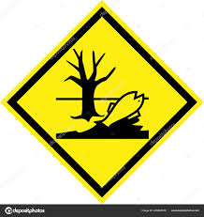


Slide 9

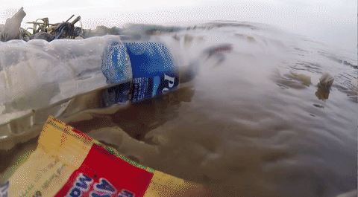
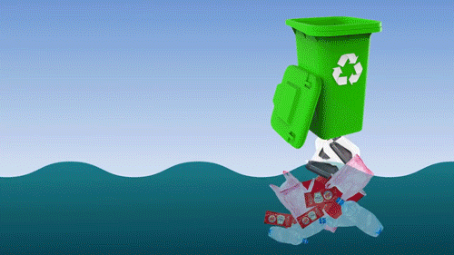
[Sen, denizlere çöp atmamalısın.]

Slide 10

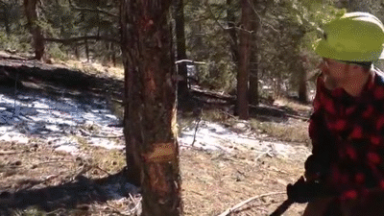
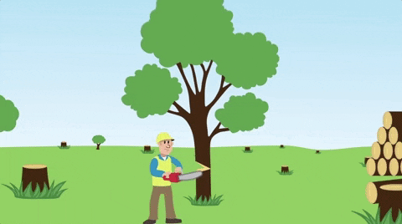
[Biz, ağaçları kesmemeliyiz.]

Slide 11

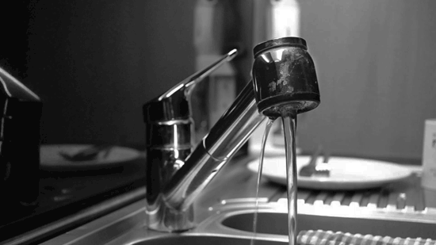
[Sen, suyu israf etmemelisin.]

Slide 12




Slide 13

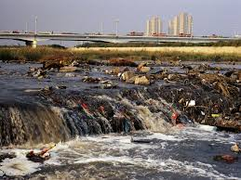
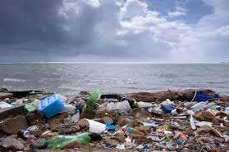


shouldn’t

Slide 14
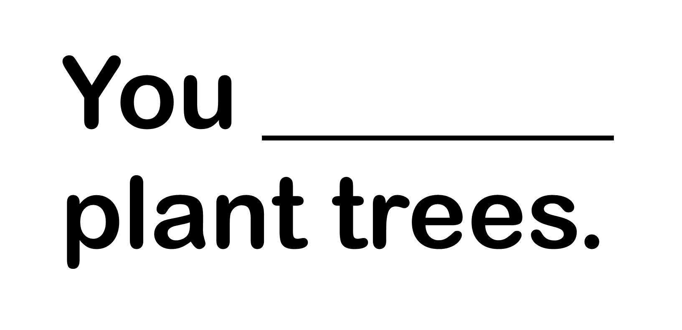
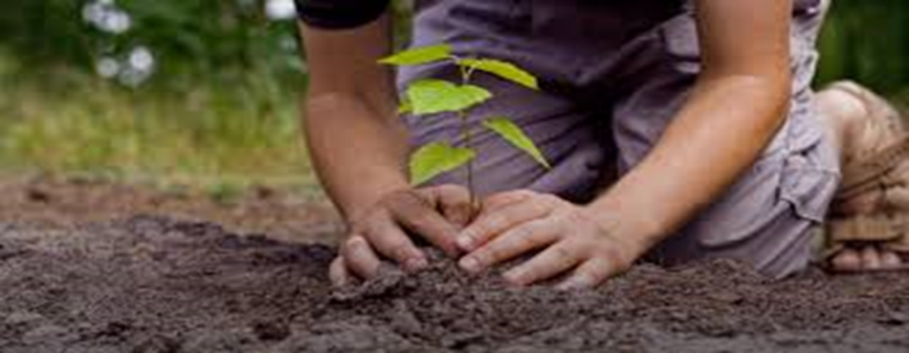
should

Slide 15
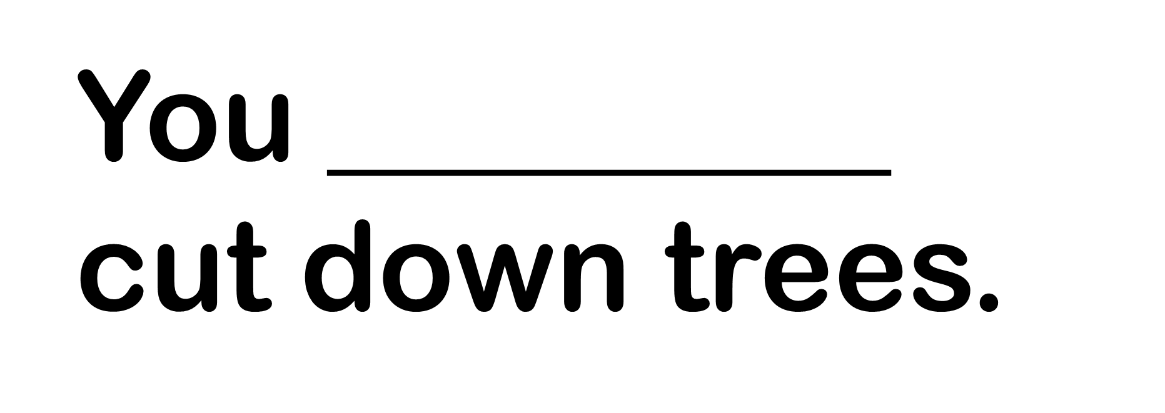
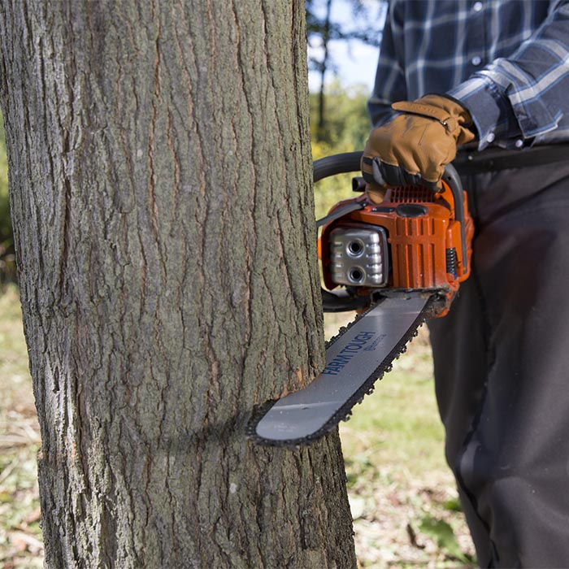
shouldn’t

Slide 16

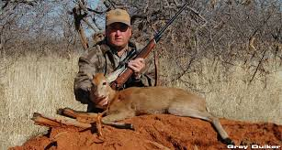
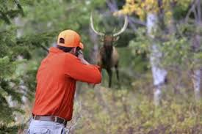
shouldn’t

Slide 17
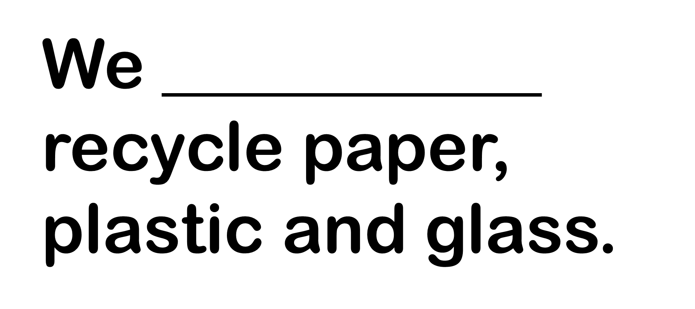
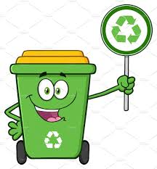
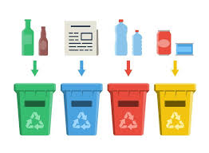
should

Slide 18
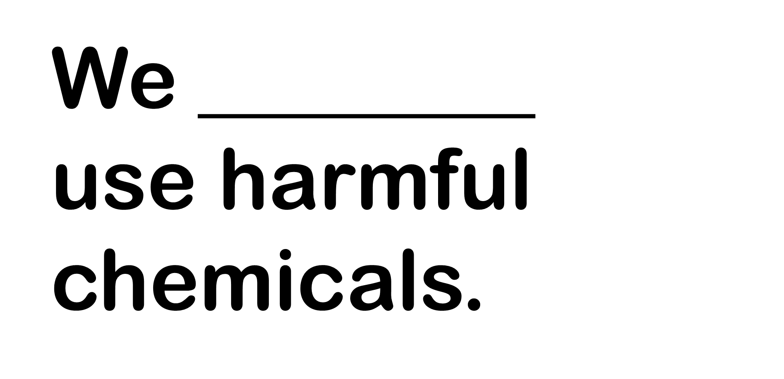

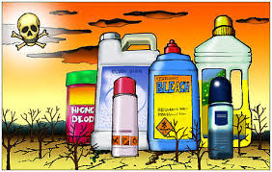
shouldn’t

Slide 19
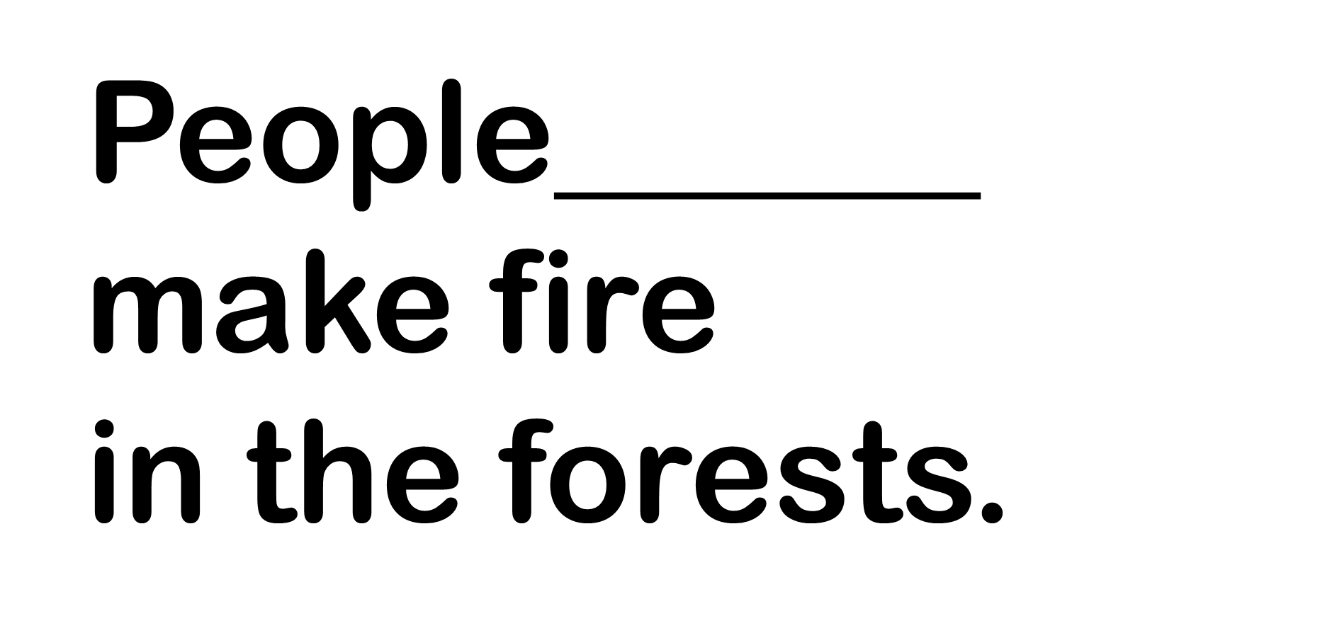
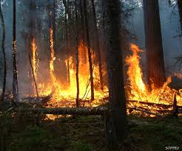
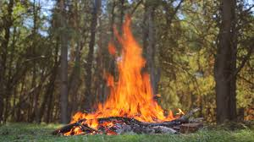
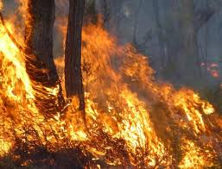
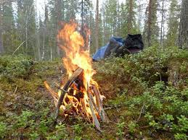
shouldn’t

Slide 20
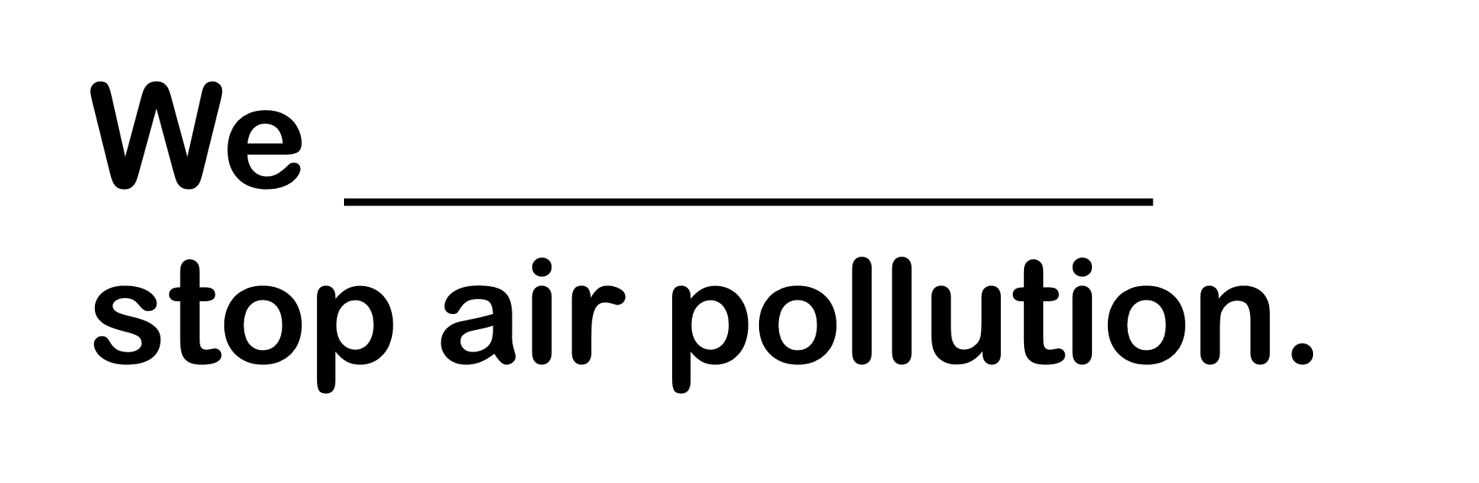
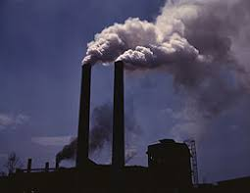
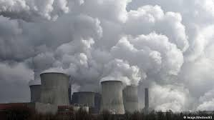
should

Slide 21
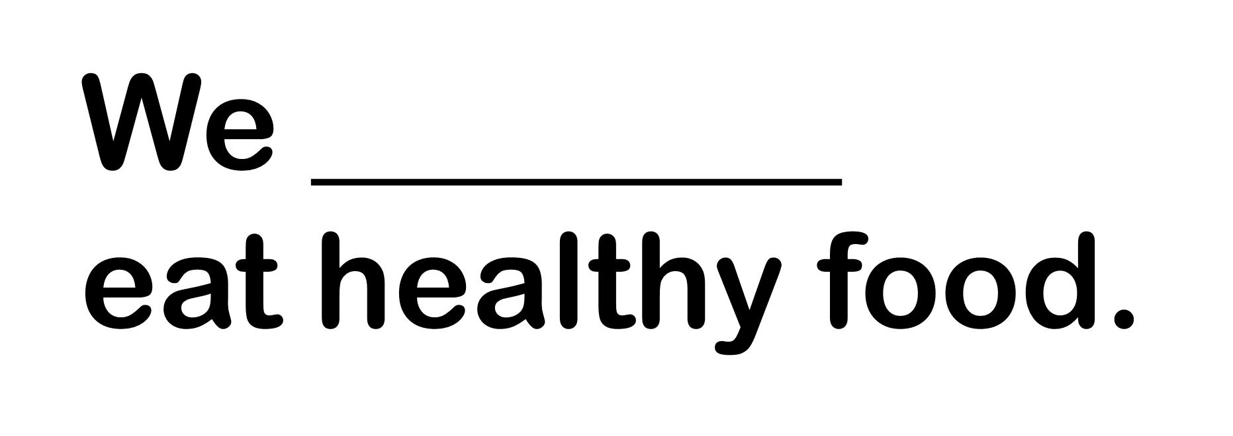
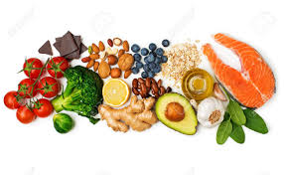
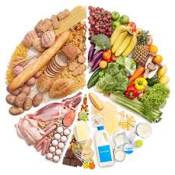
should

Slide 22
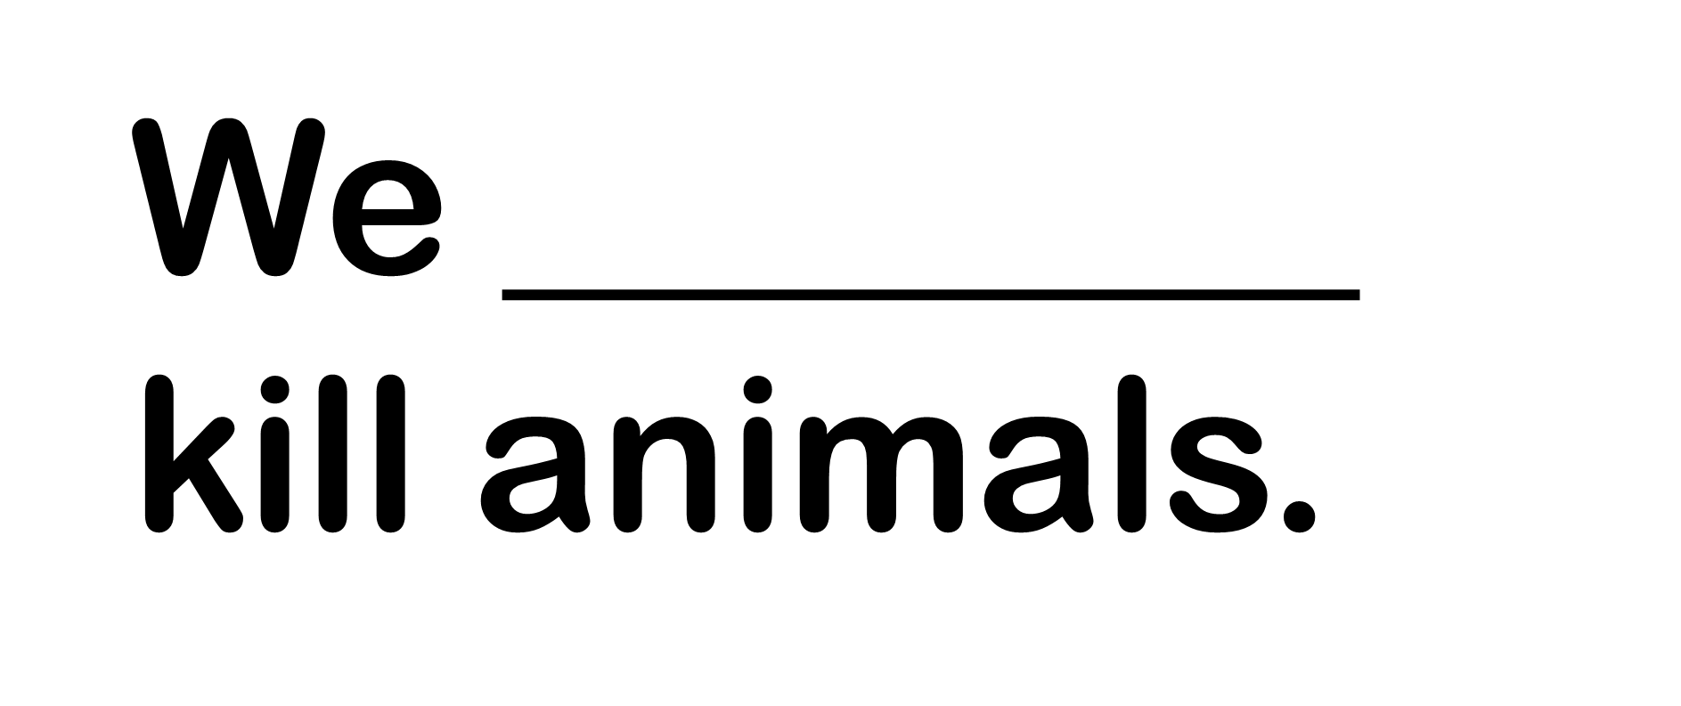
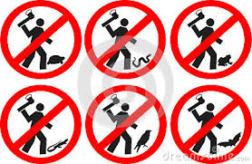
shouldn’t

Slide 23

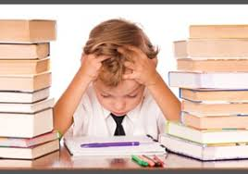

should

Slide 24


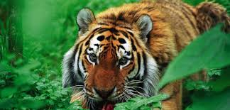
should

Slide 25
EXERCISE
-B-
Match the phrases
(İfadeleri eşleştiriniz.)

Slide 26
1-public 2-air 3-climate 4-global 5-fossil 6-renewable 7-harmful
3
a-change b-chemicals c-transportation d-fuels e-pollution f-warming g-energy
7
1
5
2
4
6

Slide 27
Test
time

Slide 28
EXERCISE
-C-
Complete the sentences
with the given words.

Slide 29
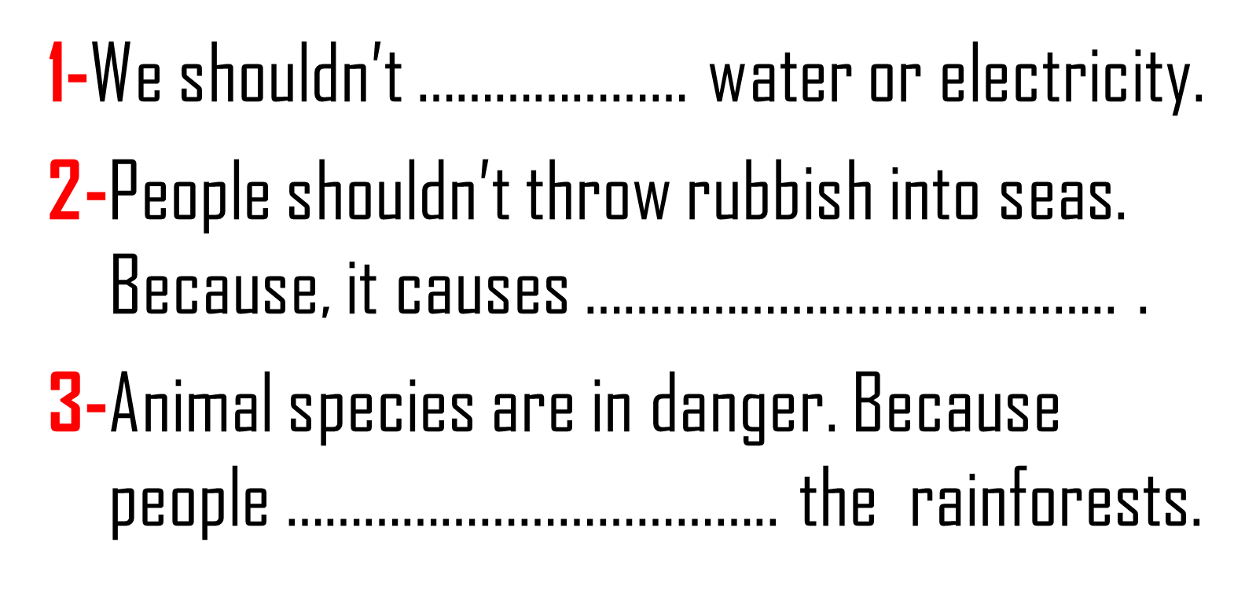
destroy
waste
water
pollution
waste
water pollution.
destroy

Slide 30
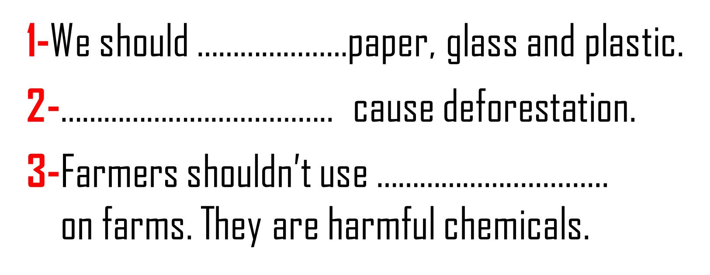
forest
fires
pesticides
recycle
recycle
Forest fires
pesticides

Slide 31
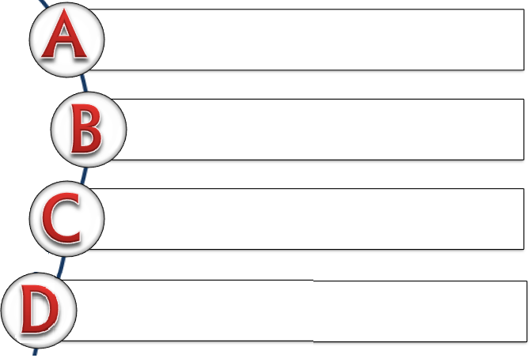
1-I ……………… bottles, cans, paper and plastic.
We should protect nature.
destroy
recycle
plant
pollute

Slide 32
2-Some factories pollute seas. Many fish species
die because of ……….. .
air pollution
deforestation
global warming
water pollution

Slide 33
3-Deforestation is a great problem on earth. People should ……………… .
destroy forests
save energy
plant trees
keep seas clean

