Slide 1
IMPORTANT WORDS

Slide 2

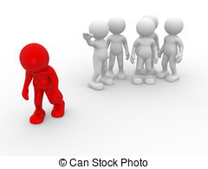

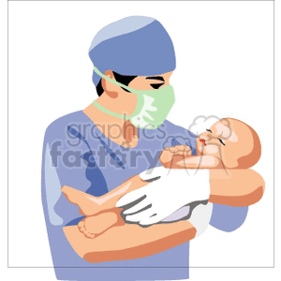
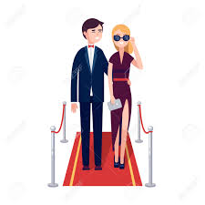

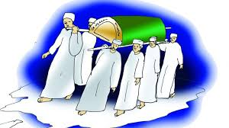
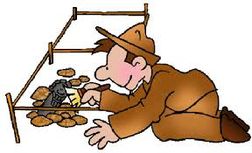
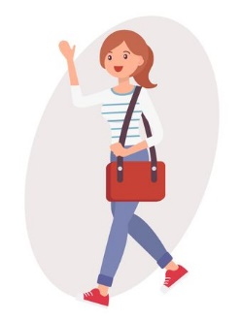
ACHIEVEMENT
ALONE
AWARD
BORN
CELEBRITY/
FAMOUS
EASYGOING/
FRIENDLY
BRILLIANT
DEATH/DIE
DISCOVER

Slide 3

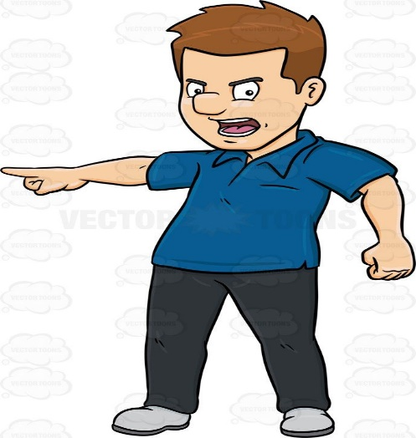
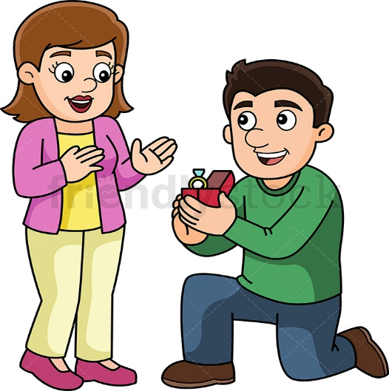
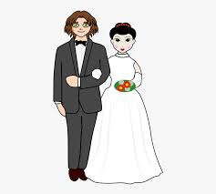
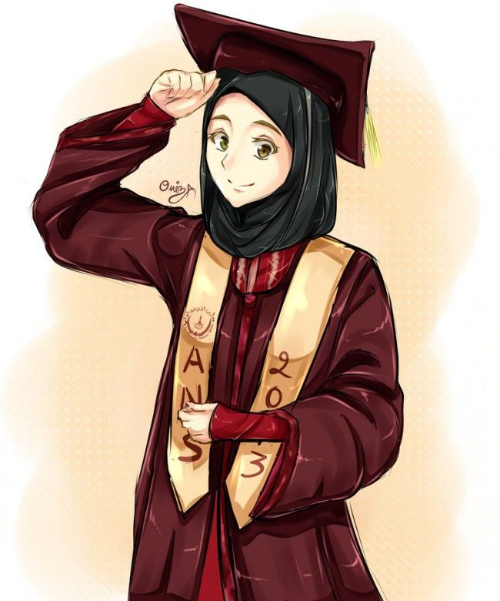
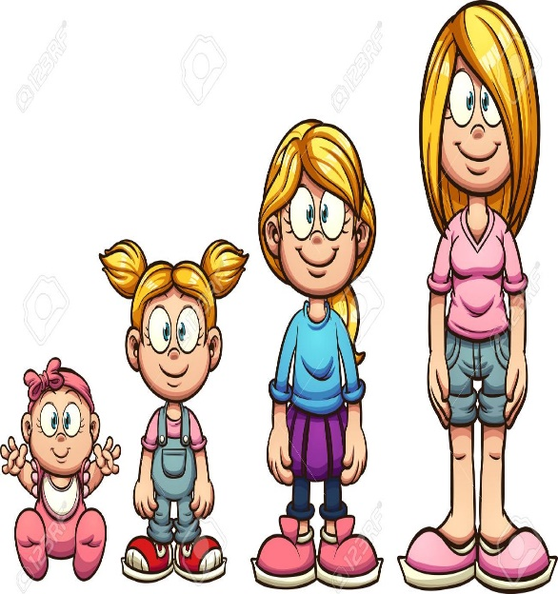
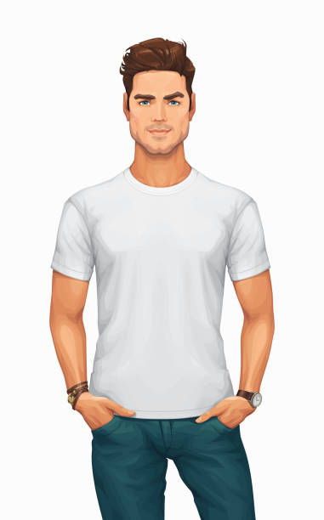

EDUCATION
FORCE
GET ENGAGED
GET MARRIED
GRADUATE
GROW UP
HANDSOME
INVITE

Slide 4
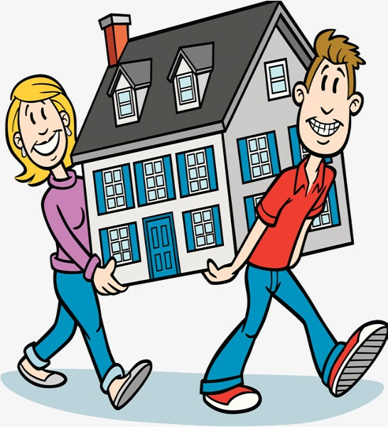
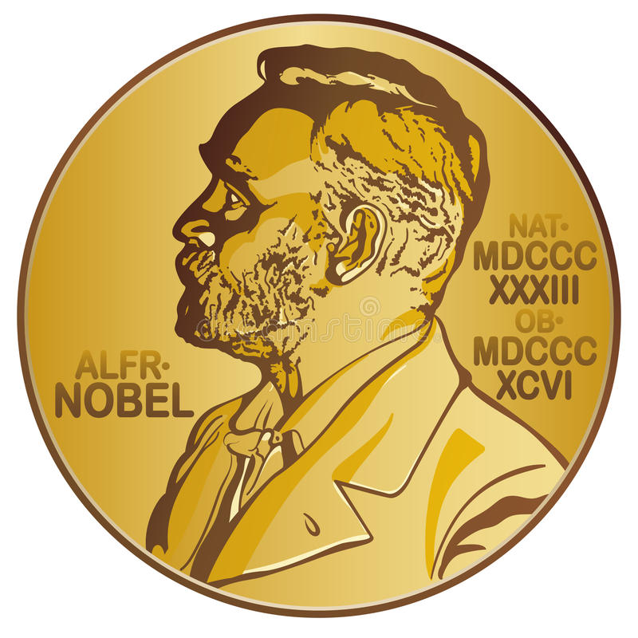
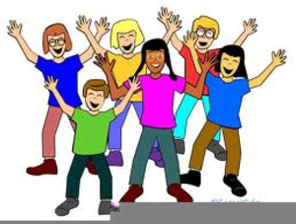



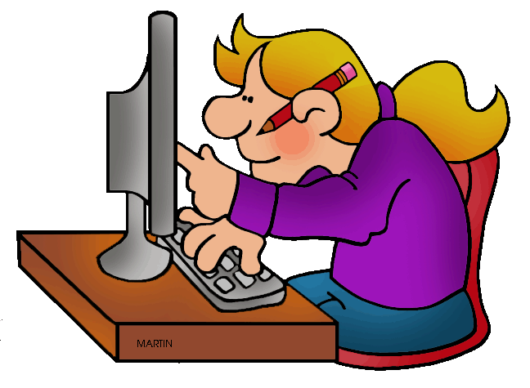
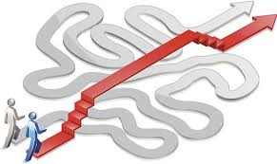

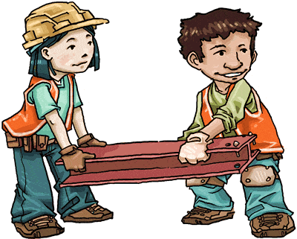
MOVE
NOBEL PRIZE
OUTGOING
PERFECT
PERSONALITY
RAISE CHILDREN
RESEARCH
SHORTCUT
UNHAPPY
WORK

Slide 5
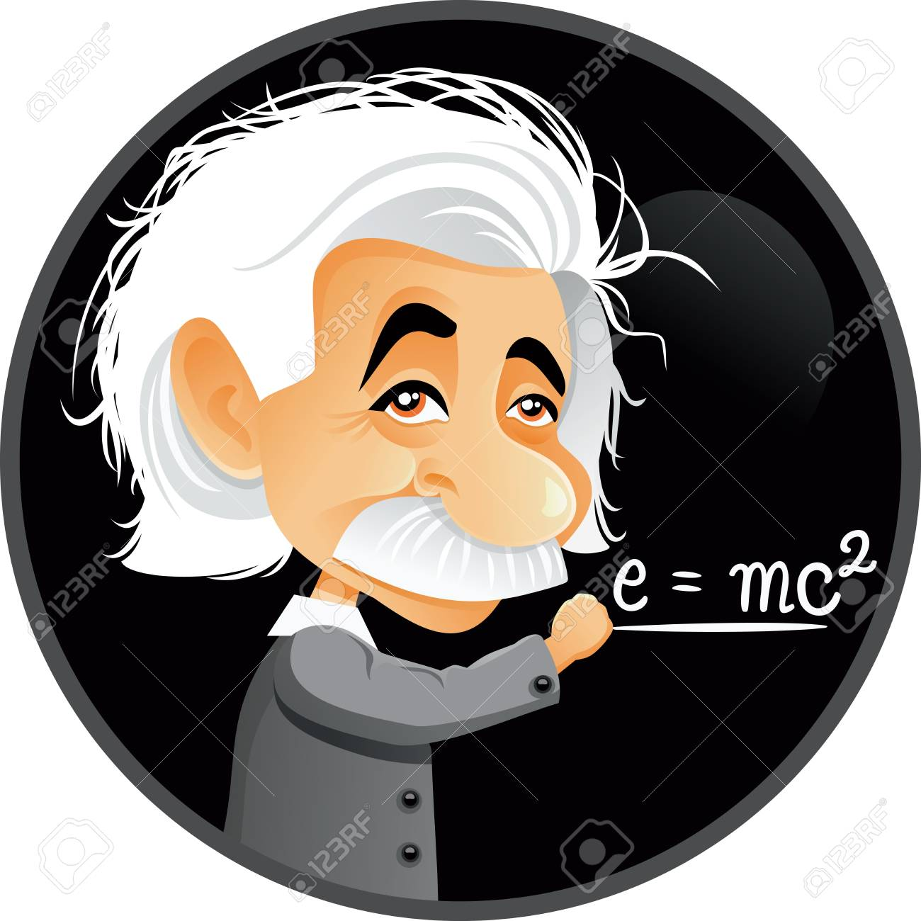
ALBERT EINSTEIN

Slide 6

Where was Albert Einstein born?
WURTTEMBERG
He was born in Württemberg.

Slide 7
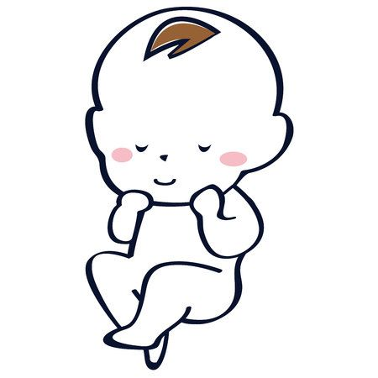

When was he born?
He was born in 1879.

Slide 8
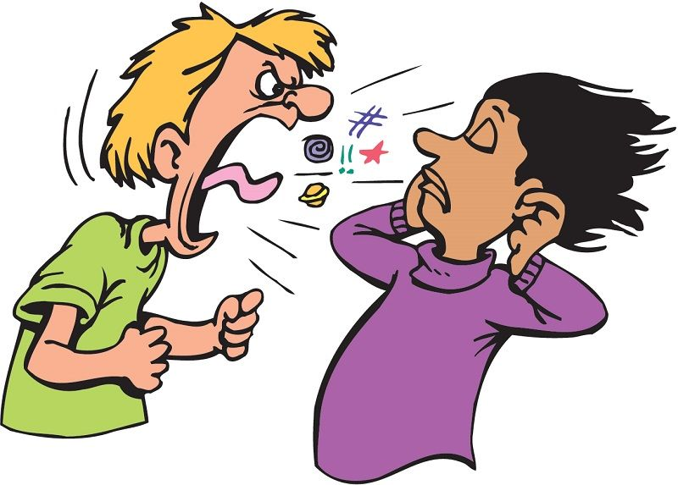
Why was he unhappy?
Because he didn’t like grammar and
the teachers forced him to learn.

Slide 9

What school subjects was Einstein interested in?
He was interested in Science and Maths.

Slide 10
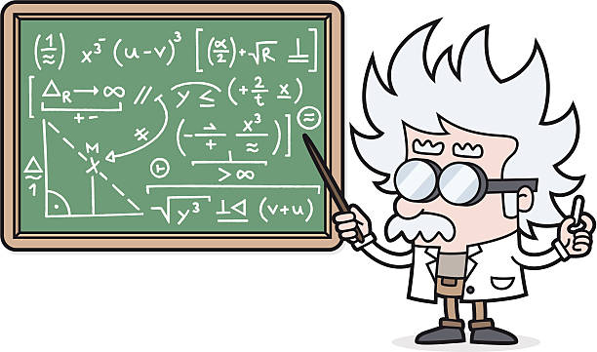
What was Einstein’s profession?
He was a brilliant mathematician and physician.

Slide 11
Was he alone during the last years of his life?
Yes, he was.

Slide 12
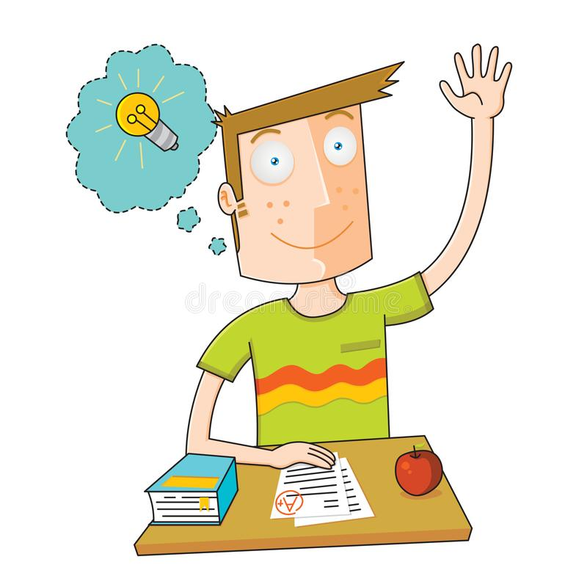
Was he a brilliant student at elementary school?
No, he wasn’t.

Slide 13
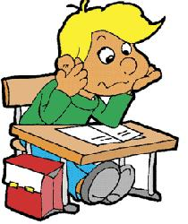

A)WAS/WERE FORM
I
He
She
It
WAS
I WAS AT SCHOOL YESTERDAY.
BEN DÜN OKULDAYDIM.
We
You
They
WERE
WE WERE AT THE BEACH LAST WEEK
BİZ GEÇEN HAFTA PLAJDAYDIK.

Slide 14
NEGATIVE (-)
WAS
WASN’T
I WASN’T AT SCHOOL YESTERDAY.
WERE
WEREN’T
WE WEREN’T AT THE BEACH LAST WEEK.

Slide 15
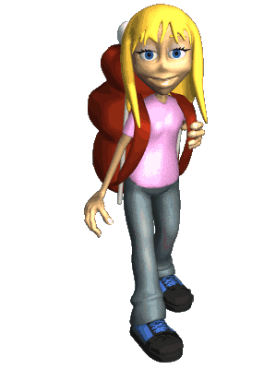
QUESTIONS(?)
I
SHE
HE
IT
Yes, she was hungry.
Yes, she was.
No, she wasn’t hungry.
No,she wasn’t.
WAS
HUNGRY?
YOU
WE
THEY
at the theatre last weekend?
Yes, we were.
No,we weren’t
WERE

Slide 16
NOUN SENTENCES(İSİM CÜMLELERİ)
İçinde bir hareket, iş olmayan; sadece bir ‘’durum’’u anlatan cümlelerdir.
Bu cümleler, BE fiiliyle kurulur. BE ise her özneye göre değişir;
1. I am happy.
2. She is sad.
3. He is at home.
4. We are at cinema.
5. My mother is tired.
6. My sister is angry.
7. I am with Ayşe.
I was happy.
He,She,It --→ is
I--→am
You, we , they → are
She was sad.
He was at home.
We were at cinema.
She was tired.
She was angry.
I was with Ayşe.

Slide 17

EXERCISES
- She ……..at the park yesterday.(+)
………. she at the park yesterday?(?)
We ……….to the hospital to visit her friend last week.(-)
- They ……… to the hospital to visit her friend last week.(+)

Slide 18
Örnek soru
They .................. at home last night.
A) was
B) is
C) were
D) isn’t

Slide 19

Where did Albert Einstein grow up?
He grew up in Munich.

Slide 20

When did Einstein move to Munich with his family ?
They moved to Munich
İn 1880.

Slide 21

Why did he move to Zurich?
He moved to Zurich to get a diploma.

Slide 22
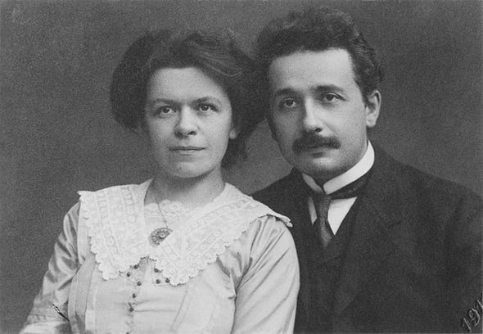
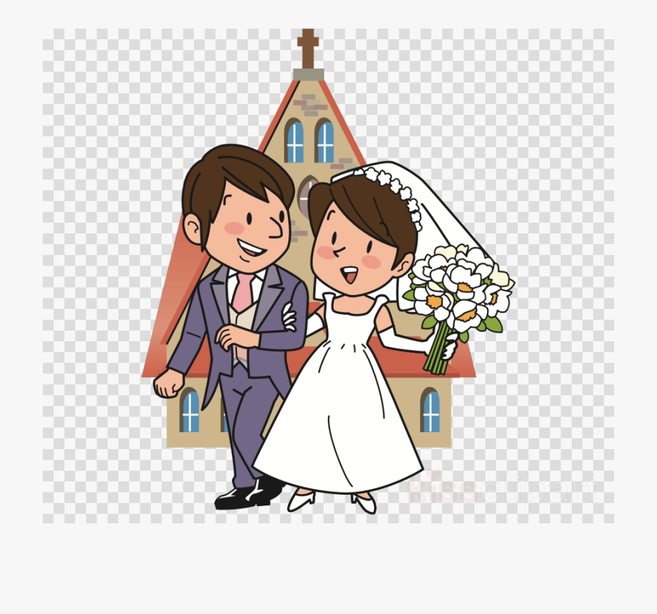
What happened in 1903?
He got married to his college mate.

Slide 23
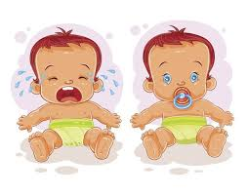
When did Einstein and his wife had two sons?
They had two sons in 1904.

Slide 24
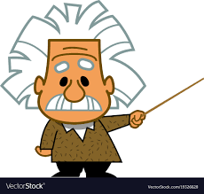
Which university did Einstein become professor at?
He became professor at the University of Zurich.

Slide 25
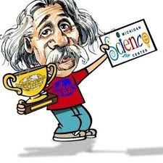
Why did Einstein have lots of awards around the World?
Because he achieved great success in science.

Slide 26

When did Einstein receive the Nobel Prize?
She received the Nobel Prize in 1921.

Slide 27

When did Elsa die?
She died in 1936.

Slide 28
Where did Einstein die?
He died in Princeton.

Slide 29
UNIT 3: BIOGRAPHIES
Bu ünitede, geçmiş zaman (Simple Past tense) göreceğiz. Geçmiş zamanda cümle kurabilmek için, fiillere ‘-ed’ eki getiririz. Bazen fiiller bu kurala uyarlar; bunlar düzenli fiillerdir (Regular verbs) .
I
He
She | playeded football | yesterday.
lt | watcheded TV | two days ago.
We | went | last week.
You
They

Slide 30
NOT
NOT 1= GEÇMİŞ ZAMAN DA KELİMEYİ GEÇMİŞ ZAMANAN ÇEVİRMEK İÇİN “-ED” EKİ GETİRİLİR.
NOT 2= KELİME “E” HARFİ İLE BİTİYORSA SADECE “-D” EKLENİR.
NOT 3=KELİME “Y” HARFİNDEN BİTİYORSA “-Y” GİDER YERİNE “-İED” EKLENİR.

Slide 31
REGULAR VERBS(DÜZENLİ FİİLLER)
Help(Yardım etmek) – Helped
Move(Taşınmak) – Moved
Die(Ölmek) – Died
Want (İstemek) – Wanted
Attend (Katılmak) – Attended
Complete (Tamamlamak) – Completed
Marry (Evlenmek) – Married
Play (Oynamak) – Played
Watch (İzlemek) – Watched
Like(Sevmek) - Liked

Slide 32
Open (açmak)- Opened
Close (kapatmak) – Closed
Phone (aramak)- Phoned
Visit (ziyaret etmek) – Visited
Jump (zıplamak) – Jumped
Work (Çalışmak) – Worked
Invent (İcat etmek) – Invented
Help (yardım etmek) - Helped

Slide 33
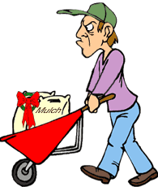

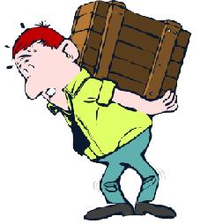
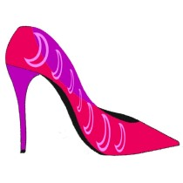
REGULAR VERBS (FORM)
I
You
He
She
It
We
You
They
worked in the garden yesterday
danced at the party last night.
carried the heavy box.
borrowed new shoes.

Slide 34

Questions & Answers
Look at the pictures and practice
the Simple Past Tense
What did he do
last weekend?
What did she do
last weekend?

Slide 35
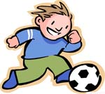
played
He soccer
last Saturday afternoon.

Slide 36

cleaned
He the floor last
Saturday afternoon.

Slide 37
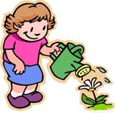
She the flowers
last Sunday morning.
watered

Slide 38
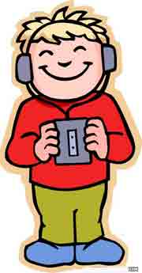
listened
He to the music
on Sunday afternoon.

Slide 39
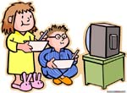
They TV last Sunday night.
watched

Slide 40
IRREGULAR VERBS ( DÜZENSİZ FİİLLER)
- Bu fiiller ‘-ed’ eki alma kuralına uymaz ve başka bir kelimeye dönüşürler.
Become (olmak)-
Have (sahip olmak)-
Come (gelmek) –
Be(am, is) –
Be(are) –
Begin (Başlamak)-
Meet (buluşmak, tanışmak)-
Go (gitmek) –
Wake up (Uyanmak) –
Do (yapmak) –
Leave ( ayrılmak, çıkmak)
Became
I | became a professor
He | had a baby
She |  | yesterday.
lt |  | two days ago.
We | went | last week.
You
They
Had
Came
Was
Were
Began
Met
Went
Woke up
Did
Left

Slide 41
irregular verbs
go ---
do ---
read ---
put ---
let ---
begin ---
come ---
become ---
buy ---
draw ---
went
sell ---
bring---
pay ---
meet---
sing ---
sleep---
have---
sold
did
brought
read
paid
put
met
let
sang
began
slept
came
had
became
bought
stood
stand ---
spell ---
swim ---
take ---
tell---
write ---
see---
sit---
drew
spelt
find ---
forget ---
know ---
give ---
have ---
make ---
run ---
say ---
swam
found
forgot
took
knew
told
gave
wrote
had
saw
made
sat
ran
said

Slide 42
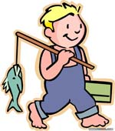
go--went
went
He fishing last
Sunday afternoon.

Slide 43
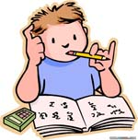
do--did
He his homework
yesterday evening.
did

Slide 44

read--read
He books
yesterday morning.
read

Slide 45
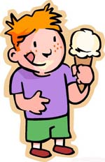
eat--ate
He ice cream
yesterday.
ate

Slide 46
EXERCISES
I drink milk every morning.
I go to school every weekdays.
My mom makes a big omlette.
My father never comes home late .
I have serious injuries.
We sometimes go skiing.
Serena Williams wins the matches.
I drank milk yesterday morning.
I went to school last weekday.
She made a big omlette.
He never came home late .
I had injuries.
We sometimes went skiing.
She won the matches.

Slide 47
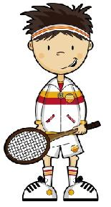
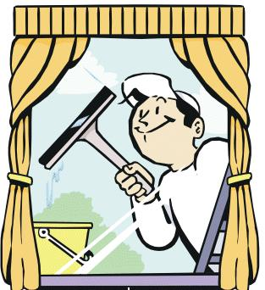
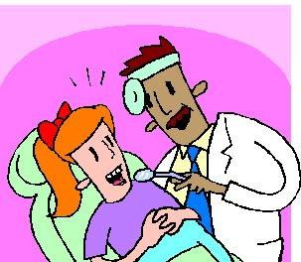
NEGATİVE FORM
I
You
He
She
It
We
You
They
didn’t play tennis last weekend.
didn’t clean the windows.
didn’t go the dentist.

Slide 48

QUESTİON FORM
DİD
I
You
He
She
It
We
You
They
find your umbrella?
Yes, I did..
No, I didn’t.

Slide 49
* Did you watch TV yesterday?
+Yes, I did.
*Did you go to cinema last weekend?
-No we didn’t.
*Did you help your mother yesterday evening?
+Yes, I did.
* Did your sister clean her room?
-No, she didn’t.

Slide 50
EXAMPLES
Where did you go yesterday? (cinema)
- I went to cinema.
How was your day?
- It was tiring but good.
What did you do last evening? (have dinner)
- We had dinner with my family.
When did you do your homework?(Last weekend)
- I did my homework last weekend.

Slide 51
EXERCISES
We_________________(have) rice for lunch yesterday.
I_________________(not,buy) three kilos of apples last Saturday.
_______ she __________(see) me five days ago.
Erdem_________________(bring) his sister to the party yesterday.
_______ the police ________ (catch) the robbers?
Orhan Veli______________________(not,write) many poems.
I_________________(not, know) him before.

