Slide 1
PRESENT CONTINOUS TENSE
ŞİMDİKİ ZAMAN

Slide 2
QUESTION FORMS ( SORU CÜMLELERİ)
I am riding a bike now.
Am I riding a bike now?
She is dancing at the moment.
Is she dancing at the moment?
They are swimming today.
Are they swimming today?

Slide 3
Questions am/is /are + subject + V-ing ?
A: Are you listening to me?
(Beni dinliyor musun?)
B: Yes, I am. (olumlu cevap)
B: No, I’m not. (olumsuz cevap)

Slide 4
QUESTION FORMS ( SORU CÜMLELERİ)
Are the students writing now?
(Öğrenciler şimdi yazıyorlar mı?)
B: Yes, they are. (olumlu cevap)
B: No, they aren’t. (olumsuz cevap)

Slide 5
QUESTION FORMS ( SORU CÜMLELERİ)
Is it raining outside?
(Dışarda yağmur yağıyor mu?)
B: Yes, it is. (olumlu cevap)
B: No, it isn’t. (olumsuz cevap)

Slide 6
QUESTION FORMS ( SORU CÜMLELERİ)
am | I | playing | football today?
is | he she it
are | we you they

Slide 7
NOW IT’S YOUR TURN!!

Slide 8
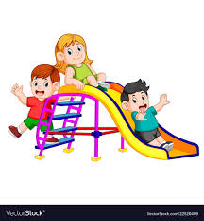
Are they playing at the park now?
Yes,they are.

Slide 9
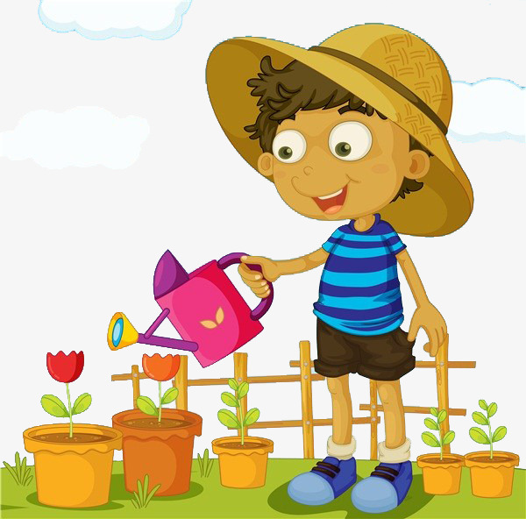
Is Atakan riding a bike now?
No, he isn’t.

Slide 10
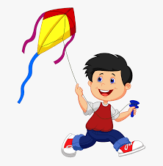
Is your brother walking in the forest at the moment?
No, he isn’t.

Slide 11
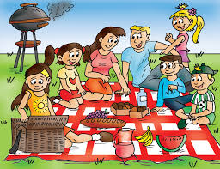
Are they having a picnic now?
Yes, they are.

Slide 12

Is Yağmur watching a movie at the moment?
No, she isn’t.

Slide 13

Are you doing your homework today?
Yes, I am.

Slide 14

Gizem – do homework – now?
Is Gizem doing her homework now?
Yes, she is.

Slide 15

You – play chess – now?
Are you playing chess now?
No, I am not.

Slide 16
They – feel – cold – at the moment?
Are they feeling cold at the moment?
Yes, they are.

Slide 17
Nergiz and Emine – feed the animals-now?
Are Nergiz and Emine feeding the animals now?
No, they aren’t.

Slide 18
Nurselin – live – in a crowded city – now?
Is Nurselin living in a crowded city now?
No, she isn’t.

Slide 19
We- set the table – at the moment?
Are we setting the table at the moment?
Yes, we are.

Slide 20
Your sister – design hair – now?
Is your sister designing hair now?
Yes, she is.

Slide 21
You- repair your car- at the moment?
Are you repairing your car at the moment?
Yes, I am.

Slide 22
You and Fatma – run in the forest – now?
Are you and Fatma running in the forest now?
No, we aren’t.

Slide 23
Eğer soruda bir soru zamiri varsa o zaman soru zamiri en başa gelir.
What are you doing now?
Where is she going today?
When is your brother coming?
Why are you crying now?
DİKKAT!!!
Bu sorulara yes ya da no kullanarak cevap veremeyiz.
Cevap vermek için cümle kurmamız gerekli.

Slide 24
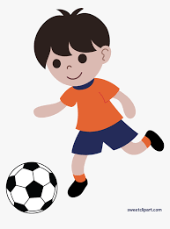
What are you doing now?
I am playing football now.

Slide 25
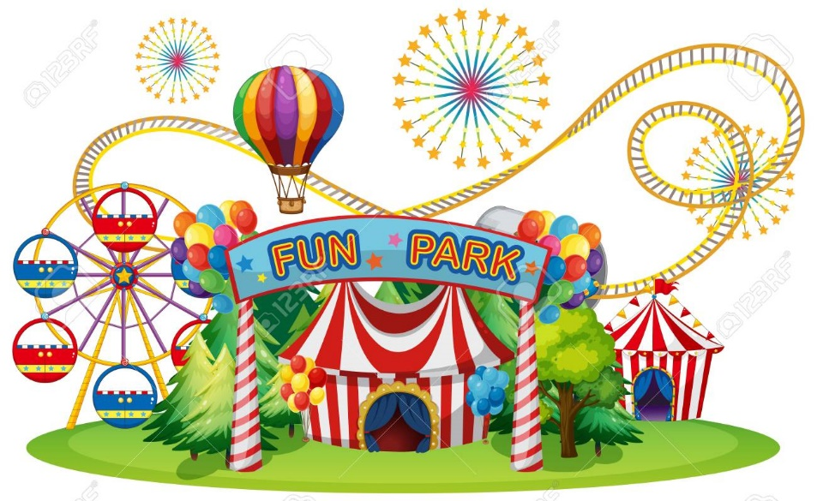
Where is going today?
She is going to the fun fair.

Slide 26

When is your brother coming?
He’s coming on Sunday.

Slide 27

Why are you crying?
I am sad.

Slide 28
NOW IT’S YOUR TURN!!!

Slide 29
What ‘s Gizem doing now?
She is doing homework.

Slide 30
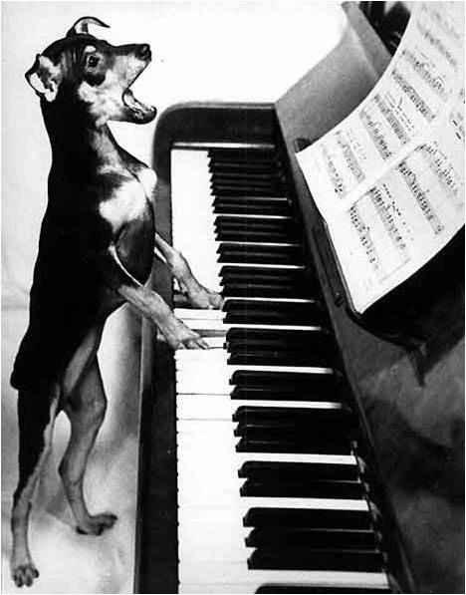
What is the dog doing now?
It’s playing the piano.

Slide 31

What’s she doing at the moment?
She is studying English.

Slide 32
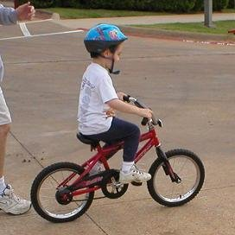
What’s he doing now?
He’s riding a bike now.

Slide 33
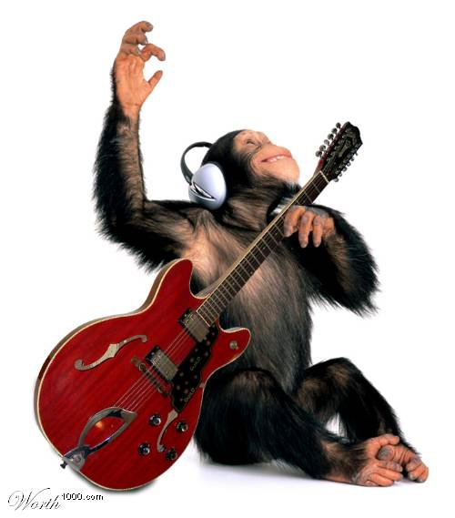
What’s the monkey doing now?
It’s playing the guitar.

Slide 34
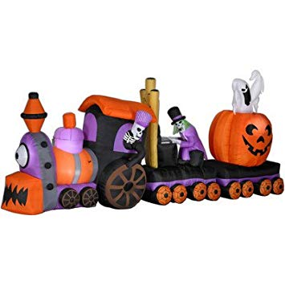
What are they doing now?
They are riding a ghost train.

Slide 35
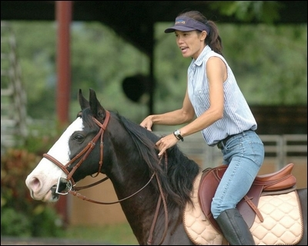
What are you doing now?
I’m riding a horse.

Slide 36

Is he sleeping?
No, he isn’t.

Slide 37
What’s he doing now?
He’s playing computer games.

Slide 38
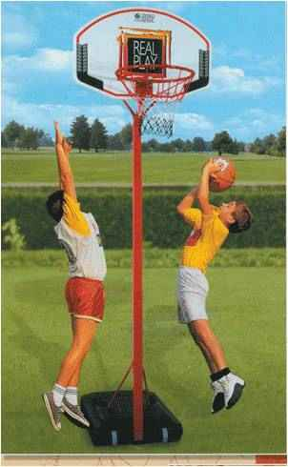
What are the children doing?
They are playing basketball.

Slide 39
Are the children playing basketball?
Yes, they are.

Slide 40
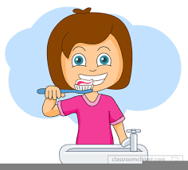
What are you doing?
I’m brushing my teeth.

Slide 41
GİZEM ŞEYDA KAYALI

