Slide 1
PRESENT CONTINOUS TENSE
Şimdiki zaman

Slide 2
NEGATIVE FORMS(OLUMSUZ CÜMLELER)
I am not Ving
I am not watching movie now.
I am not walking in the forest at the moment.
I’m not drinking coffee now.
I’m not enjoying party now.
I am not = I’m not

Slide 3
NEGATIVE FORMS(OLUMSUZ CÜMLELER)
He
She is not Ving
It (isn’t)
He is not going fishing today.
She is not going on holiday this year.
It is not eating vegetables now.
He isn’t walking by the river at the moment.
She isn’t swimming in the sea right now.
It isn’t running now.
İs not = isn’t

Slide 4
NEGATIVE FORMS(OLUMSUZ CÜMLELER)
You
We are not Ving
They (aren’t)
You are not studying at the moment.
We are not working today.
They are not cooking dinner right now.
You aren’t doing your homework at the moment.
We aren’t doing shopping noe.
They aren’t climbing a mountain today.
Are not = aren’t

Slide 5
NEGATIVE FORMS(OLUMSUZ CÜMLELER)
I | am not (’m not) | playing | football today.
He She It | is not (isn’t)
We You They | are not (aren’t)

Slide 6
NOW IT’S YOUR TURN!!

Slide 7
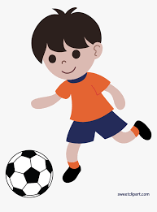
I __________ football.
I _________________ volleyball.
am playing
am not playing

Slide 8
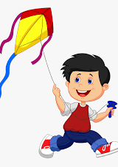
He _______ flying a plane.
He _____________ fying a kite.
İsn’t
is

Slide 9
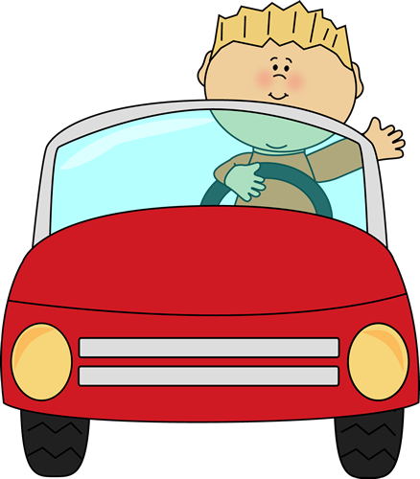
He ______ driving a car.
He _______ riding a bike
İs
İsn’t

Slide 10
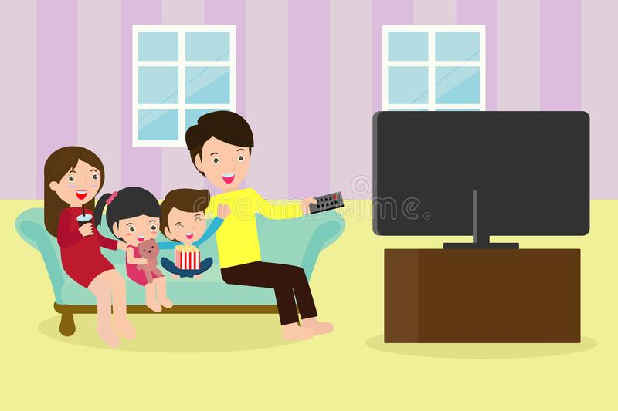
They _________ watching tv.
They __________ reading a book.
are
aren’t

Slide 11
Emel – not – make a sandcastle - at the moment
Emel isn’t making a sandcastle at the moment.

Slide 12
Gizem and Atakan – not – swim - today
Gizem and Atakan aren’t swimming today.

Slide 13
Mandy – not – write – on the board - now
Mandy isn’t writing on the board now.

Slide 14
You – not – ride a bike - today
You aren’t riding a bike today.

Slide 15
They – not – eat – bananas – at the moment
They aren’t eating bananas at the moment.

Slide 16
We – not – go skiing - now
We aren’t going skiing now.

Slide 17
Atakan – not – arrive home – at the moment
Atakan isn’t arriving home at the moment.

Slide 18
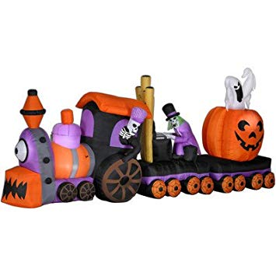
My father – not – ride a ghost train –now
My father isn’t riding a ghost train now.

Slide 19
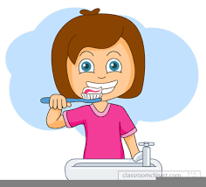
My sister – not – brush her teeth – at the moment
My sister isn’t brushing her teeth at the moment.

Slide 20
GİZEM ŞEYDA KAYALI

