Slide 1
PRESENT CONTINOUS TENSE
ŞİMDİKİ ZAMAN

Slide 2
Şu anda olan eylemleri anlatmak için kullanılır.
Time Expressions(Zaman ifadeleri)
Now
At the moment
At the present
Today
Right now

Slide 3
POSITIVE FORMS(OLUMLU CÜMLELER)
I am Ving
I am watching a movie right now.
I am studying English at the moment.
I’m walking in the forest now.
I’m having a breakfast at the moment.
I am = I’m

Slide 4
POSITIVE FORMS(OLUMLU CÜMLELER)
HE
SHE İS Ving
IT
He is visiting his grandparents now.
She is taking care of flowers right now.
It is barking at the moment.
He’s making a sandcastle at the moment.
She’s picking up fruits now.
It’s climbing a tree now.
He is = He’s
She is = She’s
It is = It’S

Slide 5
POSITIVE FORMS(OLUMLU CÜMLELER)
WE
YOU ARE Ving
THEY
We are playing golf at the moment.
You are playing the piano now.
They are swimming in the lake today.
We’re walking by the river at the moment.
You’re living in the village now.
They’re making a snowman now.
We are = We’re
You are = You’re
They are = They’re

Slide 6
POSITIVE FORMS(OLUMLU CÜMLELER)
I | am (=’m) | playing | football today.
He She It | is (=’s)
We You They | are (=’re)

Slide 7
Tekil – çoğul özneler
Mehmet _____ playing the guitar now.
Ayşe and Gizem _______ listening to him.
The dog _____ barking.
I and my brother ________ dancing.
My sister ______ talking on the phone.
My parents ______ working now.
The children _______ playing in the park at the moment.
The rabbit ______ jumping.
My cellphone _______ working.
is
are
is
are
is
are
are
is
is

Slide 8
NOW IT’S YOUR TURN!

Slide 9
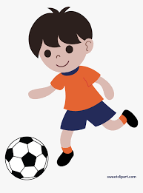
1. I…football now. a. am playing b. am play c. play d. playing
A

Slide 10
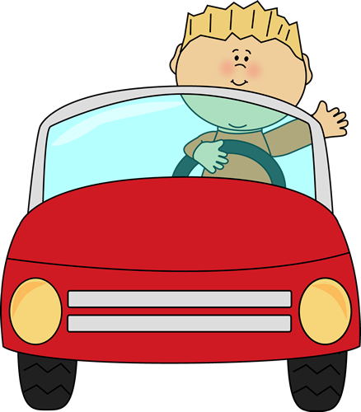
2. He…a car now. a. is drive b. driving c. drives d. is driving
D

Slide 11
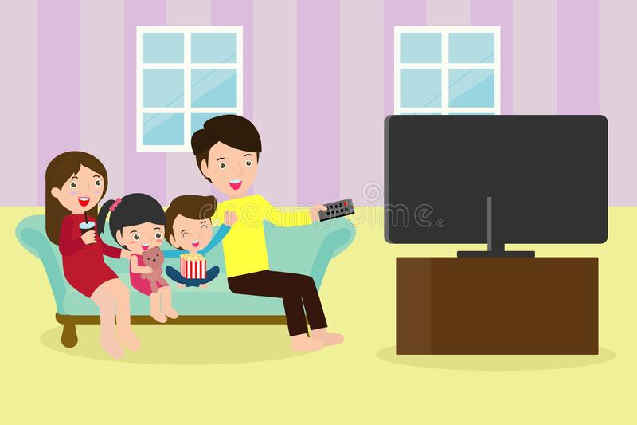
3. They…TV. a. is watching b. are watching c. are watch d. watches
B

Slide 12
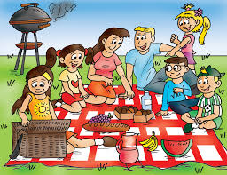
4. We…a picnic at the moment. a. are having b. are have c. having d. has
A

Slide 13

5. She…a book now. a. reads b. am reading c. is reading d. is read
C

Slide 14

6. It…. a. am rain b. is raining c. rain d. is rains
B

Slide 15
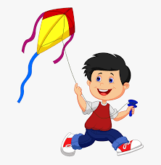
7. You…a kite in the park. a. am flying b. are fly c. are flying d. is fly
C

Slide 16

8. Jane…her homework at the moment. a. is does b. are doing c. does d. is doing
D

Slide 17
9. I…my homework at the moment. a. am doing b. do c. am do d. is doing
A

Slide 18
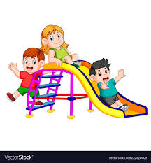
10. They…fun. a. have b. are have c. is having d. are having
D

Slide 19
NOW IT’S YOUR TURN!

Slide 20
AHMET – PLAY FOOTBALL - NOW
Ahmet is playing football now.

Slide 21
I – dance – at the moment
I am dancing at the moment.

Slide 22
My mother and I – water – the flowers
My mother and I are watering the flowers.

Slide 23
My dog – sleep – right now
My dog is sleeping right now.

Slide 24
Jack – have lunch – at school - now
Jack is having lunch at school now.

Slide 25
They – play snowball – at the moment
They are playing snowball at the moment.

Slide 26
You – go skiing – now
You are going skiing now.

Slide 27
GİZEM ŞEYDA KAYALI

