Slide 1
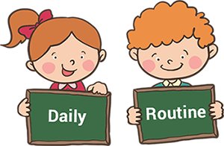

Slide 2
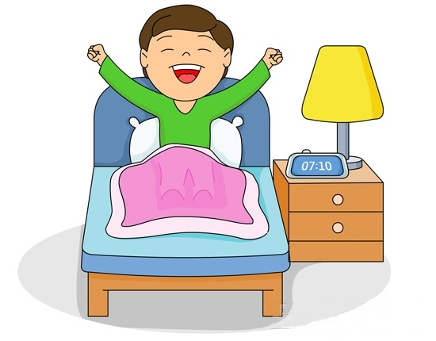
get up

Slide 3
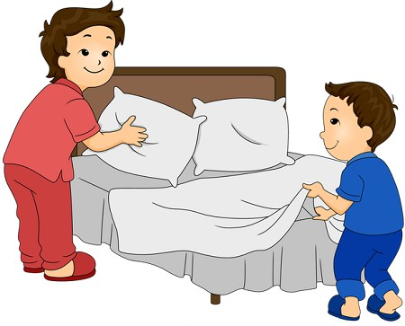
make the bed

Slide 4
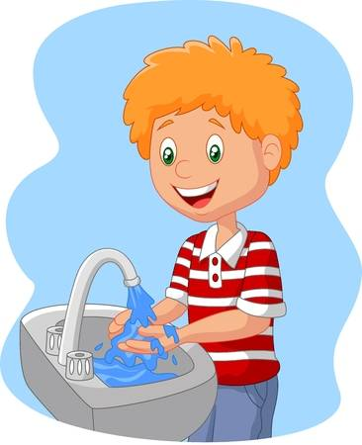
wash hands

Slide 5
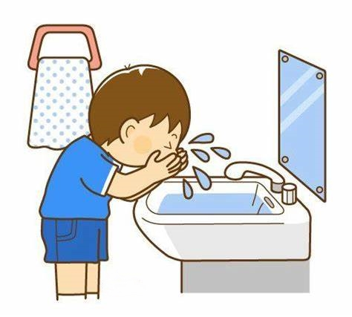
wash face

Slide 6
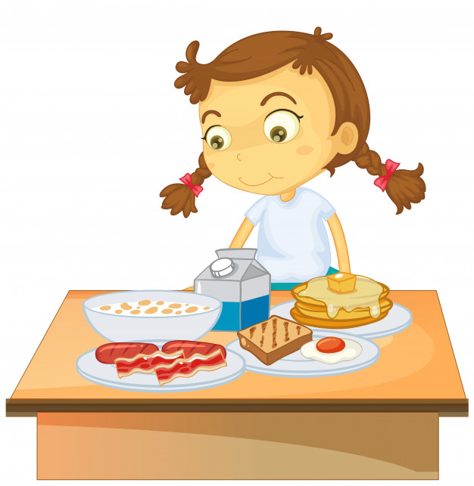
have breakfast

Slide 7
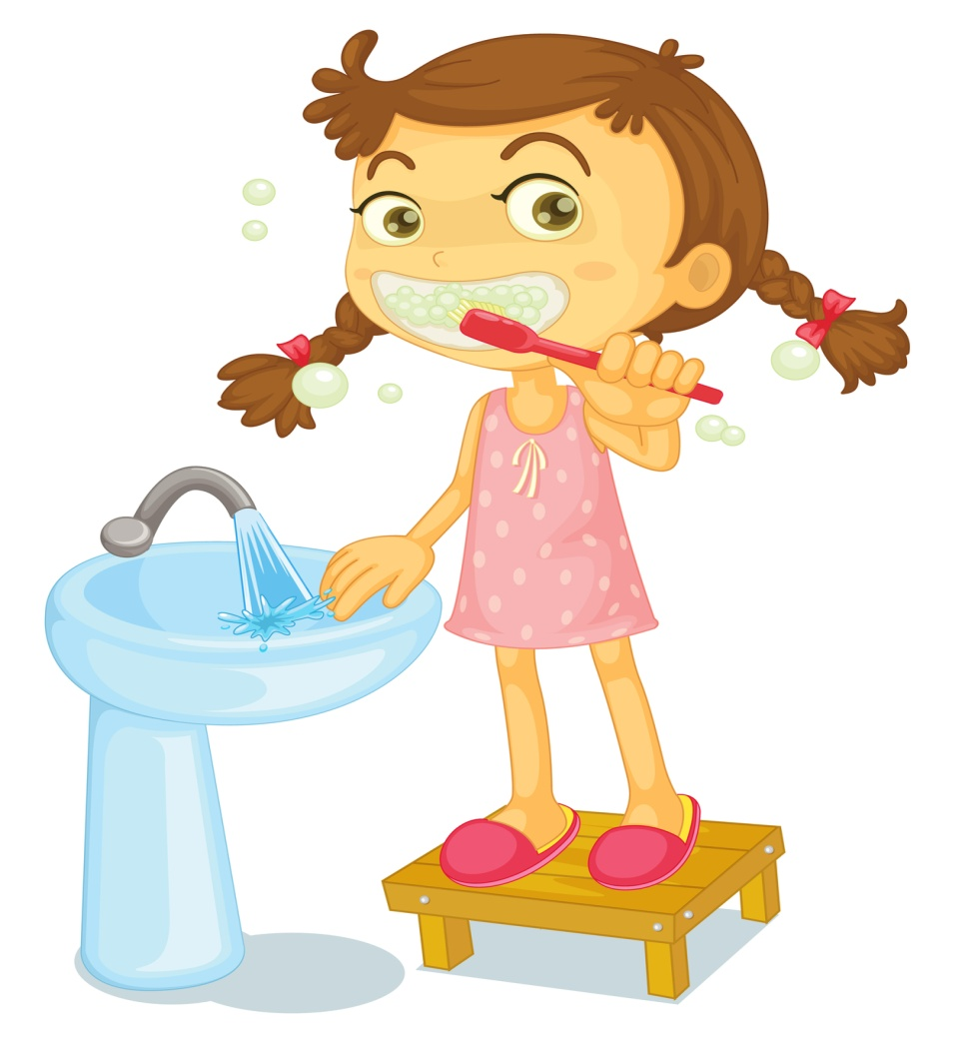
brush teeth

Slide 8
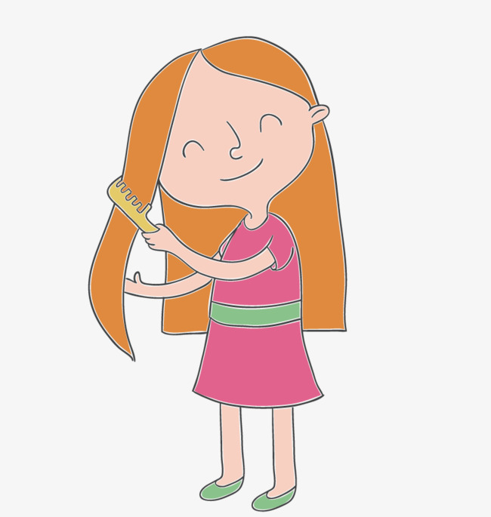
comb hair

Slide 9
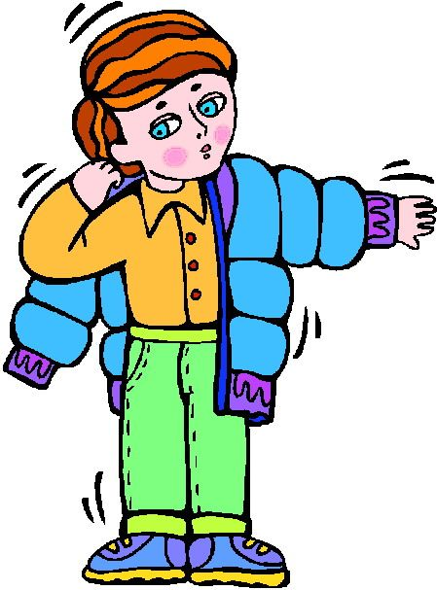
get dressed

Slide 10

get on the bus

Slide 11

go to school

Slide 12

arrive at school

Slide 13
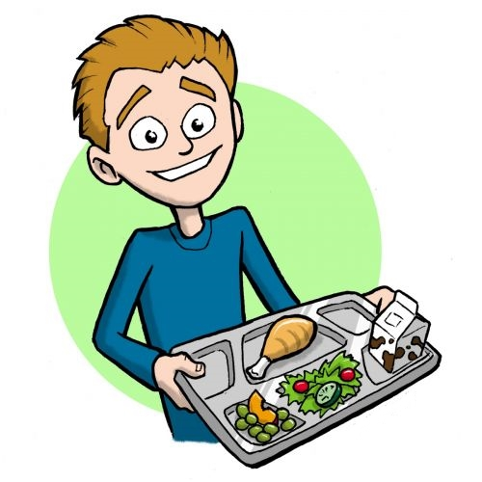
have lunch

Slide 14

arrive home

Slide 15
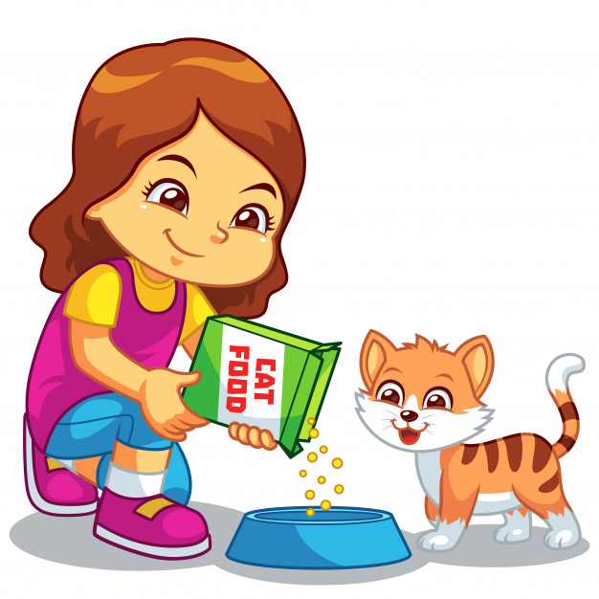
feed the pet

Slide 16

listen to music

Slide 17
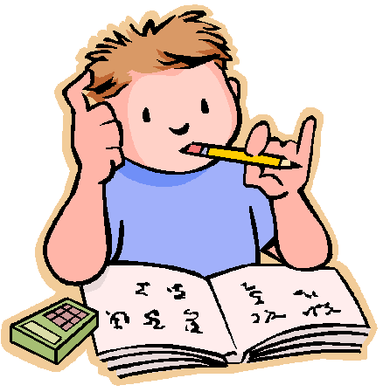
do homework

Slide 18

go online

Slide 19
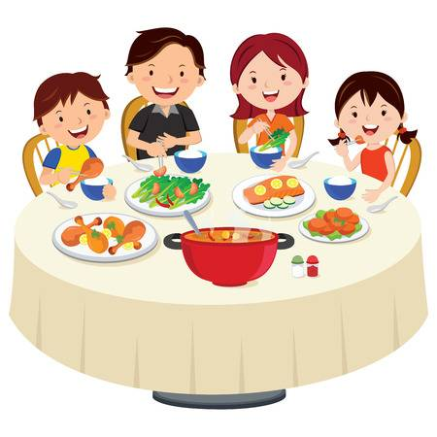
have dinner

Slide 20

read a book

Slide 21

watch tv

Slide 22
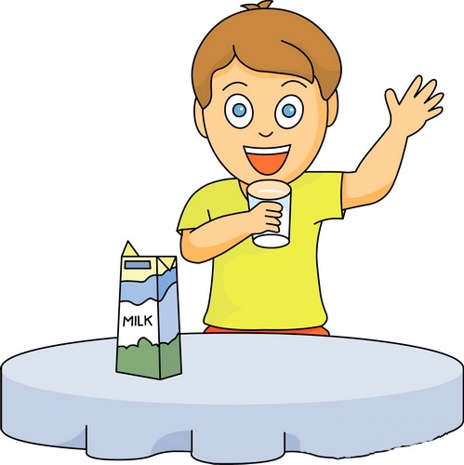
drink milk

Slide 23
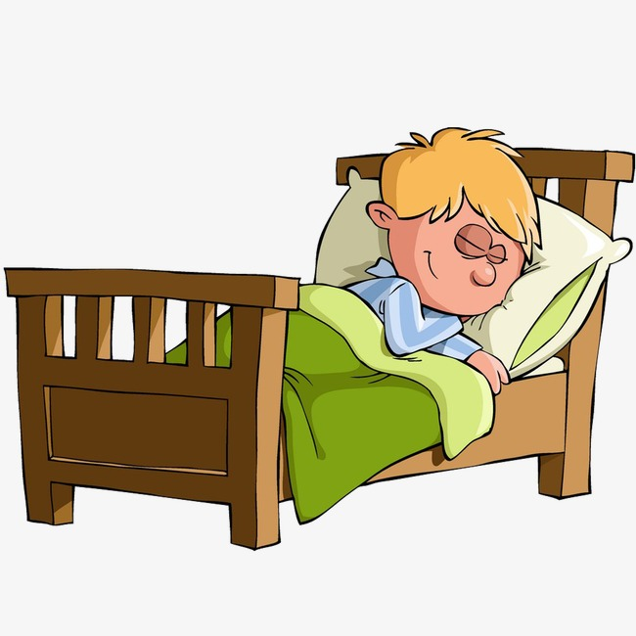
go to bed

