Slide 1
Unit 3
Games and Hobbies

Slide 2
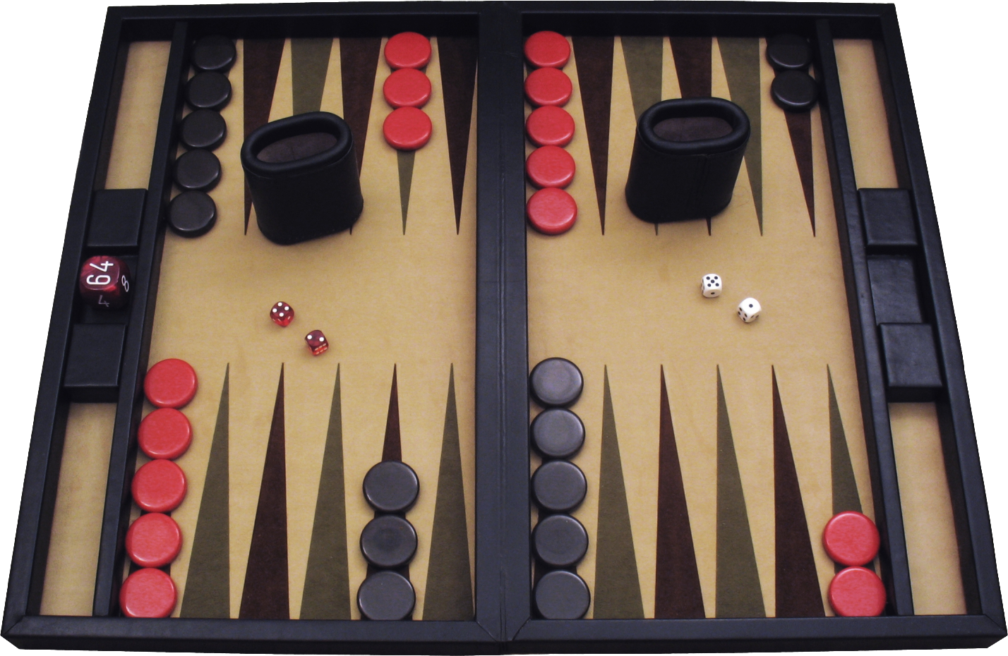
backgammon

Slide 3
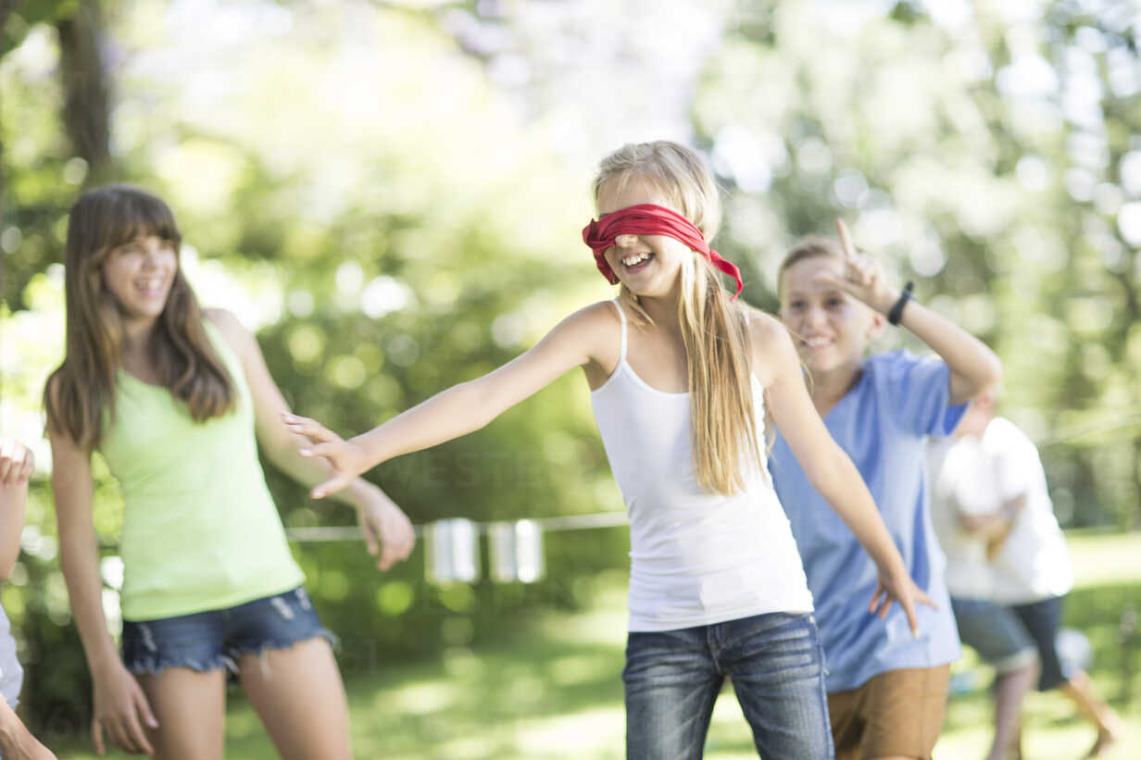
blind man’s buff

Slide 4
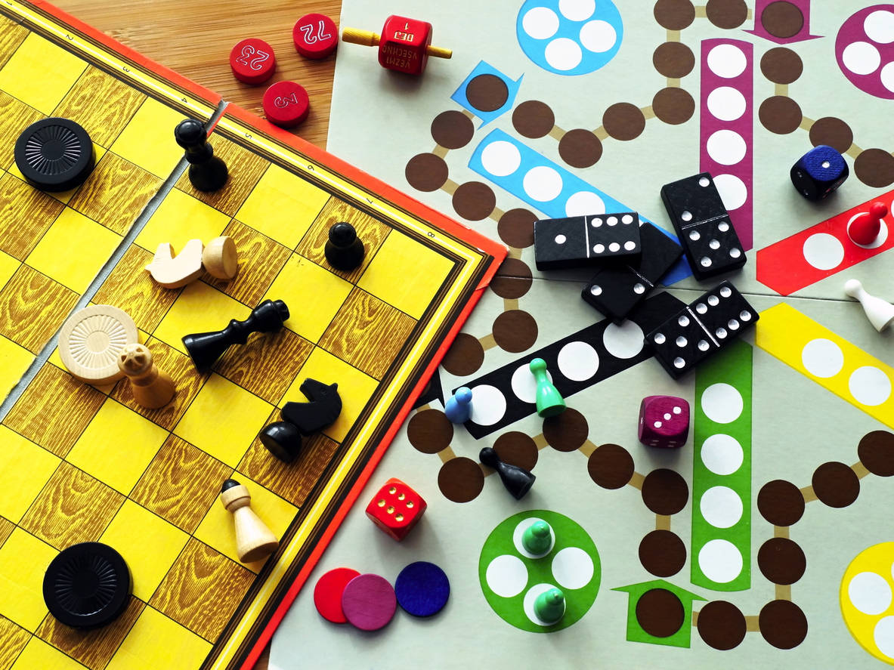
board game

Slide 5
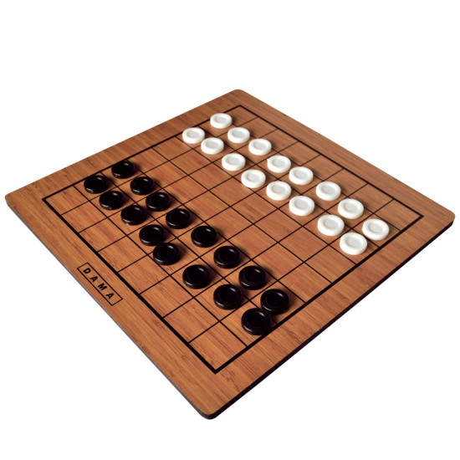
checkers

Slide 6
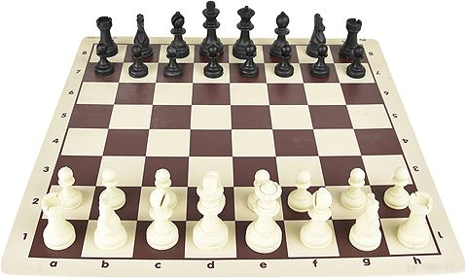
chess

Slide 7

Chinese whispers

Slide 8
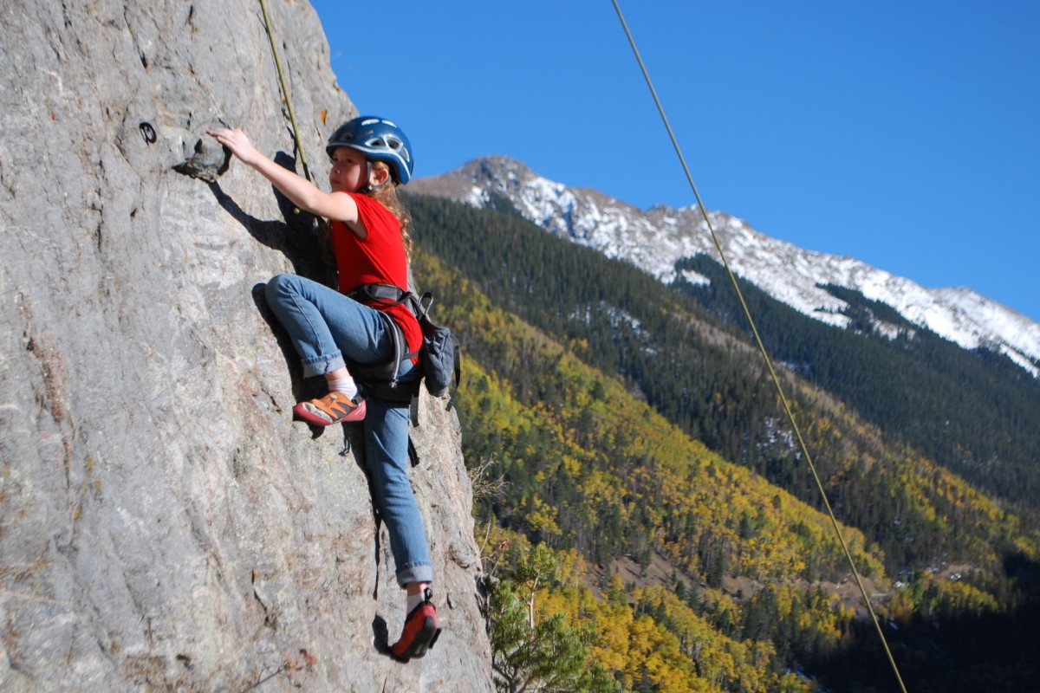
climb a mountain

Slide 9
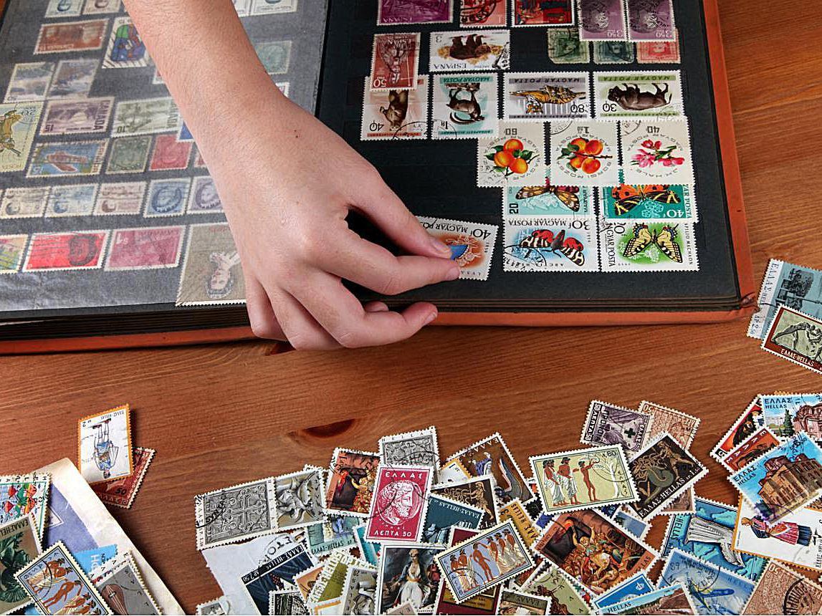
collect stamps

Slide 10
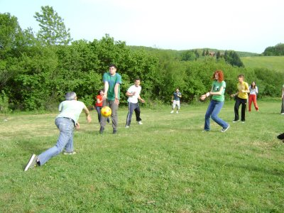
dodgeball

Slide 11

do puzzle

Slide 12
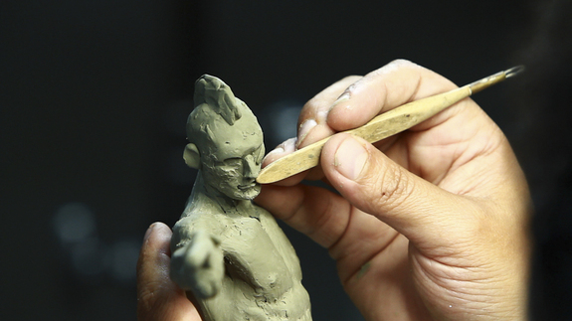
do sculpting

Slide 13
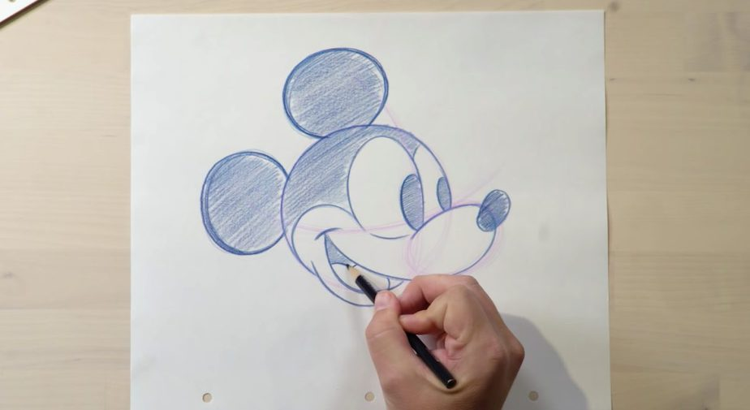
draw

Slide 14

fly a kite

Slide 15

free time

Slide 16

game

Slide 17
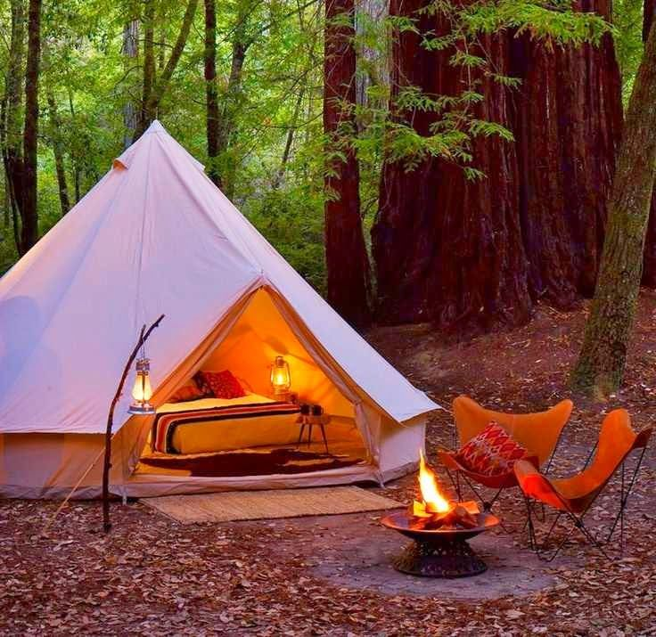
go camping

Slide 18
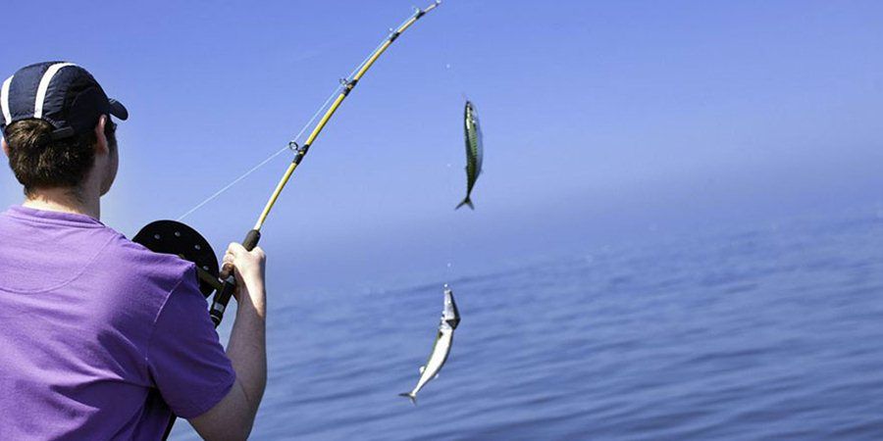
go fishing

Slide 19

go hiking

Slide 20
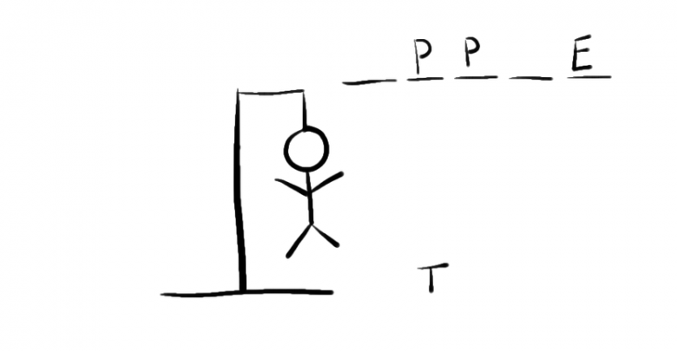
hangman

Slide 21
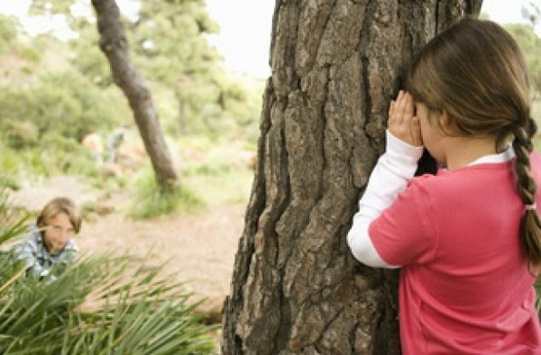
hide and seek

Slide 22

hobby

Slide 23
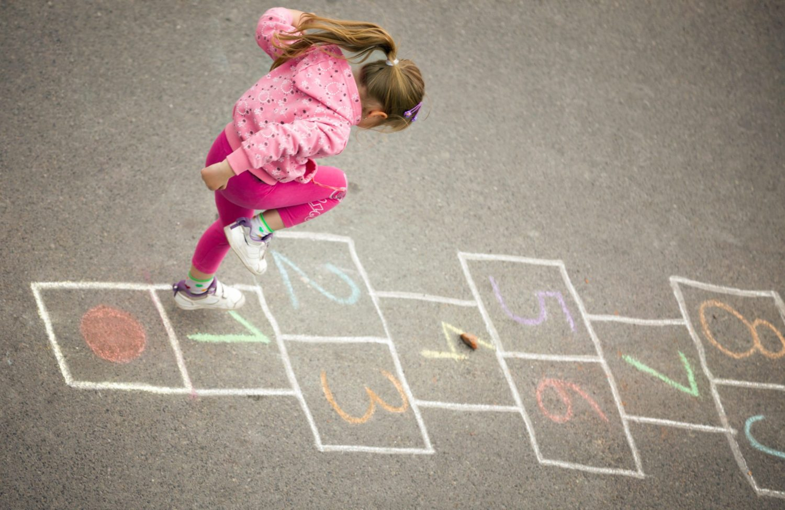
hopscotch

Slide 24
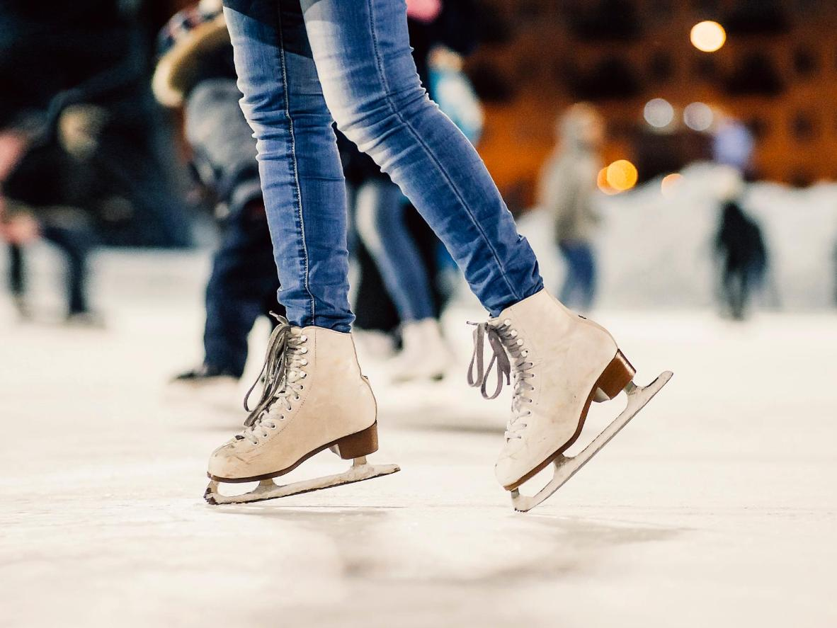
ice skate

Slide 25
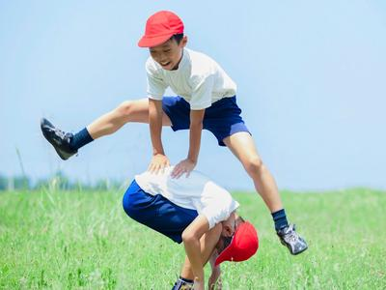
leapfrog

Slide 26
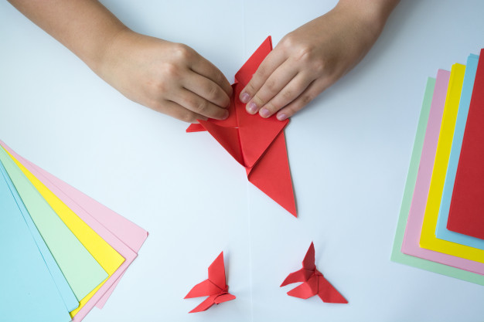
make origami

Slide 27

paint

Slide 28
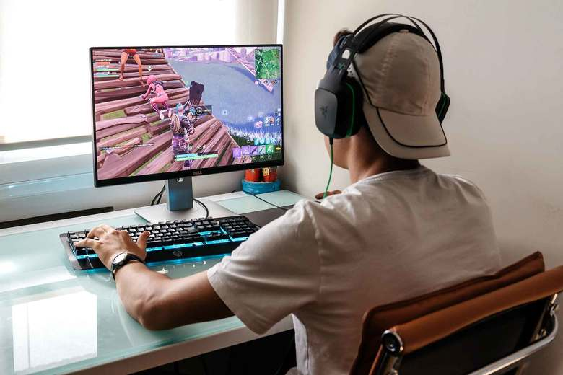
play computer games

Slide 29
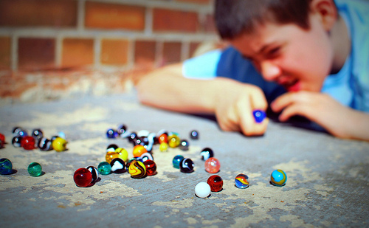
play marbles

Slide 30
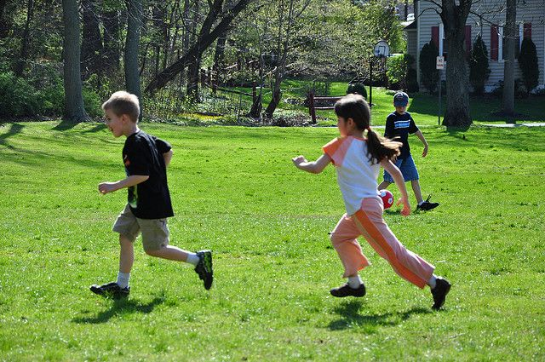
play tag

Slide 31
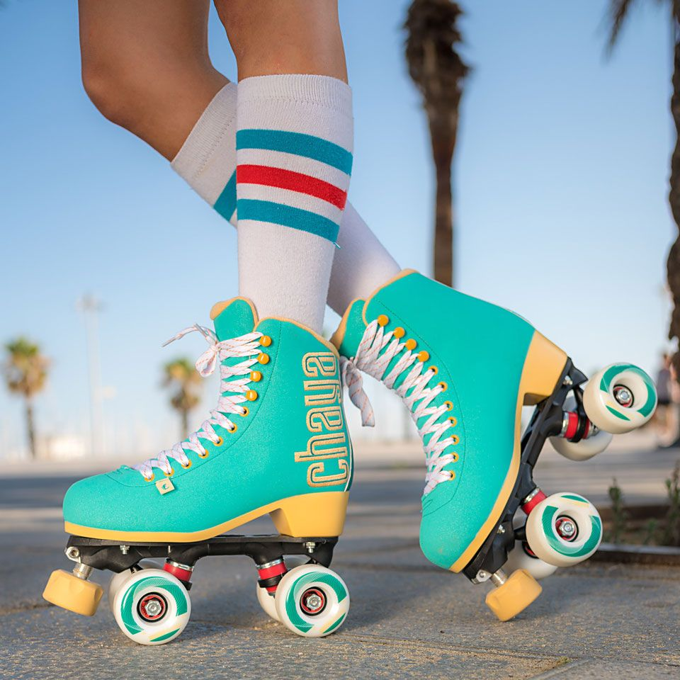
roller skate

Slide 32
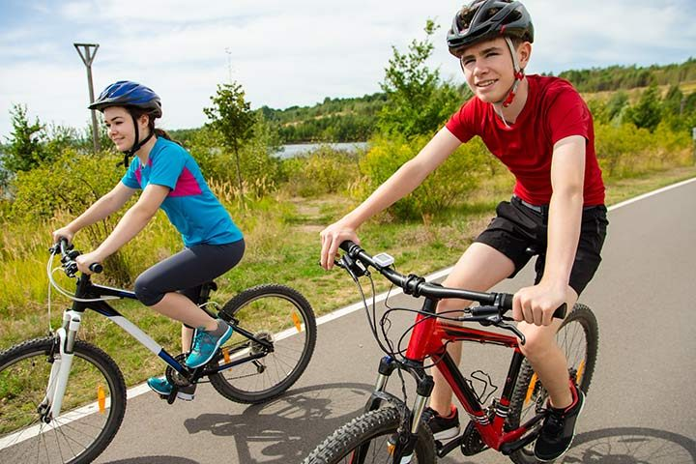
ride a bike

Slide 33
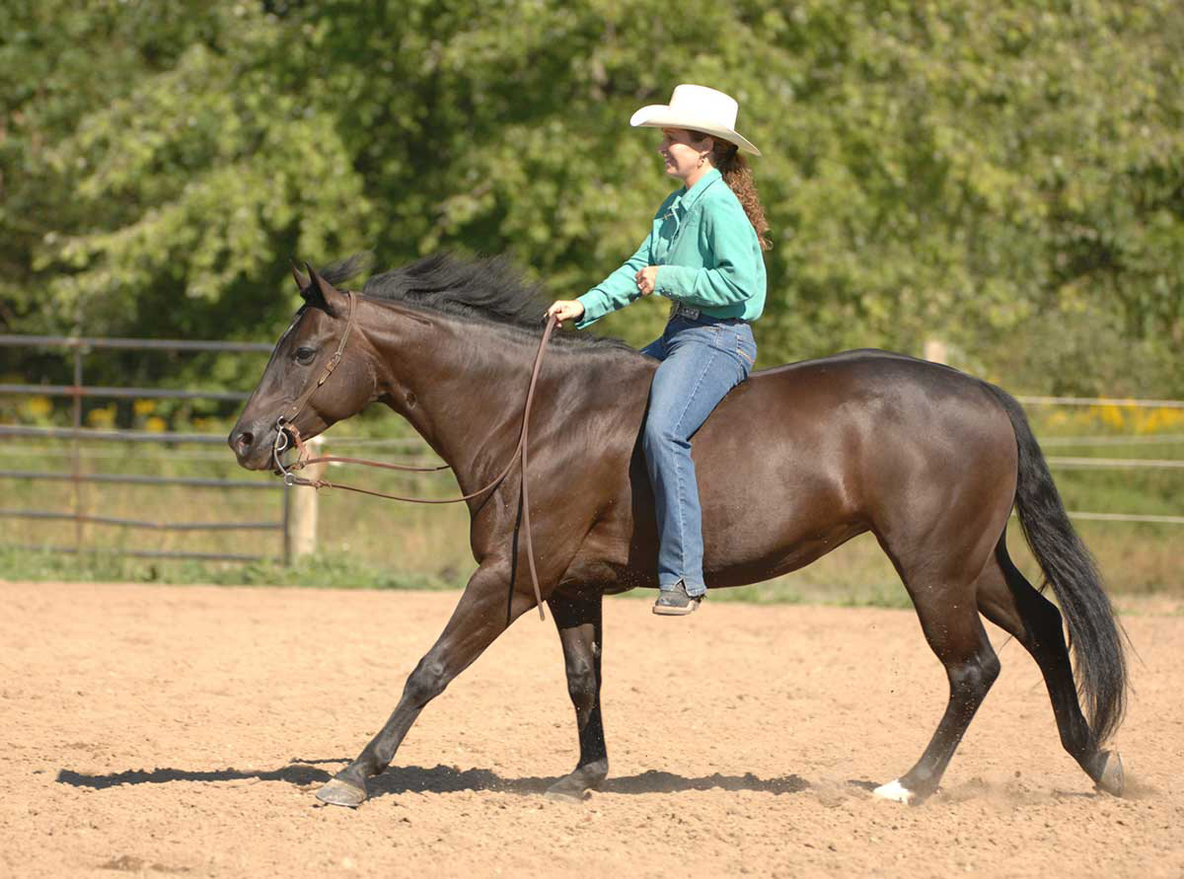
ride a horse

Slide 34

sing a song

Slide 35
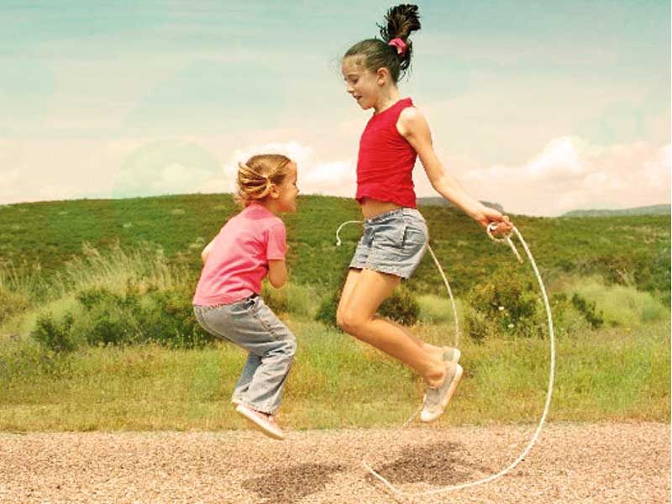
skip rope

Slide 36
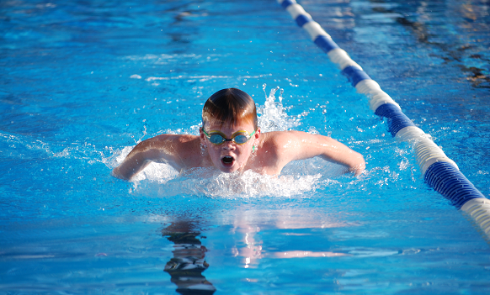
swim

Slide 37
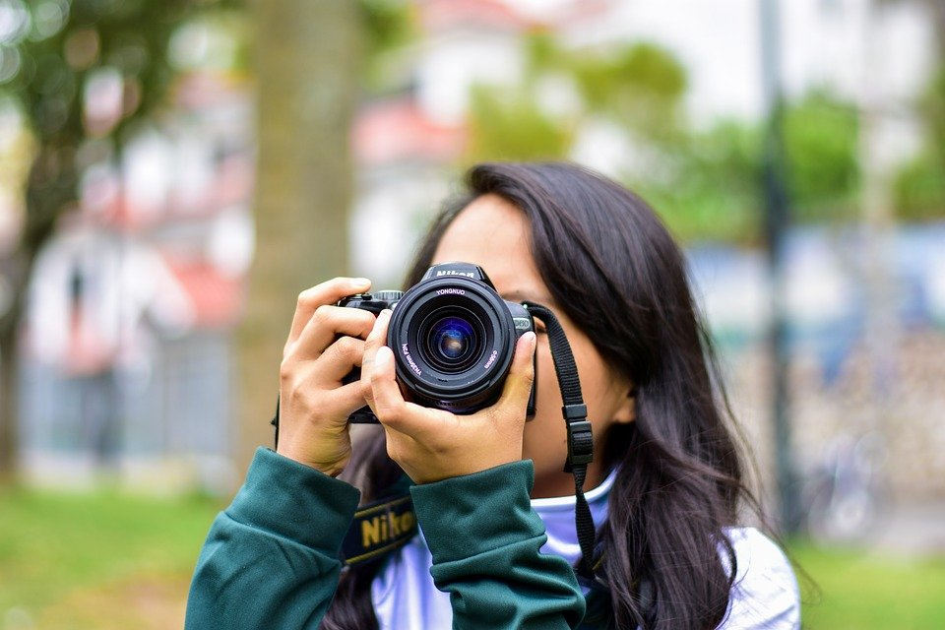
take photos

Slide 38
The End ☺
Thank you!
By Erkan TOY

