Slide 1

CAN
CAN’T

Slide 2
* Yetenek ve becerilerimizden bahsederken “can” yardımcı fiilini kullanırız.
- I can play guitar.
- She can speak French.
- He can run fast.

Slide 3
* Yapamadığımız şeylerden bahsederken “can’t” yardımcı fiilini kullanırız.
- I can’t play piano.
- She can’t speak Spanish.
- He can’t ride a bike.

Slide 4
* Bir kişinin bir şeyleri yapıp yapamadığını sorarken “can” yrd. fiilini başa getiririz.
- Can you play soccer?
+Yes, I can
-No, I can’t

Slide 5
- Can they swim?
+Yes, they can
-No, they can’t

Slide 6
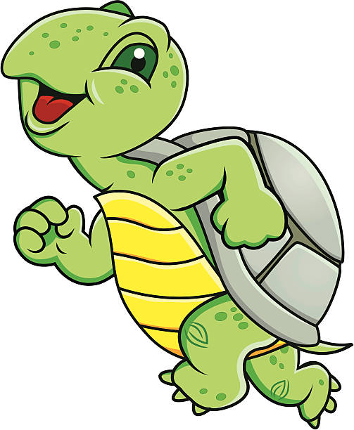
Exercises

Slide 7


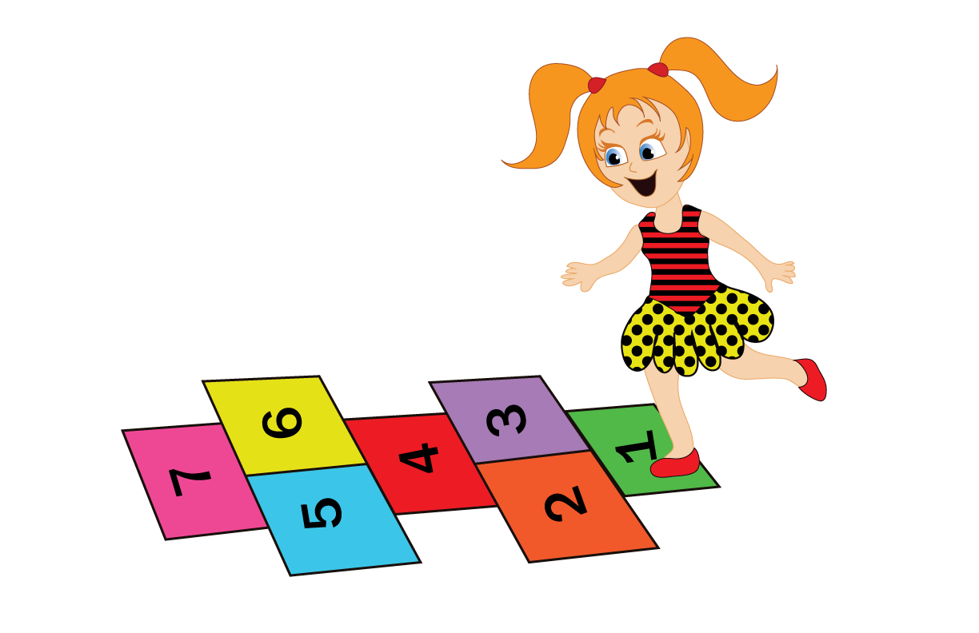
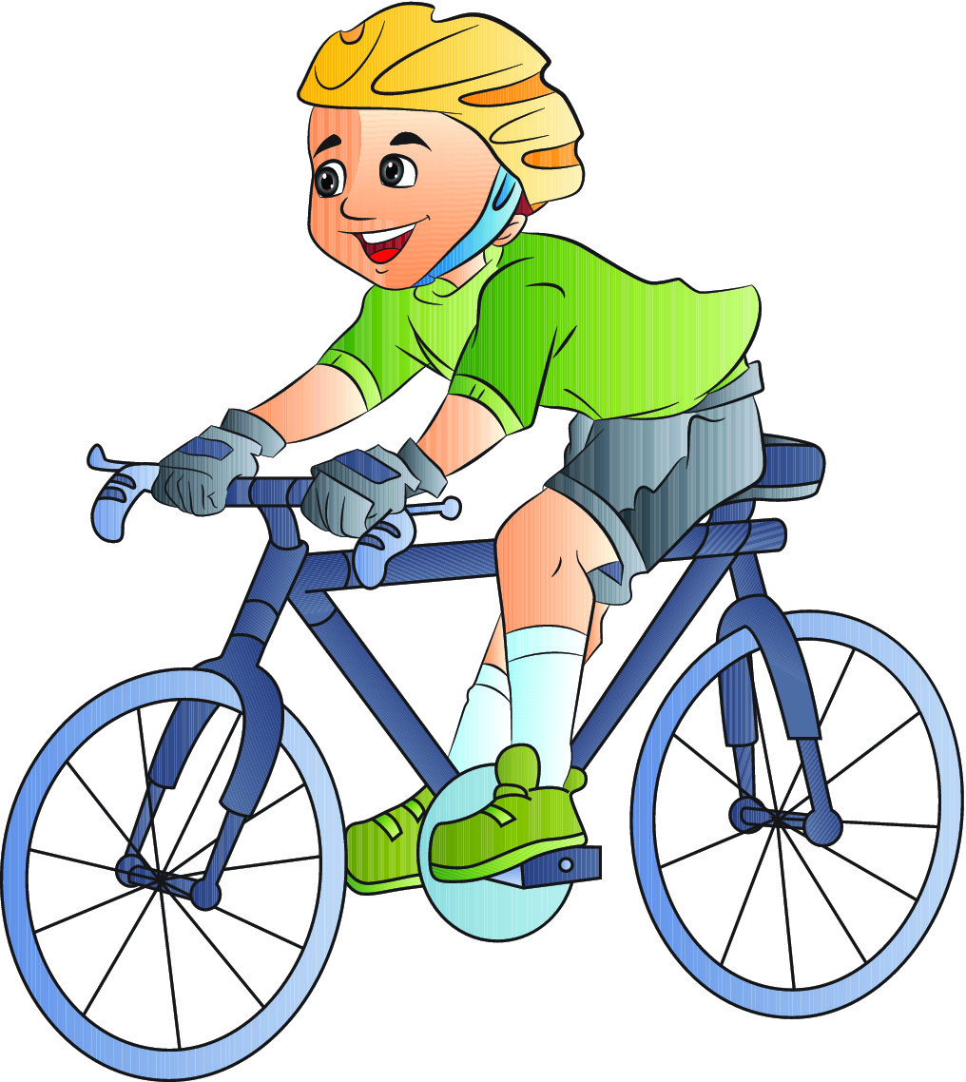
I can play hopscotch but I can’t ride a bike.

Slide 8
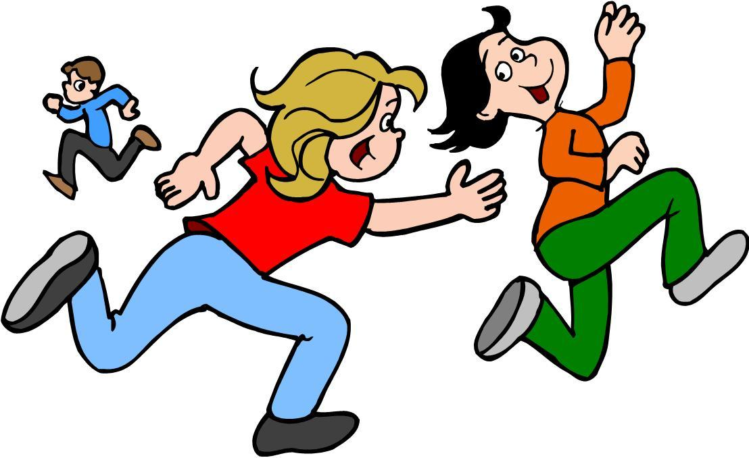
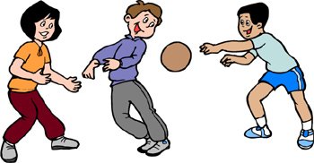
I can play dodgeball but I can’t play tag.

Slide 9
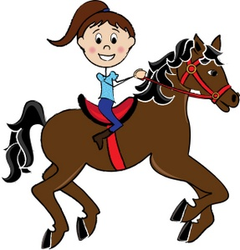
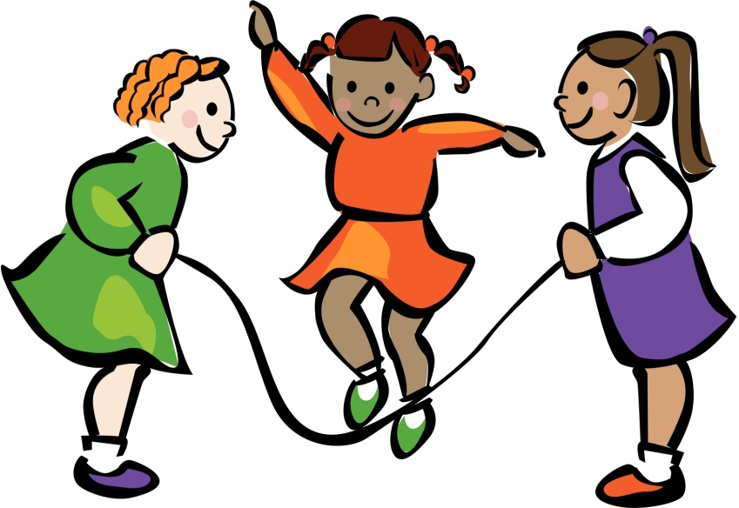
I can ride a horse but I can’t skip rope.

Slide 10
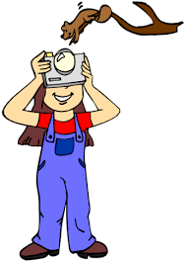

I can take photos but I can’t swim.

Slide 11
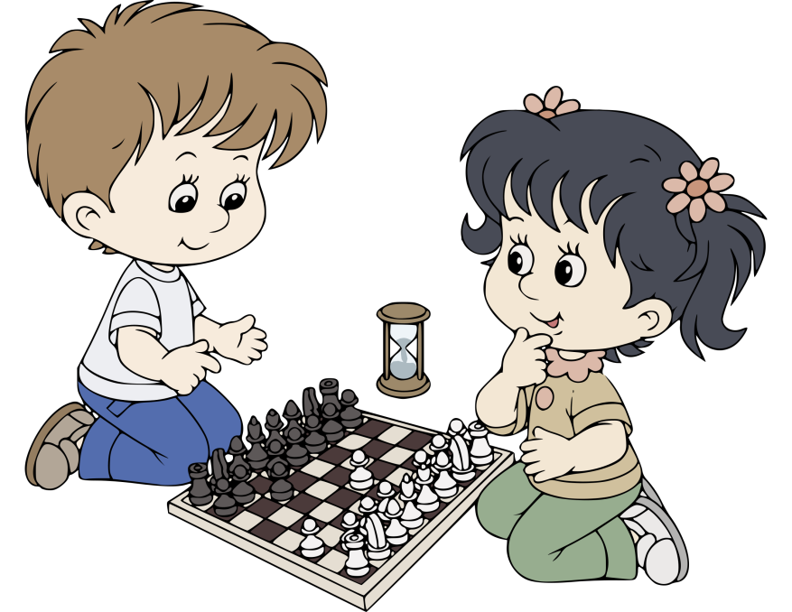
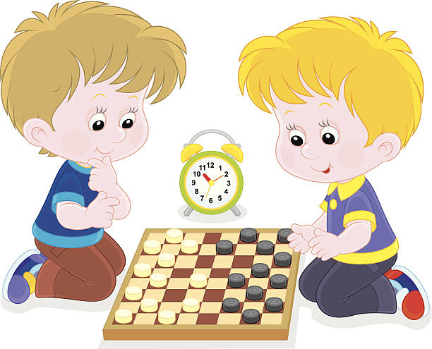
I can play chess but I can’t play checkers.

Slide 12
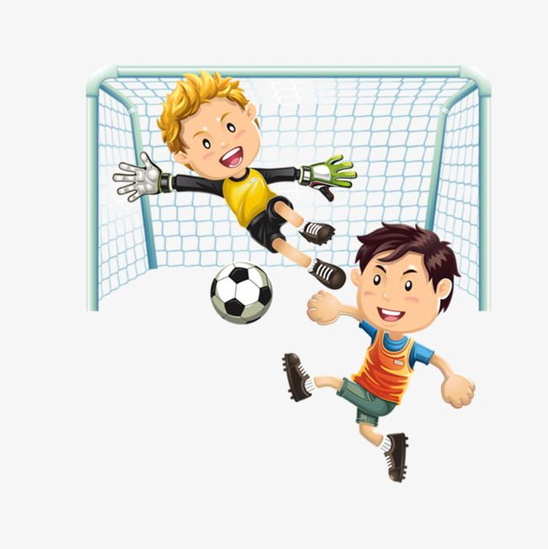
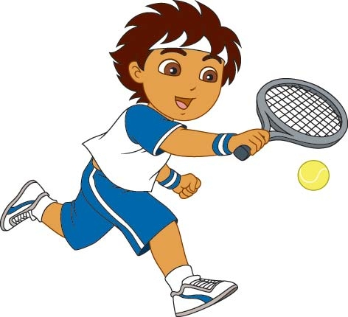
I can play soccer but I can’t play tennis.

Slide 13
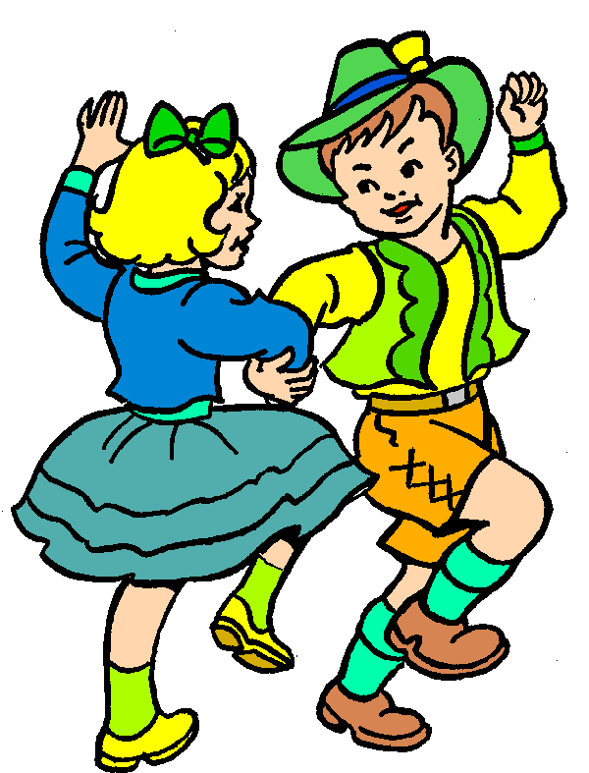
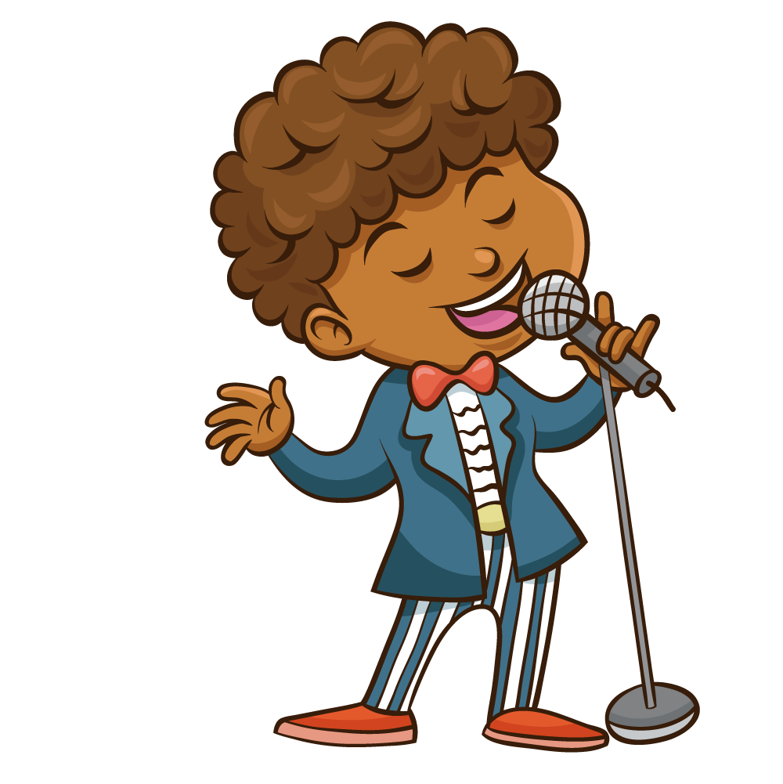
I can dance but I can’t sing a song.

Slide 14
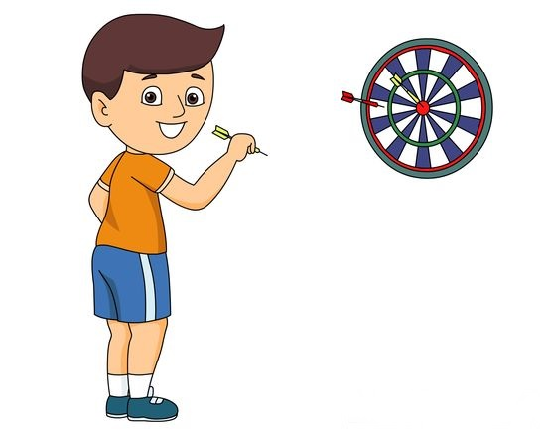
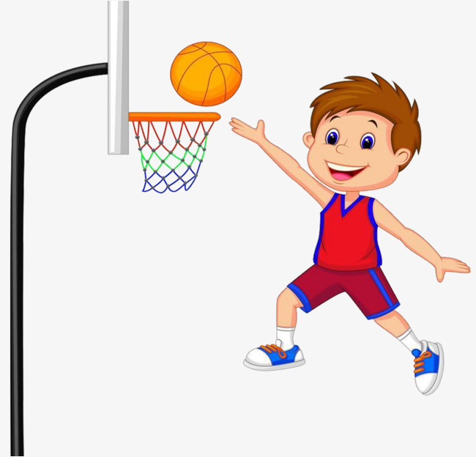
I can play dart but I can’t play basketball.

