Slide 1
Unit 4
Daily Routines

Slide 2
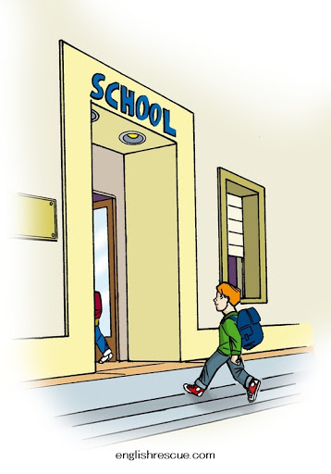
arrive

Slide 3

at night

Slide 4
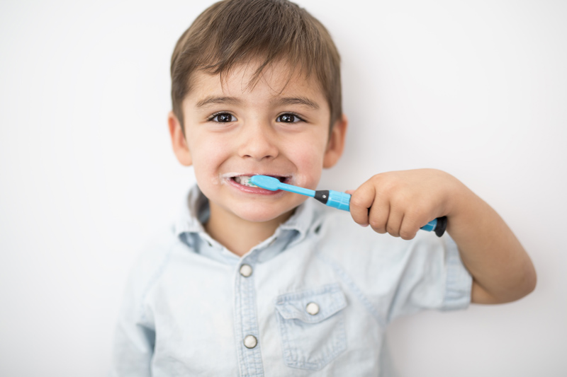
brush teeth

Slide 5
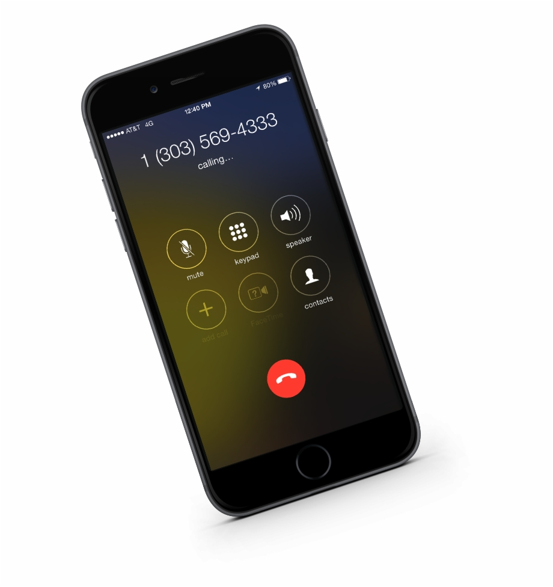
call

Slide 6
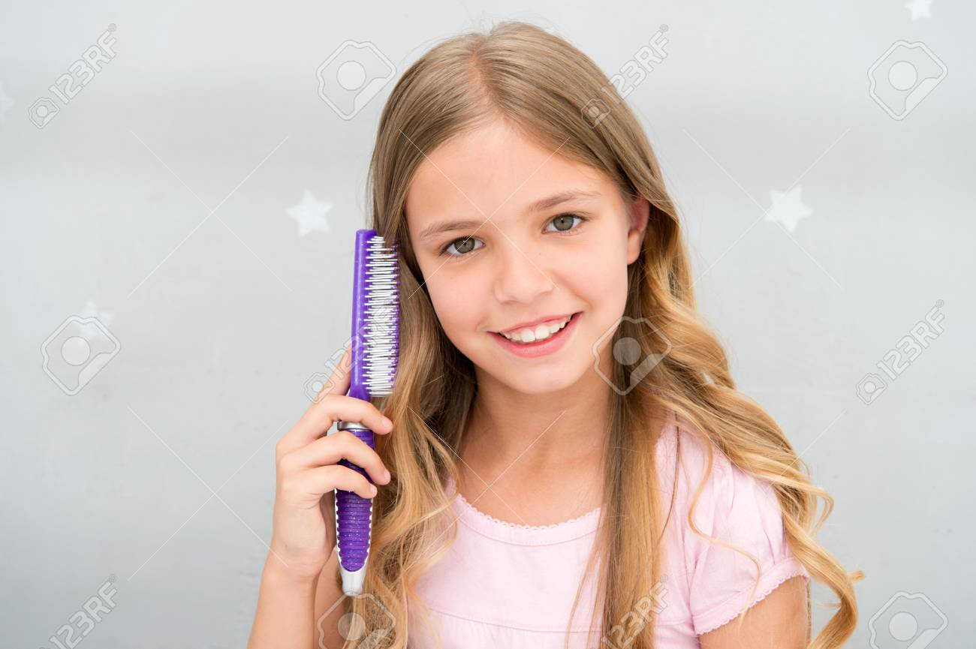
comb hair

Slide 7
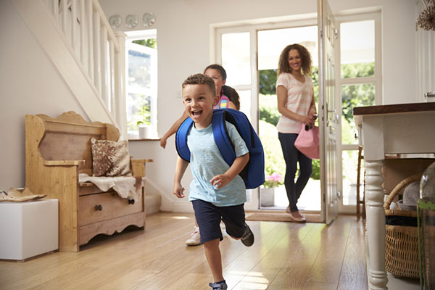
come back home

Slide 8

do homework

Slide 9
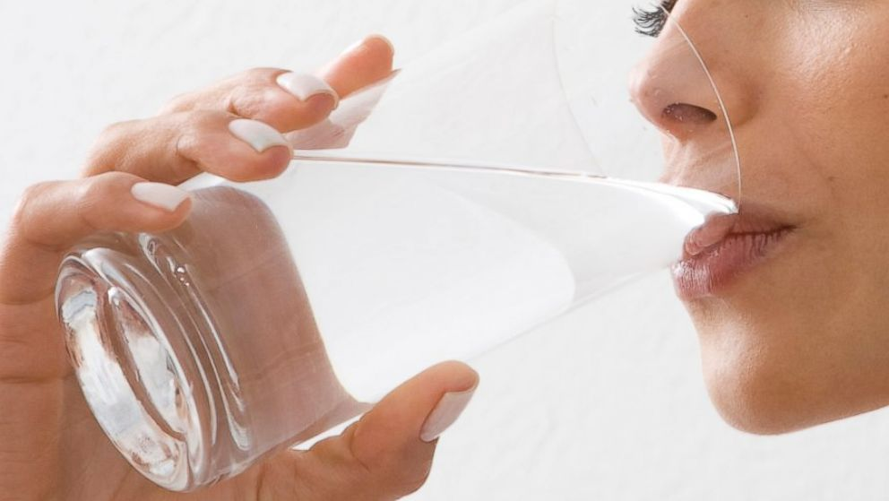
drink

Slide 10
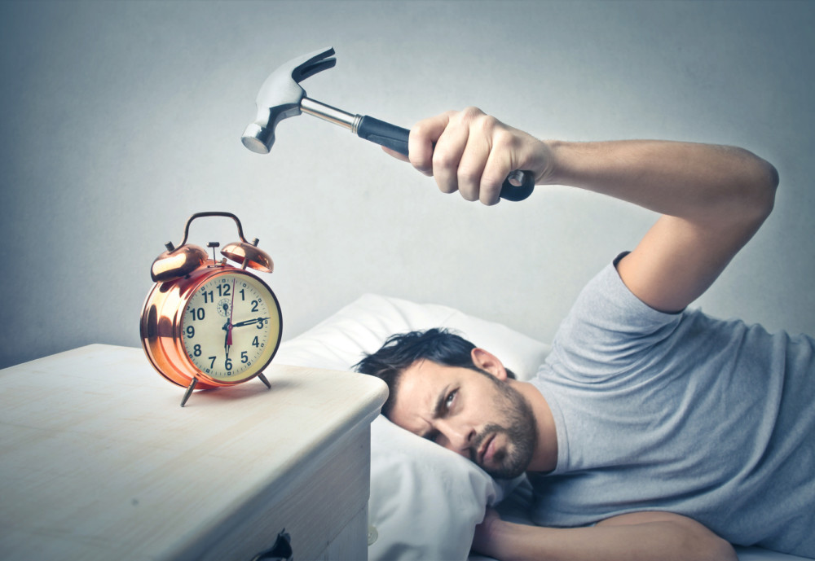
early

Slide 11
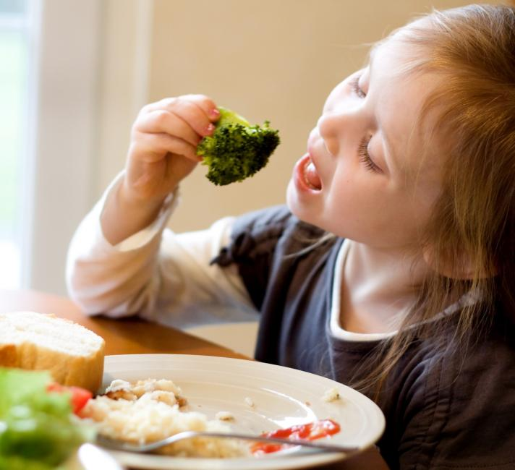
eat

Slide 12
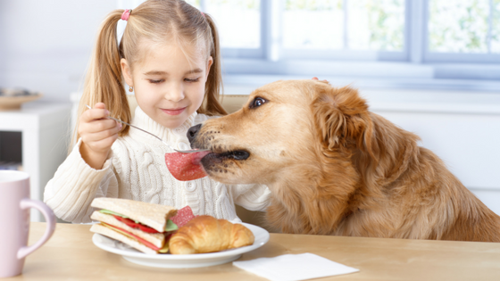
feed

Slide 13
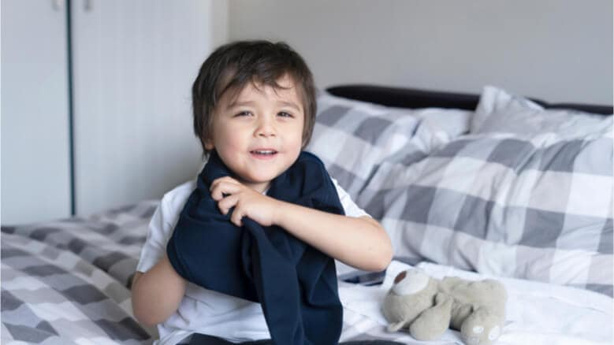
get dressed

Slide 14
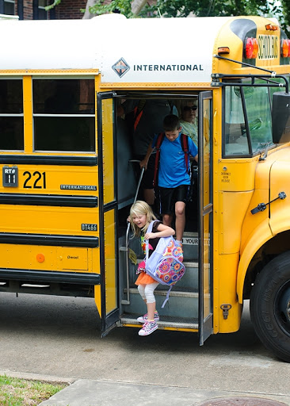
get off

Slide 15
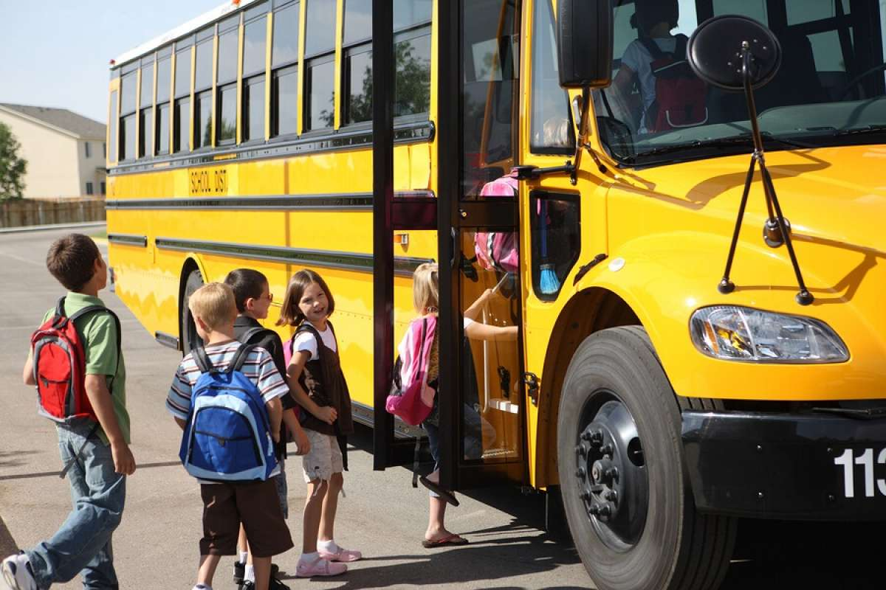
get on

Slide 16
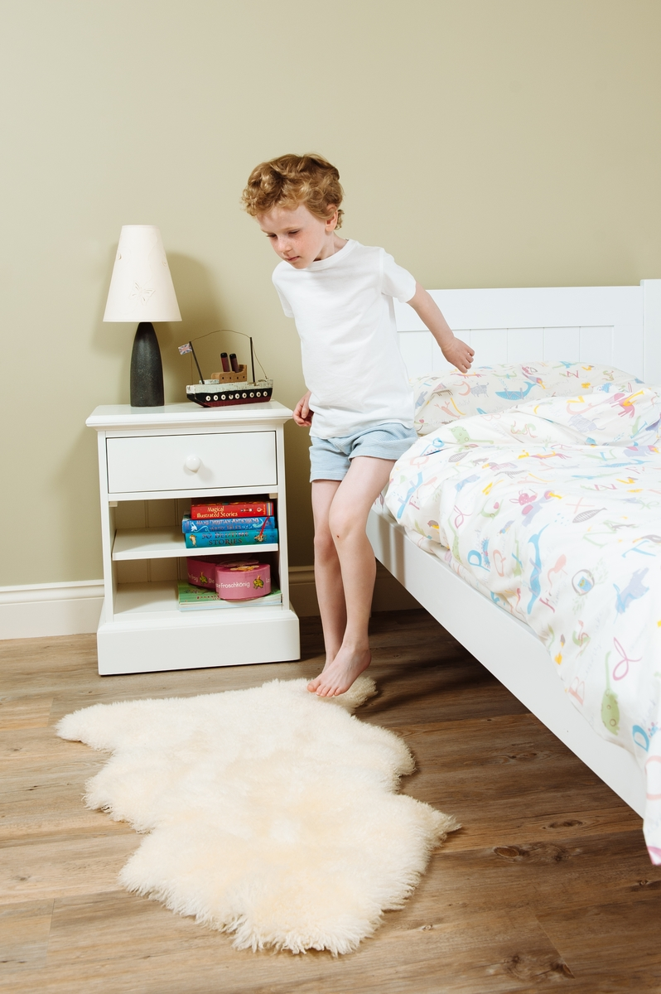
get out of bed

Slide 17

get up

Slide 18

go online

Slide 19

go shopping

Slide 20
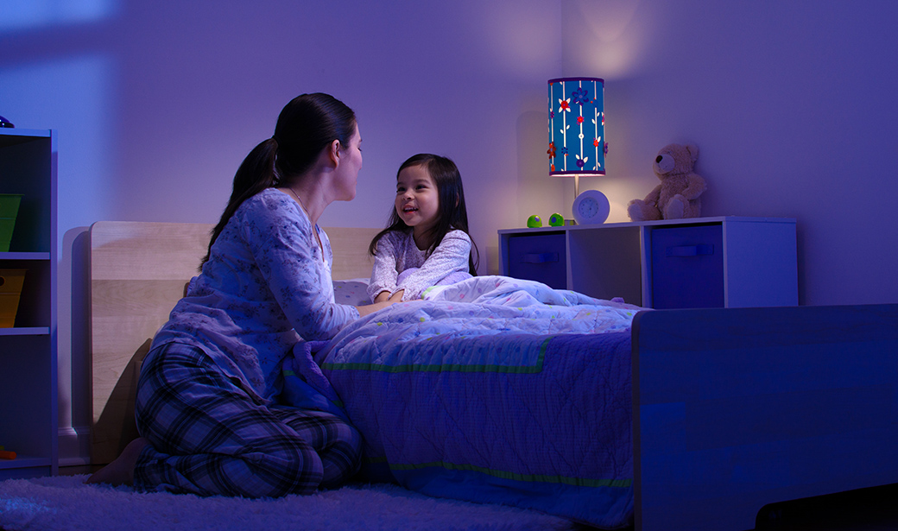
go to bed

Slide 21
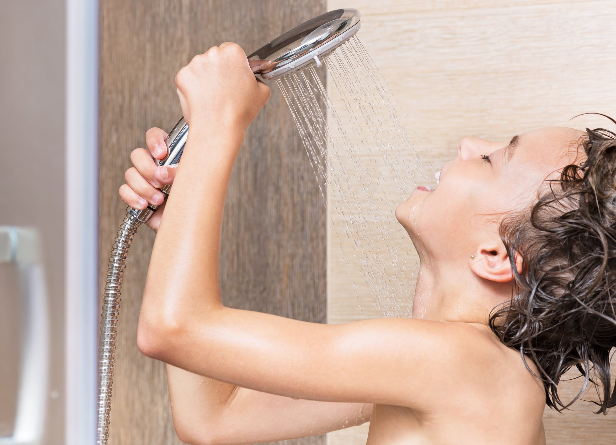
have a shower

Slide 22
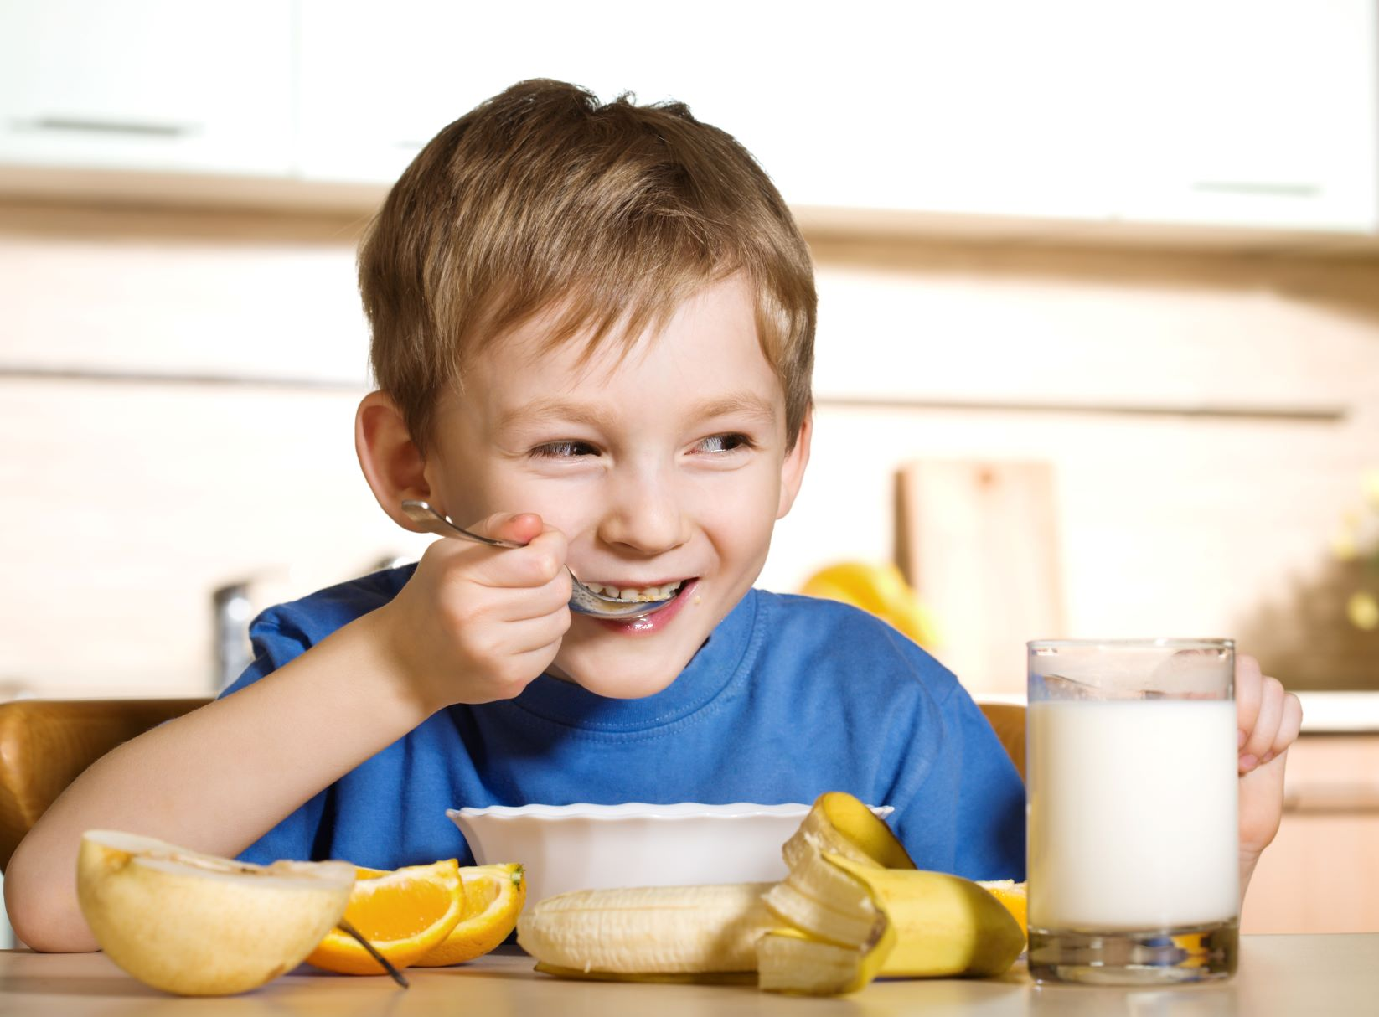
have breakfast

Slide 23
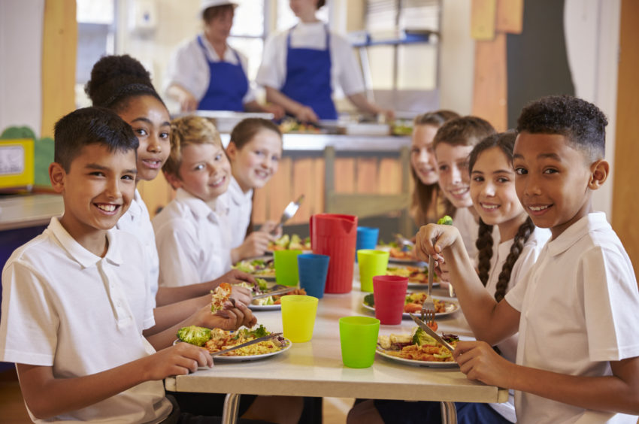
have lunch

Slide 24
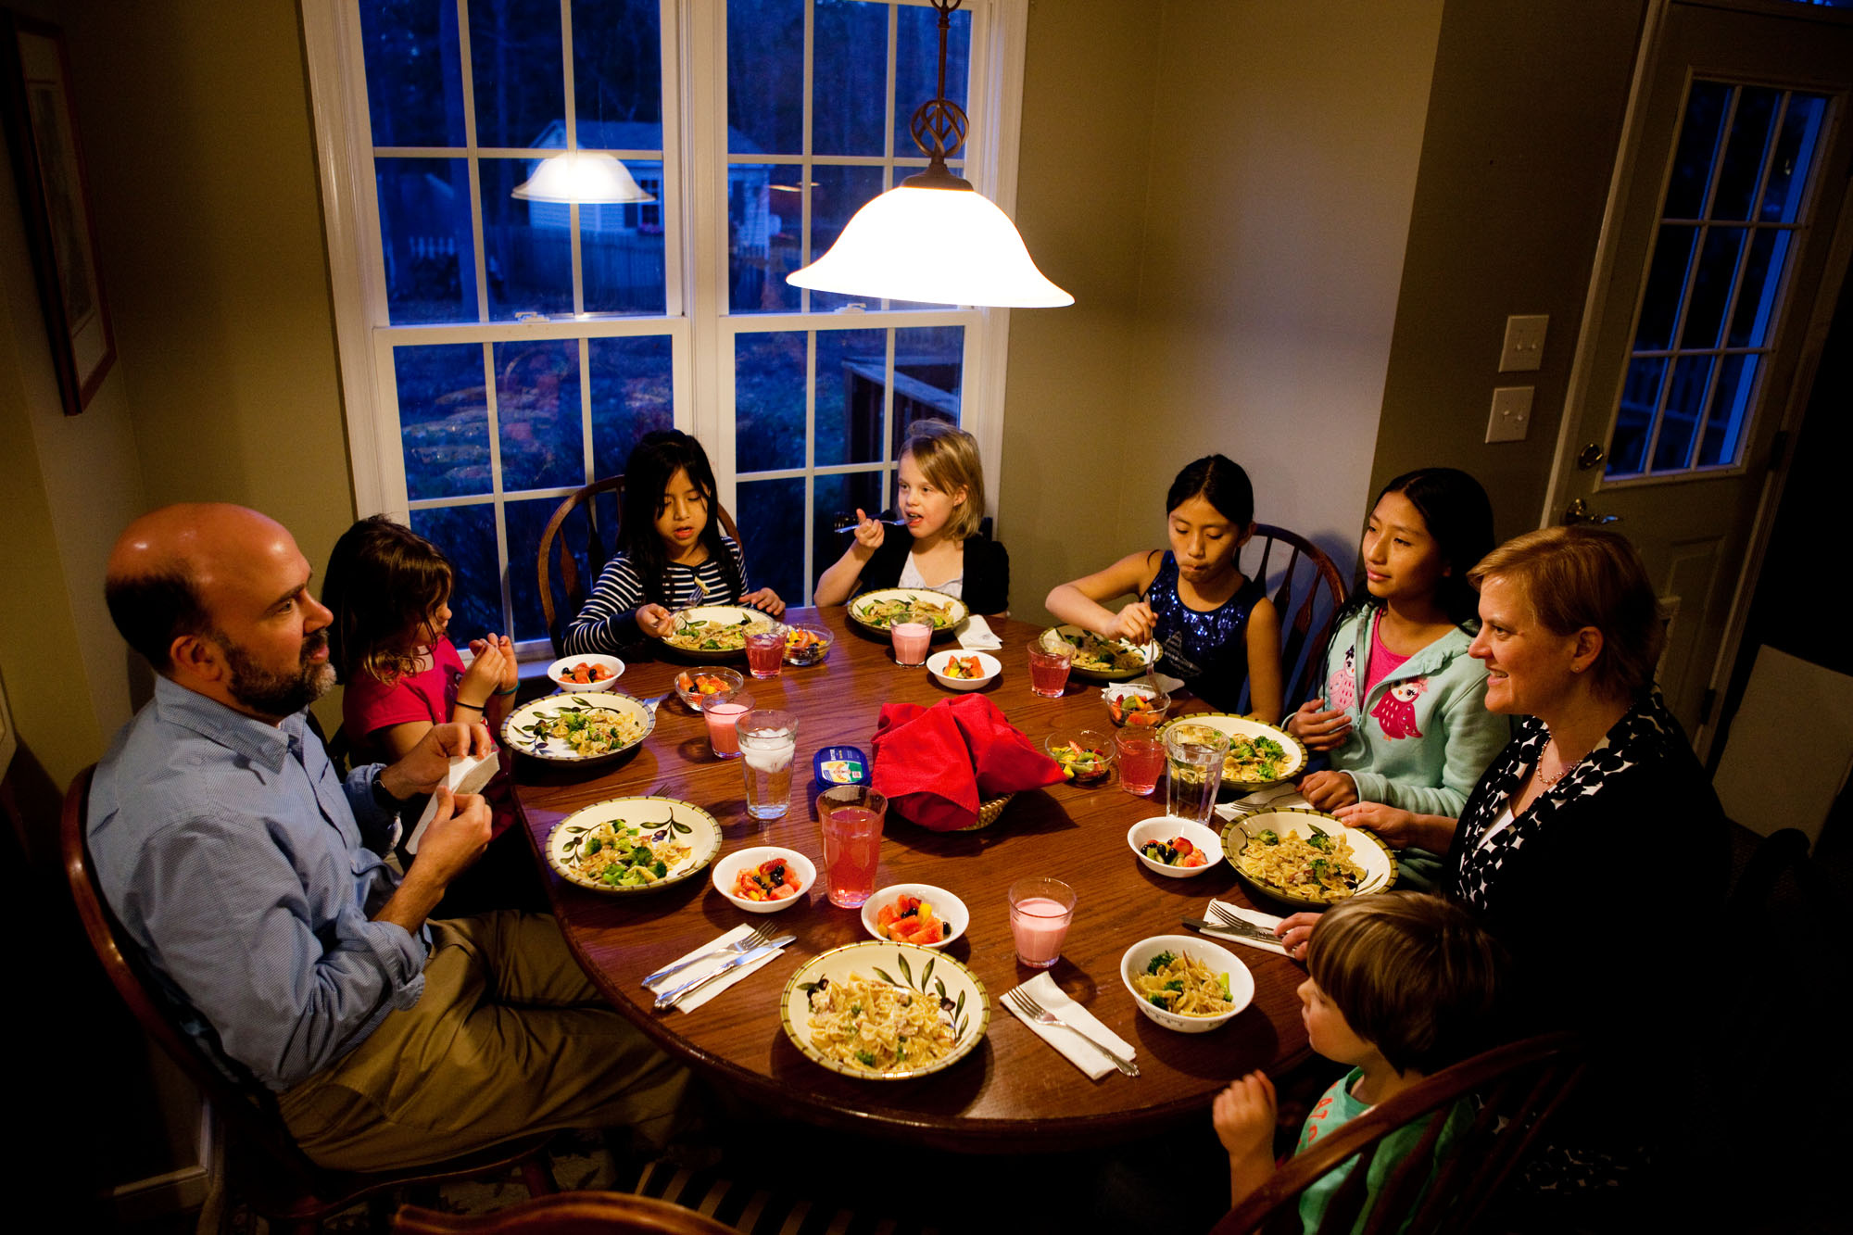
have dinner

Slide 25

in the morning

Slide 26

in the afternoon

Slide 27

in the evening

Slide 28
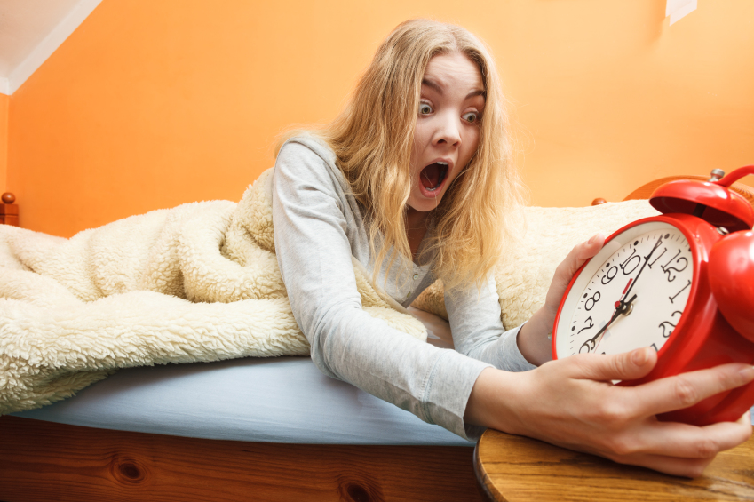
late

Slide 29

leave

Slide 30
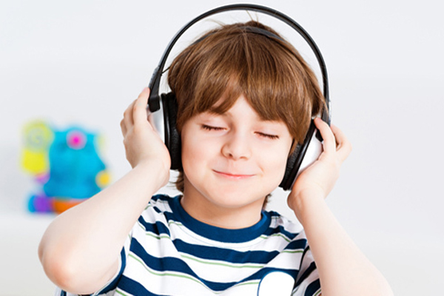
listen to music

Slide 31
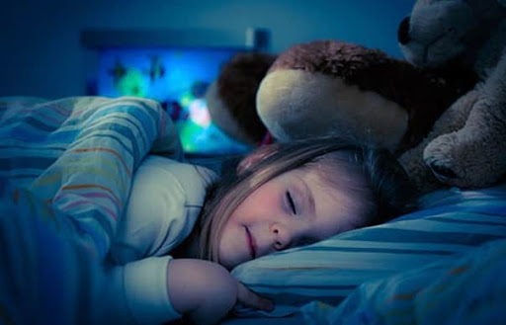
sleep

Slide 32
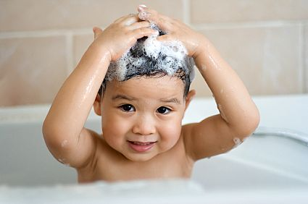
take a bath

Slide 33

talk to

Slide 34
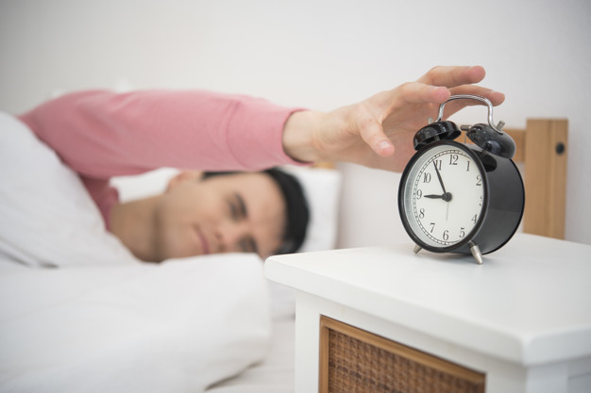
wake up

Slide 35
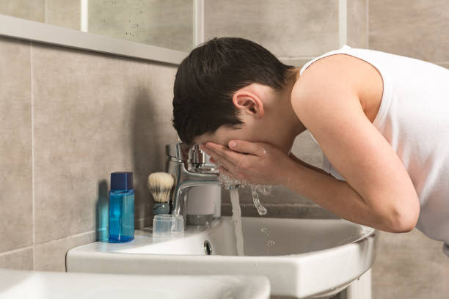
wash face

Slide 36
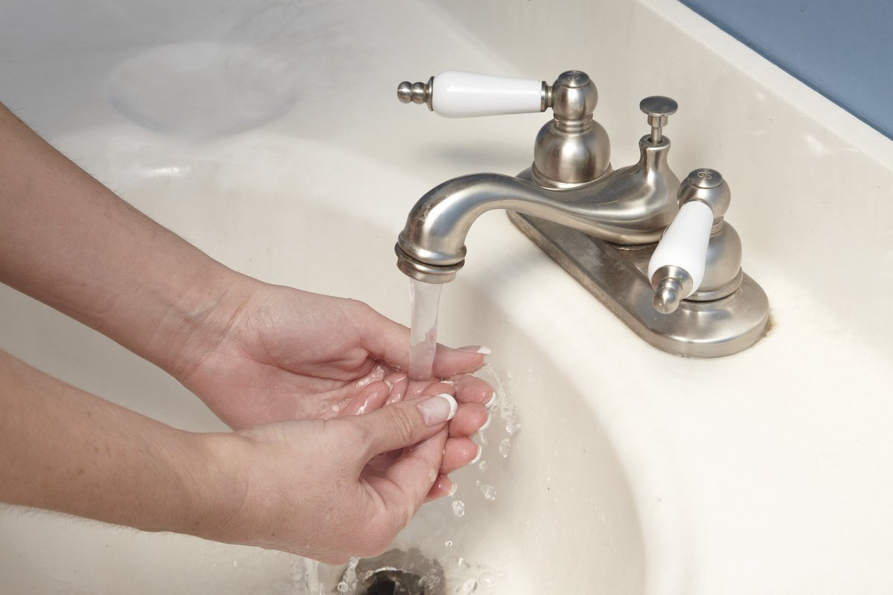
wash hands

Slide 37
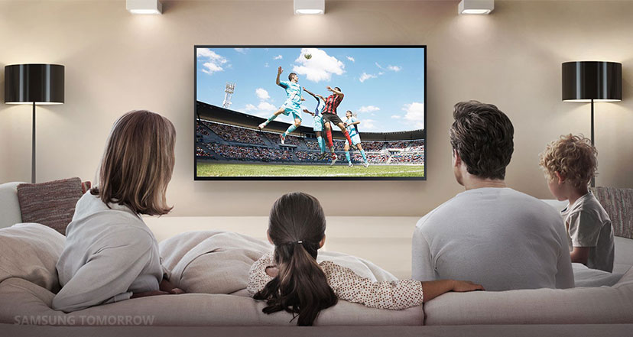
watch TV

Slide 38
NUMBERS

Slide 39
1
one

Slide 40
2
two

Slide 41
3
three

Slide 42
4
four

Slide 43
5
five

Slide 44
6
six

Slide 45
7
seven

Slide 46
8
eight

Slide 47
9
nine

Slide 48
10
ten

Slide 49
11
eleven

Slide 50
12
twelve

Slide 51
13
thirteen

Slide 52
14
fourteen

Slide 53
15
fifteen

Slide 54
16
sixteen

Slide 55
17
seventeen

Slide 56
18
eighteen

Slide 57
19
nineteen

Slide 58
20
twenty

Slide 59
30
thirty

Slide 60
40
forty

Slide 61
50
fifty

Slide 62
60
sixty

Slide 63
70
seventy

Slide 64
80
eighty

Slide 65
90
ninety

Slide 66
100
one hundred

Slide 67
The End ☺
Thank you!
By Erkan TOY

