Slide 1




Unit 2 (Teen Life)
Emrullah Ay
English Language Teacher
emaytube
CANLI DERS ANLATIMLARI İÇİN
YOUTUBE SAYFAMI TAKİP EDEBİLİRSİNİZ.
emaytube

Slide 2
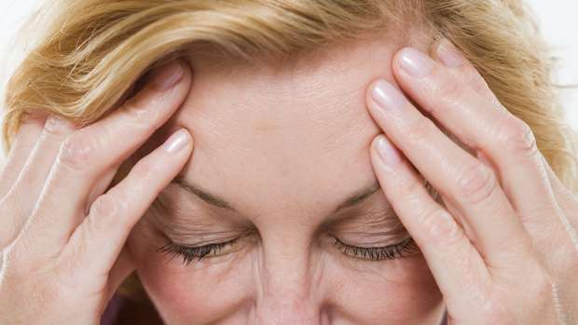
UNBEARABLE
Annoying and unpleasant experiences
I hate horror movies. I think they are unbearable.
DAYANILMAZ

Slide 3
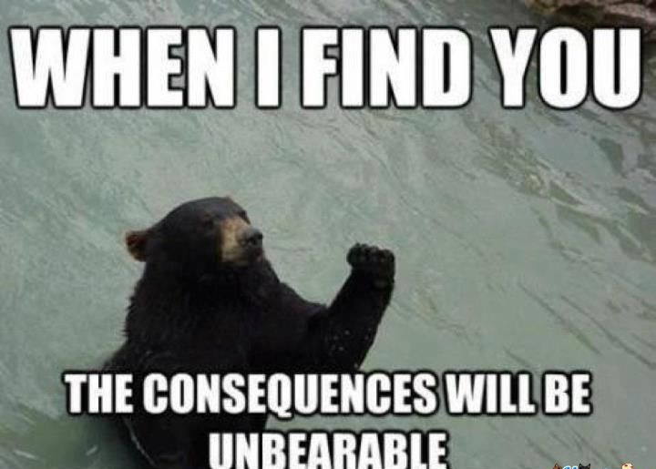

Slide 4
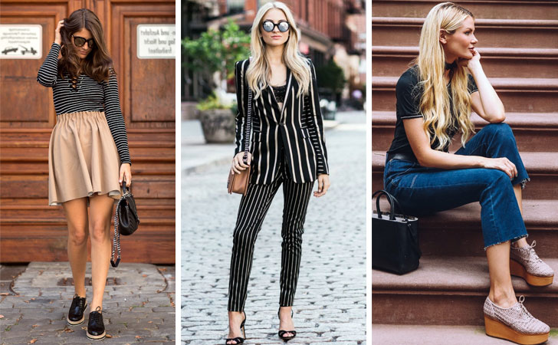
TRENDY
Modern and influenced by recent fashions
Fussell came back from holiday with trendy clothes.
MODAYA UYGUN

Slide 5
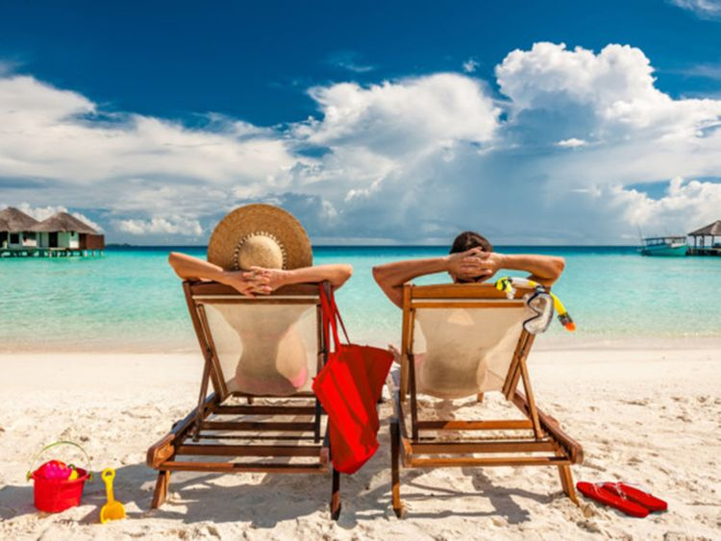
VACATION
Holiday
How about taking a vacation in June together?
TATİL

Slide 6


Slide 7

TERRIFIC = IMPRESSIVE
Amazing, incredible, marvellous
Mr Jones thought my history paper was terrific / impressive.
ŞAHANE

Slide 8

SURF ON THE NET = BROWSE THE NET
Spending time on internet
I decided to spend the night browsing / surfing the Internet.
İNTERNETTE GEZİNMEK

Slide 9
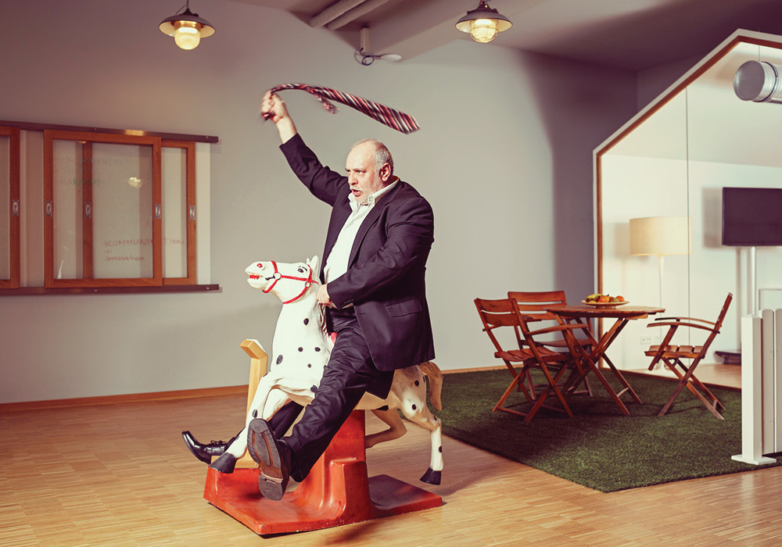
RIDICULOUS
Stupid and deserving to be laughed at
Don't be so ridiculous! I can't possibly afford to stay in a hotel like that.
GÜLÜNÇ - SAÇMA

Slide 10
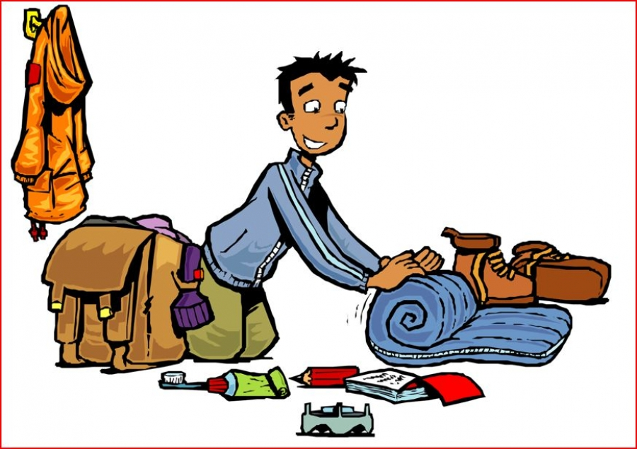
PREPARE
To make something or someone ready
Have you prepared for your interview?
HAZIRLAMAK

Slide 11
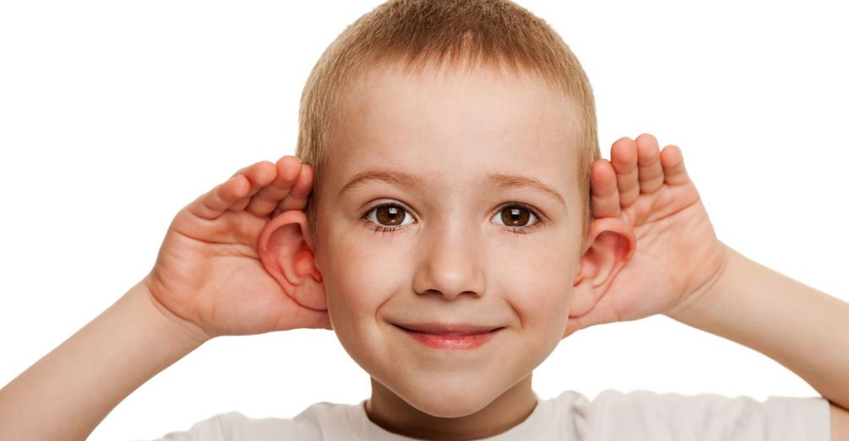
PAY ATTENTION = FOCUS ON
To watch, listen and think something carefully
You weren't paying attention to what I was saying
ODAKLANMAK

Slide 12
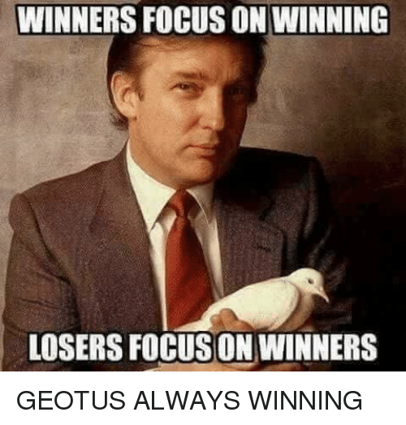

Slide 13
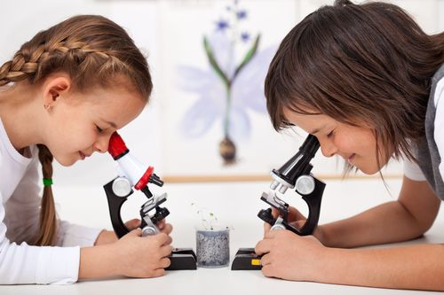
INTERESTED IN = KEEN ON = FOND OF
Wanting to give your attention to something
They were not interested in / fond of / keen on romance movies.
İLGİLİ OLMAK

Slide 14
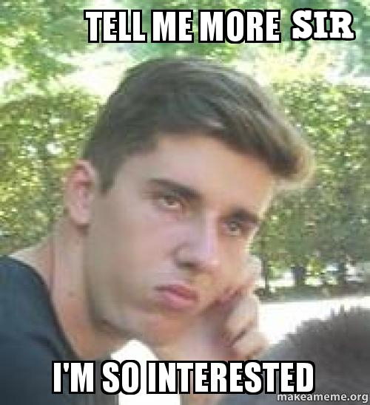

Slide 15
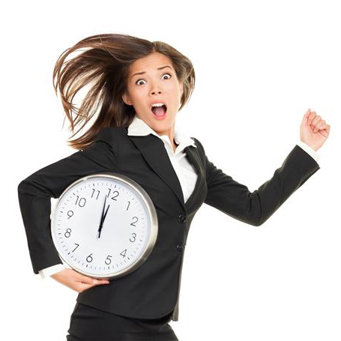
IN A HURRY
To move or do things quickly
We forgot our tickets because I left the house in a hurry.
ACELE İLE

Slide 16
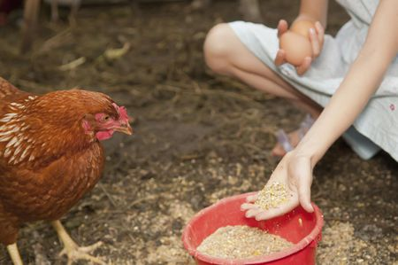
FEED
To give food to an animal, person or a group.
How often do you feed your pets?
BESLEMEK

Slide 17
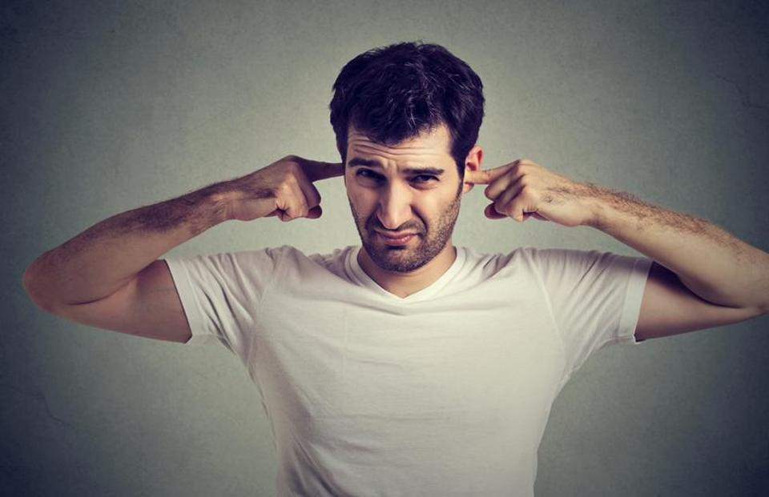
CAN’T STAND
To find something unbearable, annoying.
Alex is not fond of opera. He can’t stand listening it.
KATLANAMAMAK

Slide 18
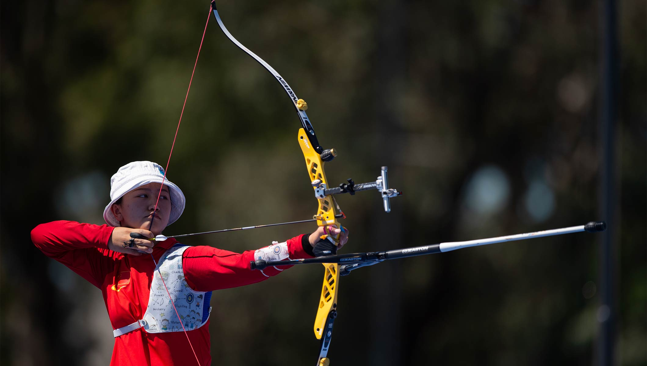
ARCHERY
A type of sports shooting arrows.
Thompson is a sports freak, with archery, cricket and scuba diving among his passions.
OKÇULUK

Slide 19

COMPASS
An instrument to find direction and points north.
Each player must be equipped with a compass and map.
PUSULA

Slide 20
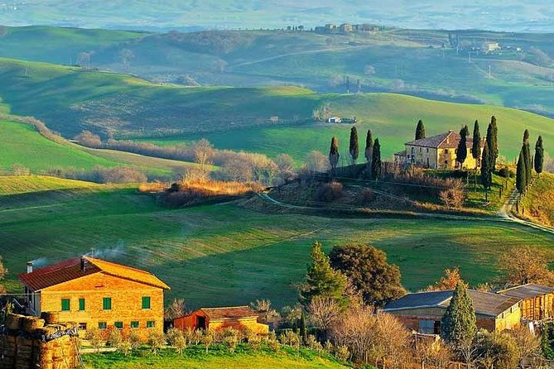
COUNTRYSIDE
The land of rural area
It's easy to spend whole fascinating days exploring the countryside.
KIRSAL ALAN

Slide 21

FIT
Suitable, standard to meet required purposes.
The clothes didn’t fit me, I need to change them.
UYMAK

Slide 22
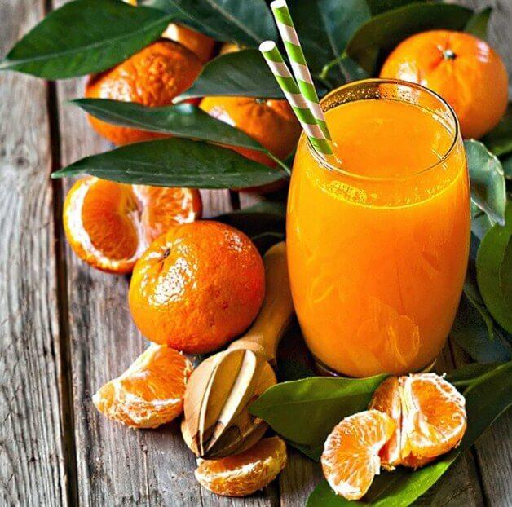
FRESH SQUEEZED
Taking the liquid of fruits or vegetables.
Fresh squeezed orange juice is the most favorite beverage of this cafe.
TAZE SIKILMIŞ

Slide 23

GAIN
To get something useful
The mayor has gained a lot of support from the teacher's union.
ELDE ETMEK

Slide 24
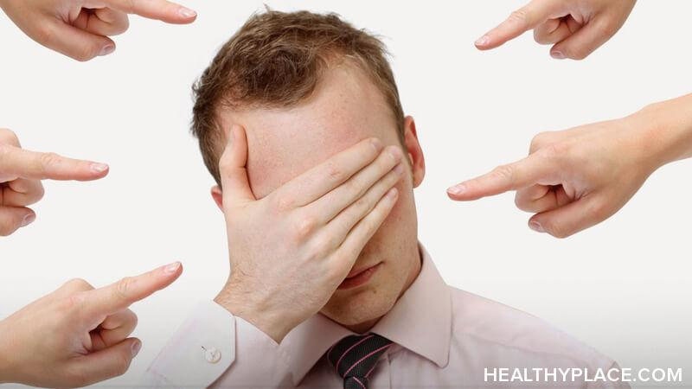
INSULT
An offensive action
Linda first insulted and then attacked me.
AŞAĞILAMAK

Slide 25
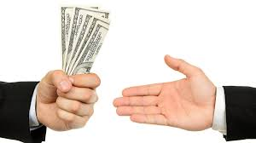
LEND
To give something to someone for a short period.
She doesnt like lending her books.
ÖDÜNÇ VERMEK

Slide 26
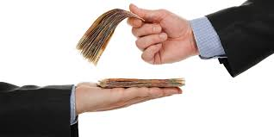
BORROW
To get something from someone for a short period.
I had to borrow a pen from my mate durinng the exam.
ÖDÜNÇ ALMAK

Slide 27
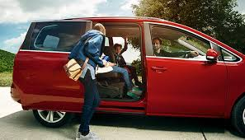
PICK UP
To take someone from somewhere
My parents will pick me up after the school.
BİRİNİ ALMAK

Slide 28
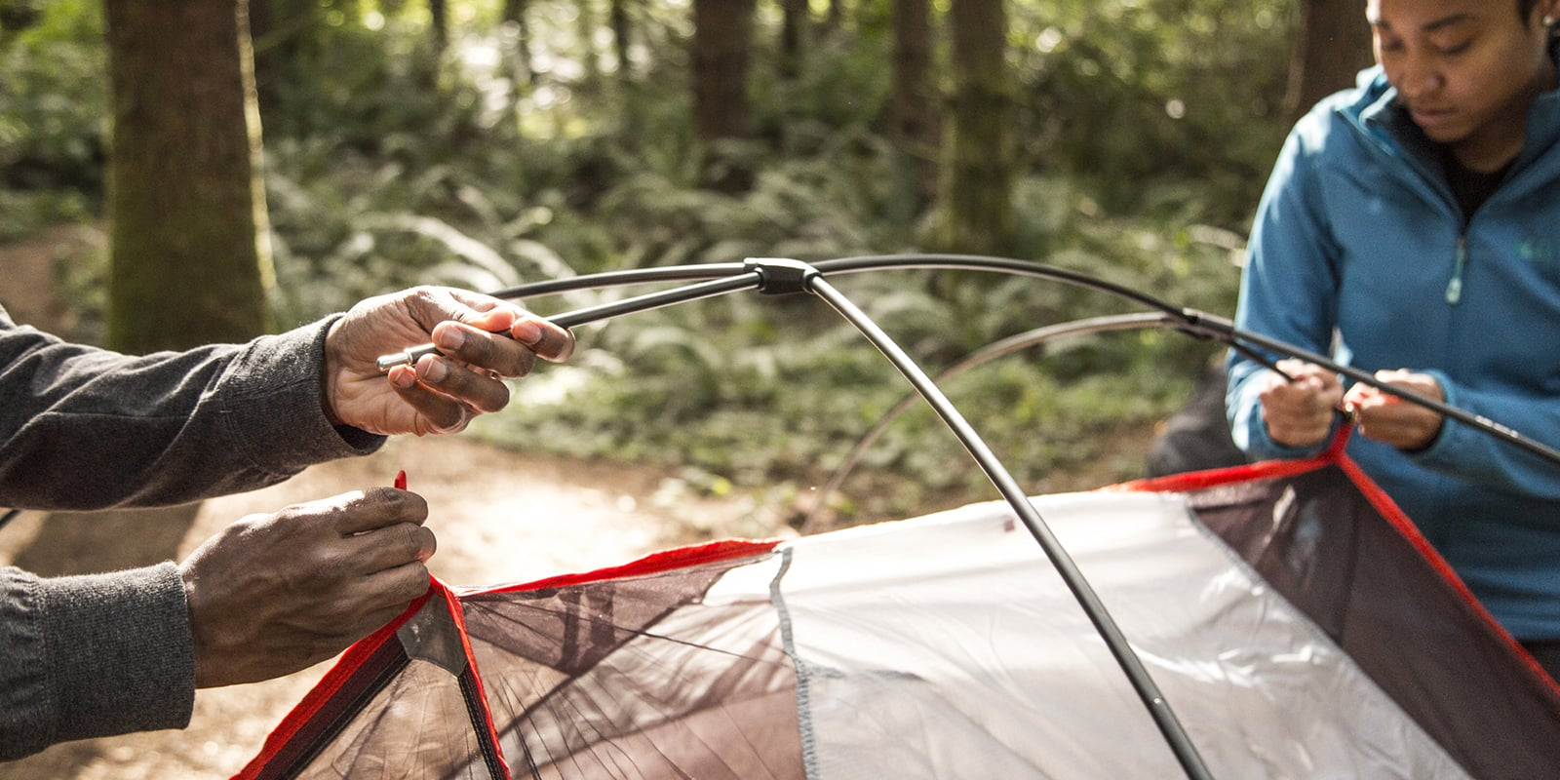
PITCH A TENT
To set up a tent
Can you lend your pocketknife to me, I need to pitch my tent.
ÇADIR KURMAK

Slide 29


Slide 30

REWARD
Something given in exchange of succesfull behavior
The police offered a reward for any information about the robbery.
ÖDÜL

Slide 31
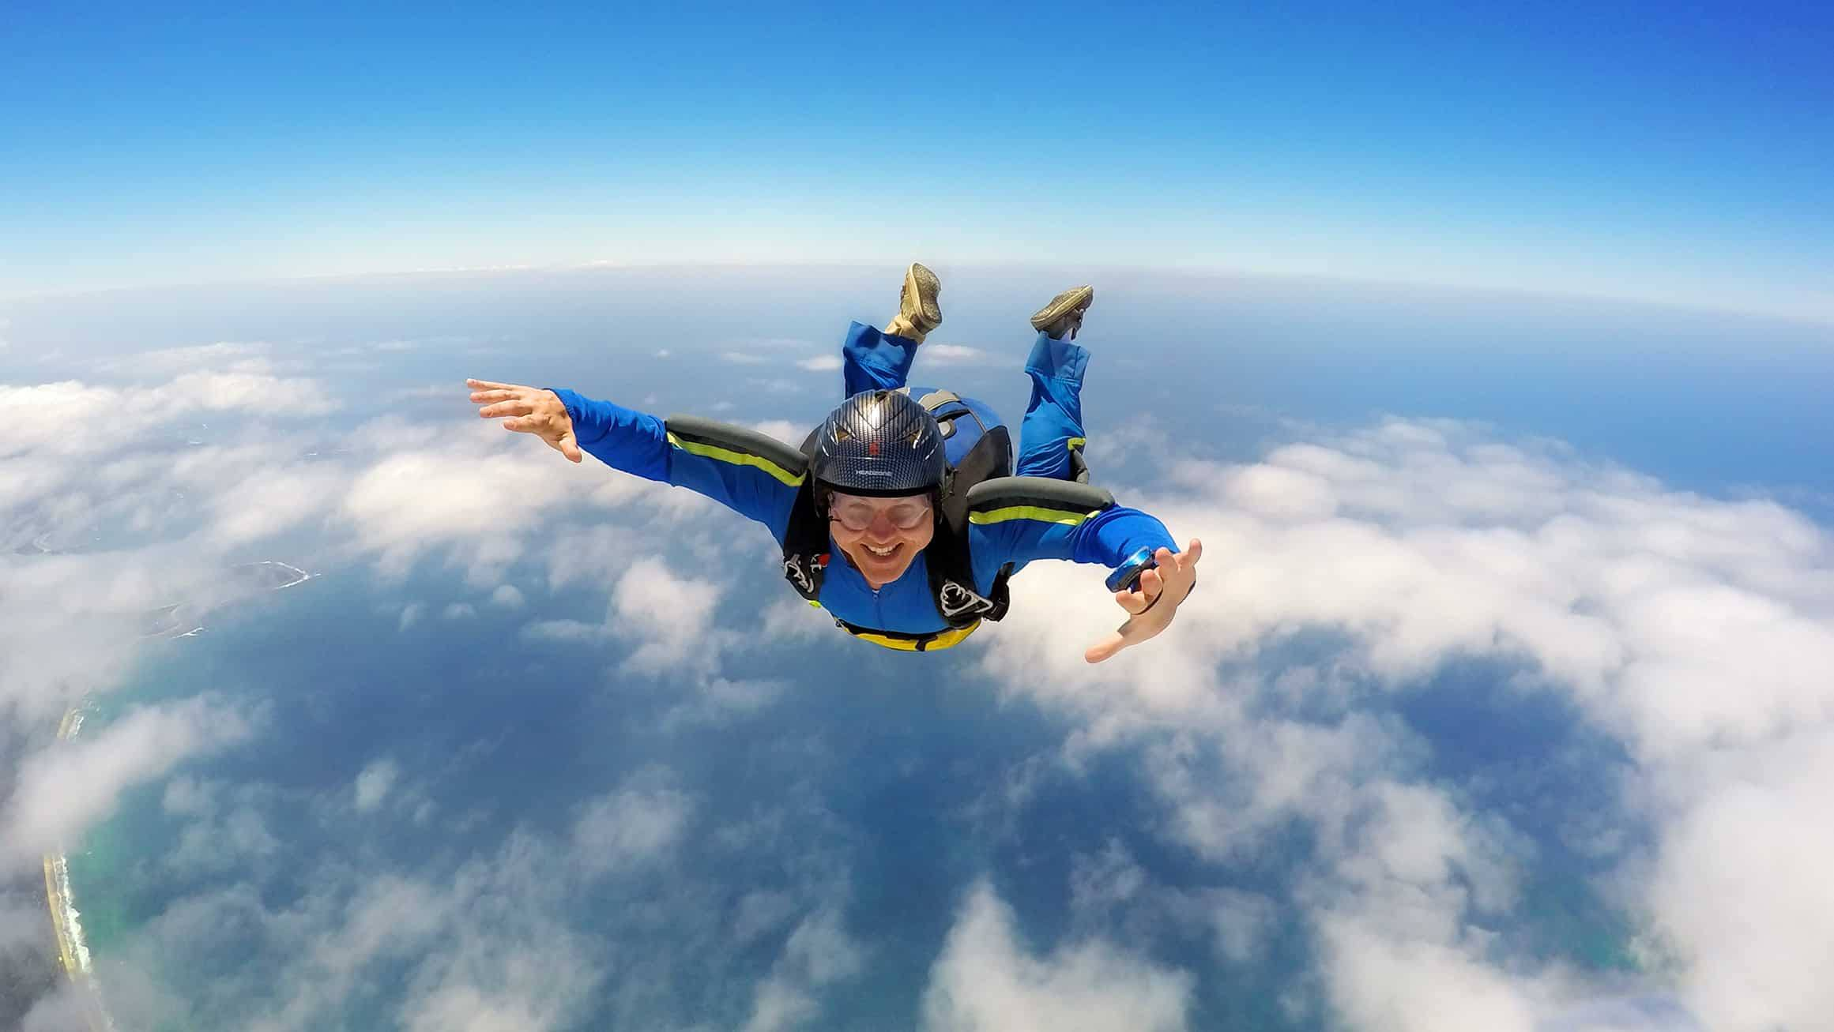
SKYDIVING
a sport in which a person jumps from an aircraft
I have had many adventures and skydiving will be the next one.
PARAŞÜTLE ATLAMA

Slide 32
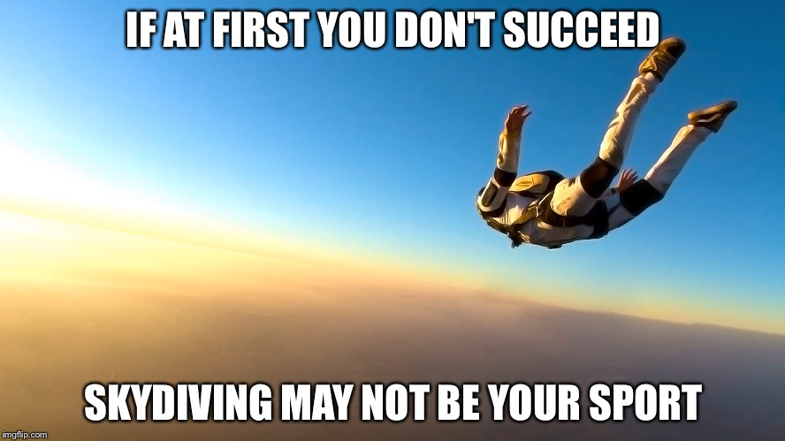

Slide 33
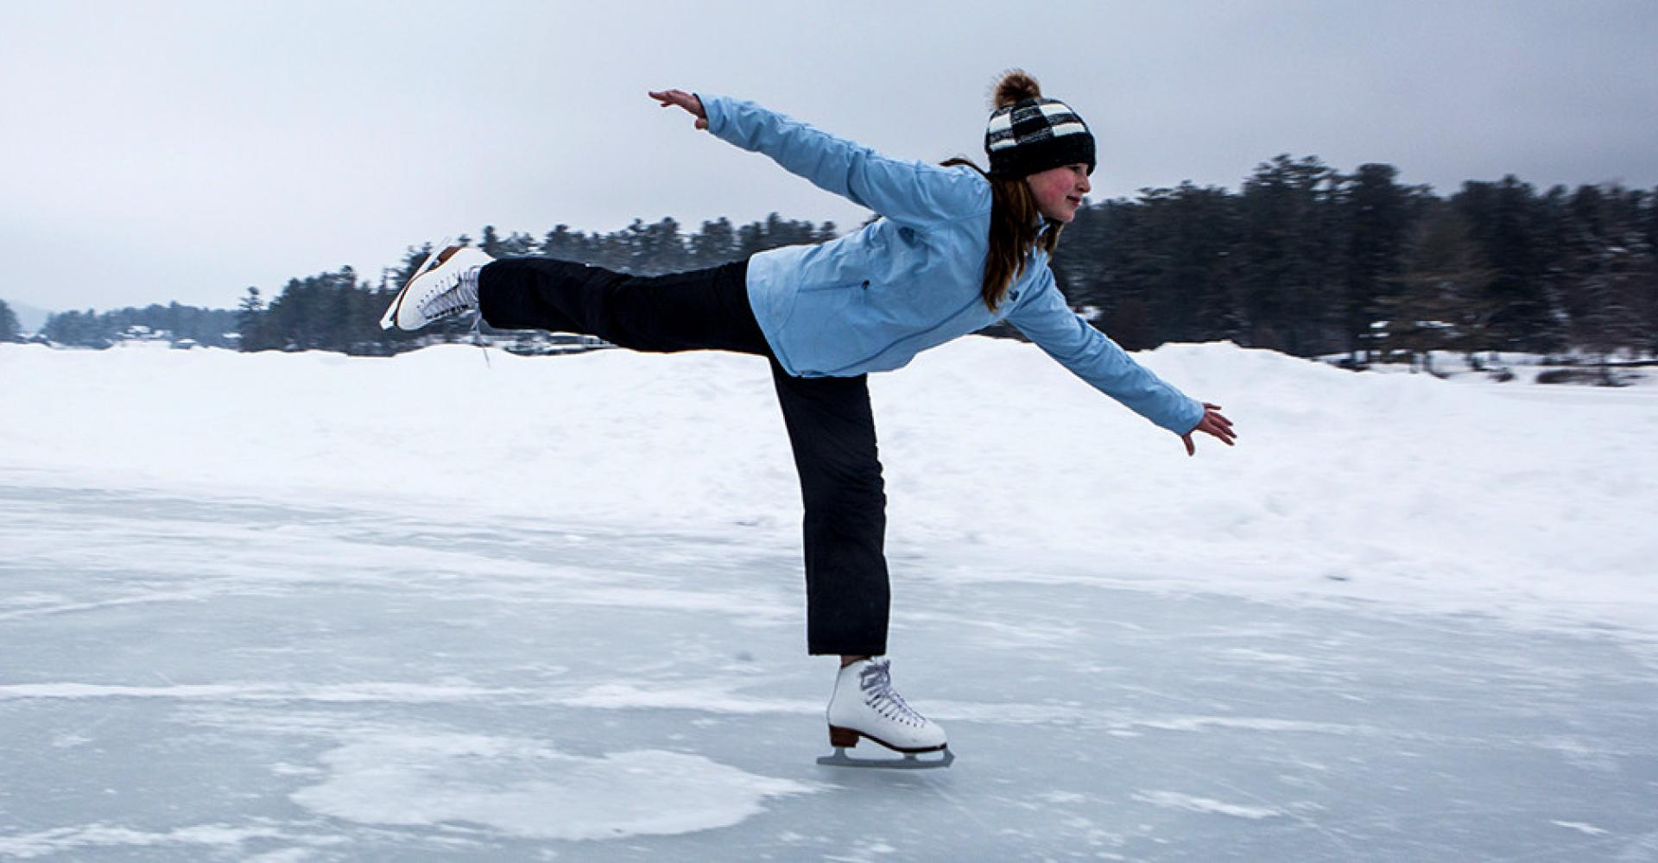
SKATING
She says skating is much easier than gymnastics.
PATENLE KAYMAK

Slide 34
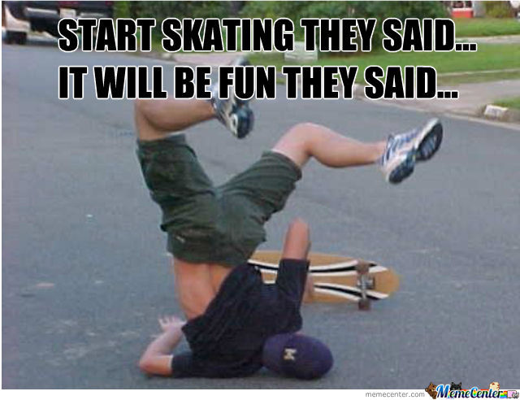

Slide 35

SURVEY
General view, description of something
Survey results show that employees are not happy with their salary.
ANKET

Slide 36
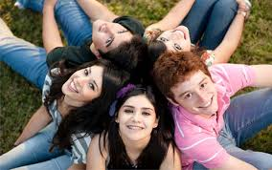
TEENAGER
Young people
As a teenager, what would you like to do after the school ?
GENÇ

Slide 37
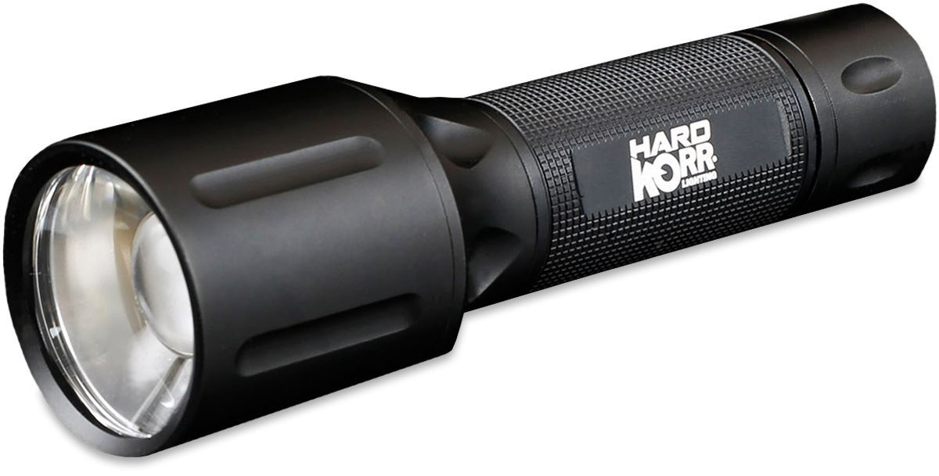
TORCH
Battery powered electric lamp.
Thank god, I brough my torch with me otwerwise it would be impossible to find our way.
EL FENERİ

Slide 38

KEEP UP WITH
Learn about and try to catch current events
I keep up with current events by reading news online.
YAKALAMAK – AYAK UYURMAK

