Slide 1
UNIT 2- YUMMY BREAKFAST
FOOD AND DRINKS

Slide 2
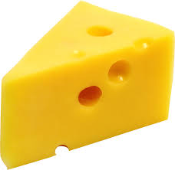
CHEESE

Slide 3

EGG

Slide 4

OLIVE

Slide 5
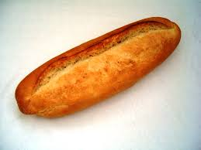
BREAD

Slide 6

HONEY

Slide 7
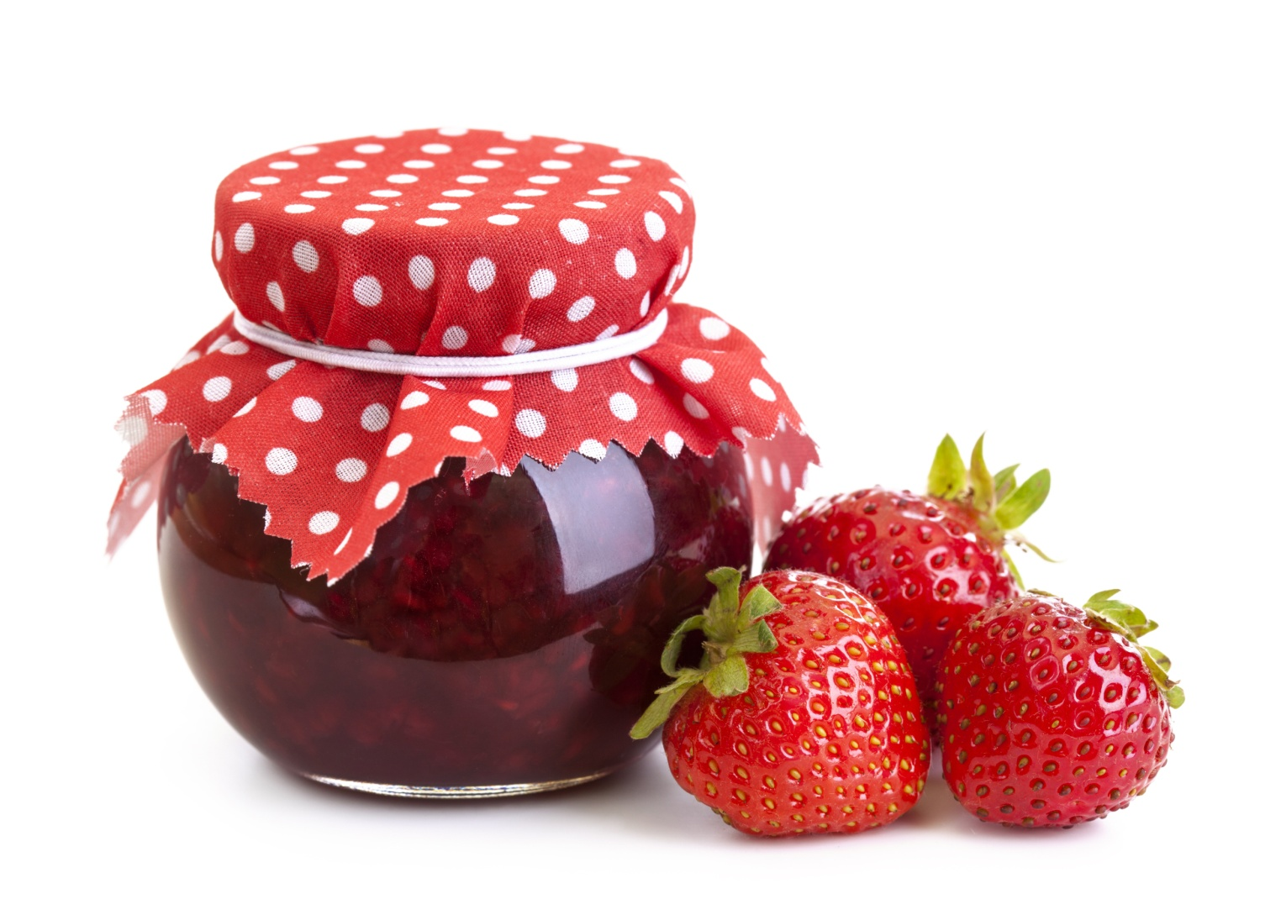
JAM

Slide 8
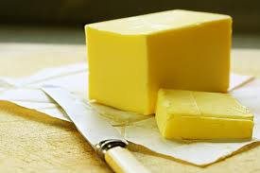
BUTTER

Slide 9
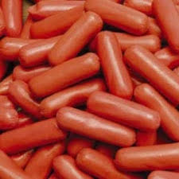
SAUSAGE

Slide 10
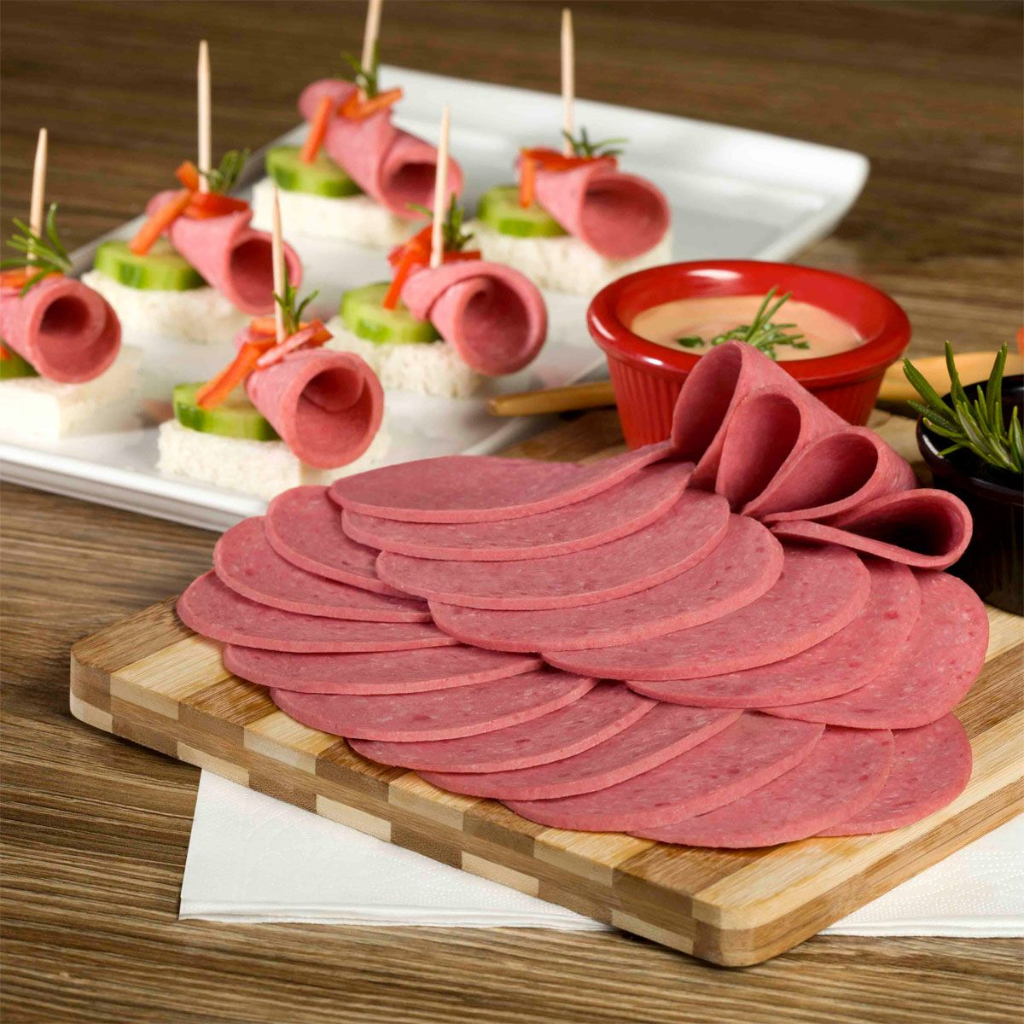
SALAMI

Slide 11
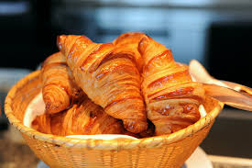
CROISSANT

Slide 12
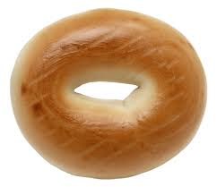
BAGEL

Slide 13
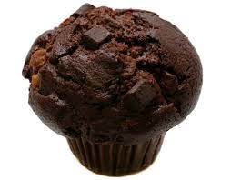
MUFFIN

Slide 14
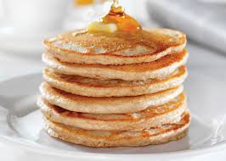
PANCAKE

Slide 15
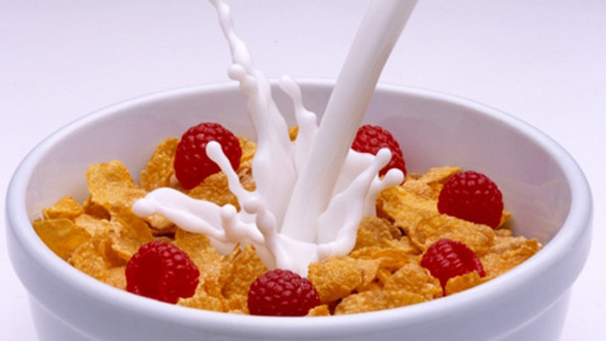
CEREAL

Slide 16
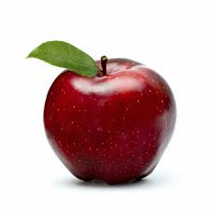
APPLE

Slide 17
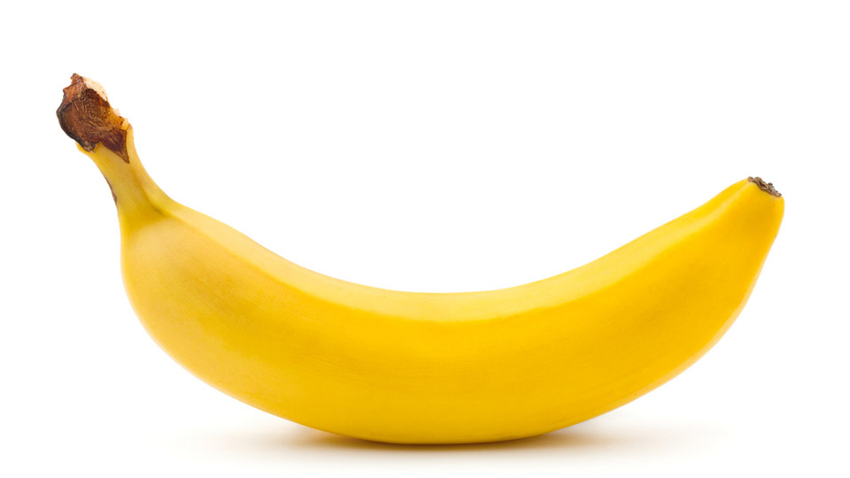
BANANA

Slide 18

BLACKBERRY

Slide 19
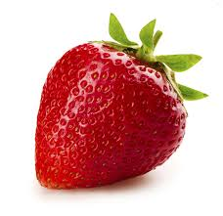
STRAWBERRY

Slide 20
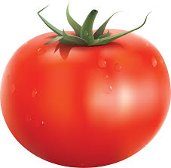
TOMATO

Slide 21
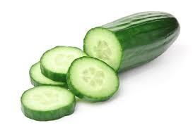
CUCUMBER

Slide 22
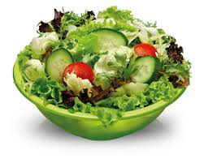
SALAD

Slide 23
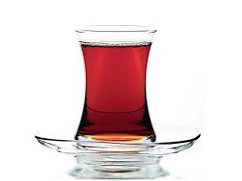
TEA

Slide 24

COFFEE

Slide 25

ORANGE JUICE

Slide 26
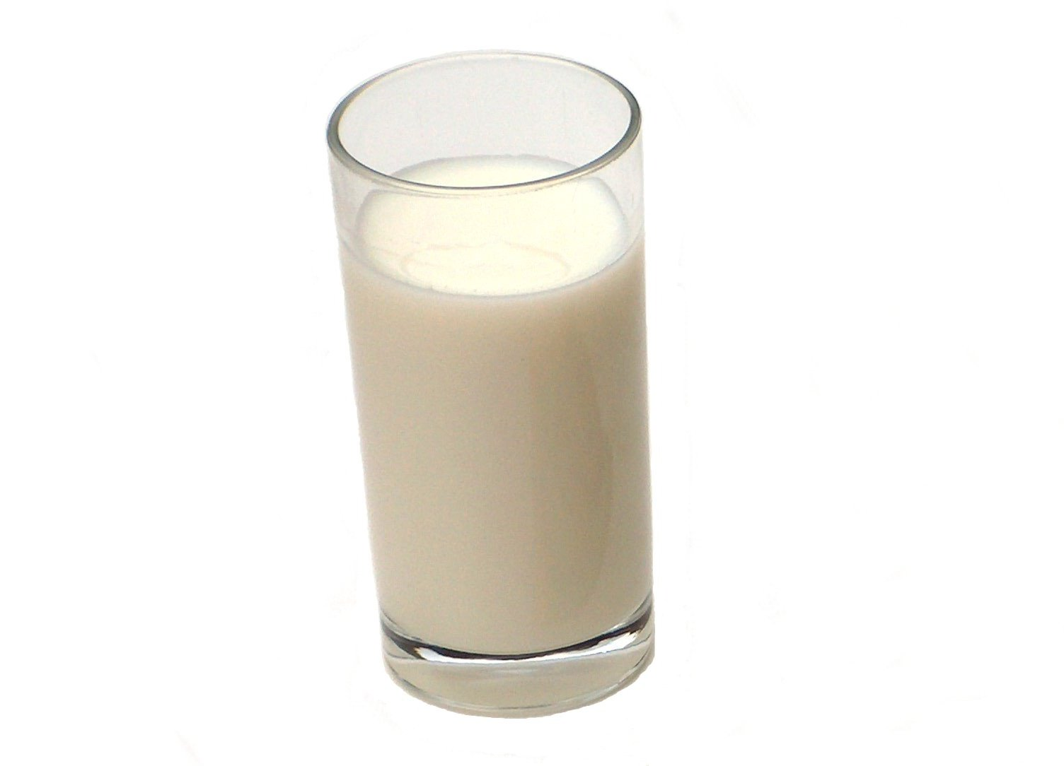
MILK

Slide 27
WHAT DO YOU EAT FOR BREAKFAST?
I EAT EGG, CHEESE AND OLIVE FOR BREAKFAST
WHAT DOES MARY EAT FOR BREAKFAST?
• SHE EATS PANCAKE AND SAUSAGES.

Slide 28
PREPARED BY:
PELİN KESKİN
ELT

