Slide 1



Slide 2
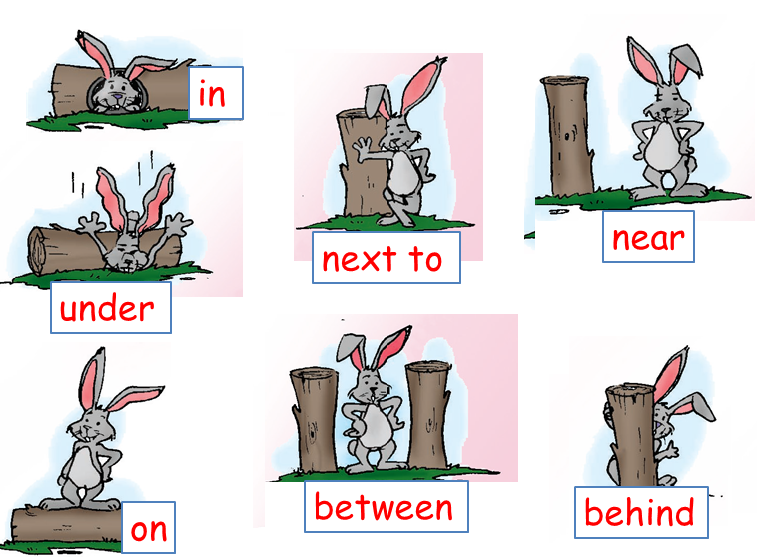

Slide 3




Slide 4

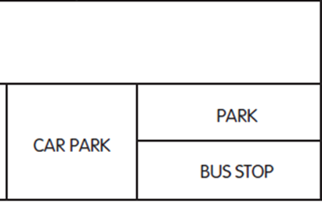

Slide 5

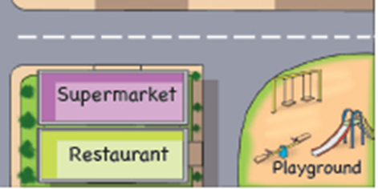

Slide 6

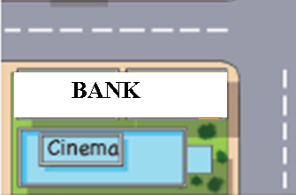

Slide 7




Slide 8

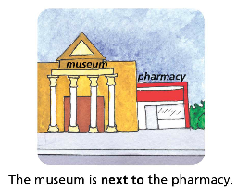

Slide 9




Slide 10





Slide 11

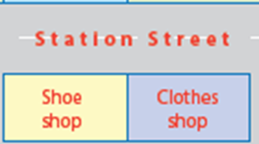

Slide 12


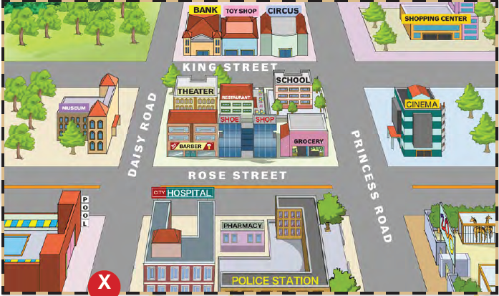

Slide 13

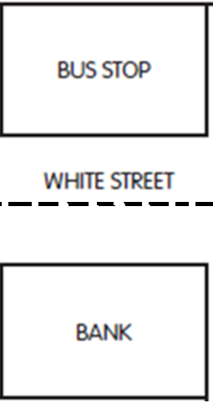

Slide 14




Slide 15

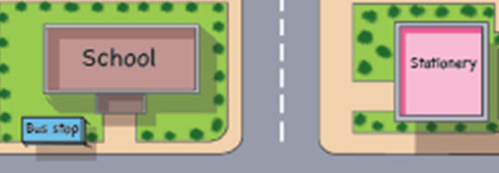

Slide 16




Slide 17

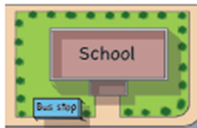

Slide 18

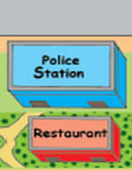

Slide 19



Slide 20







Slide 21



Slide 22



Slide 23



Slide 24


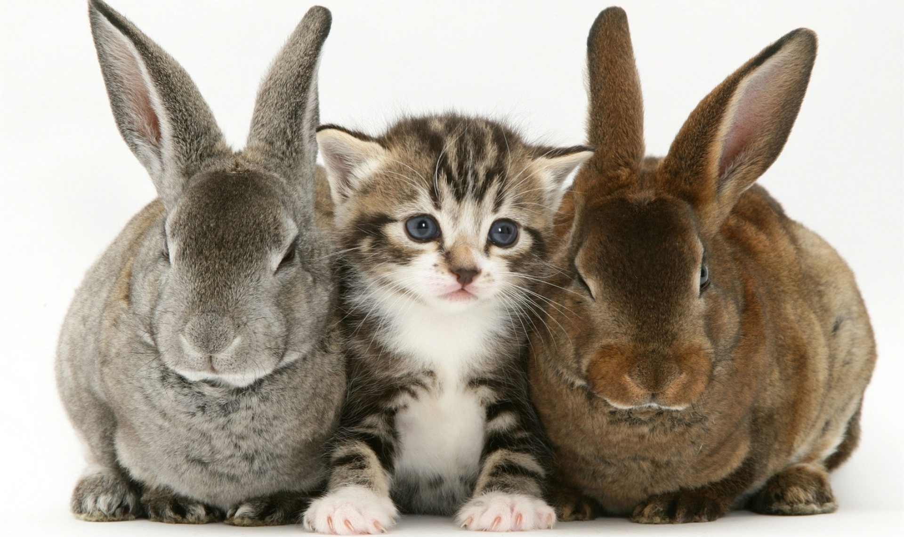

Slide 25

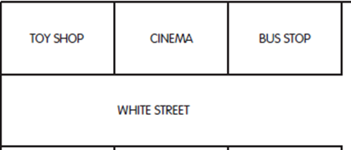

Slide 26



Slide 27



Slide 28


Slide 29

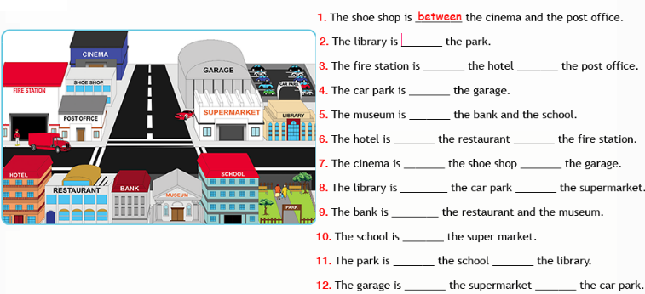
between

Slide 30


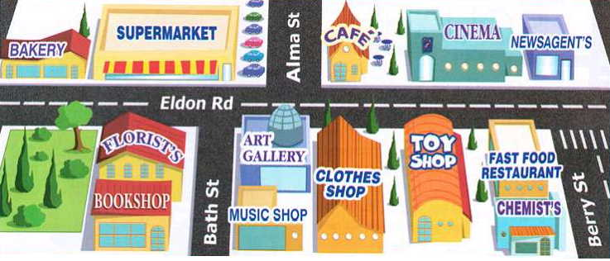
behind

Slide 31

opposite

Slide 32


next to

Slide 33

behind

Slide 34

between

Slide 35

opposite

Slide 36

in front of

