Slide 1
UNIT 1
APPEARANCE AND PERSONALITY
DIŞ GÖRÜNÜŞ
KİŞİLİK
ZEHRA AKTAŞ

Slide 2
AM / IS / ARE
Am/Is/Are yardımcı fiillerdir. İsim ve sıfat cümlelerinde kullanılır.
I
Ben
I
am
You
Sen/Siz
You
are
We
Biz
We
They
Onlar
They
He
O(erkekler için)
He
She
O(bayanlar için)
She
is
It
O(hayvanlar ve cansız varlıklar için)
It

Slide 3
Examples:
I am a teacher.
(Ben bir öğretmenim)
You are hardworking.
( Sen çalışkansın.)
They are hungry.
(Onlar aç.)
It is dangerous.
( O tehlikeli.)
Cümleyi olumsuz yapmak istediğimde am, is, are ‘dan sonra not getirilir. Kısaltılmış hali ;
is not
isn’t
are not
aren’t
I’m not tall.
( Ben uzun değilim)
You aren’t generous.
( Sen cömert değilsin.)
She isn’t old.
(O yaşlı değil.)

Slide 4

Soru cümlesi yapmak istediğimizde am, is, are cümle başına getirilir.
They are stingy.
(Onlar cimri.)
She is tall and slim.
(O uzun ve zayıf)
Are they stingy?
(Onlar cimri mi?)
Is she tall and slim?
( O uzun ve zayıf mı?)

Slide 5
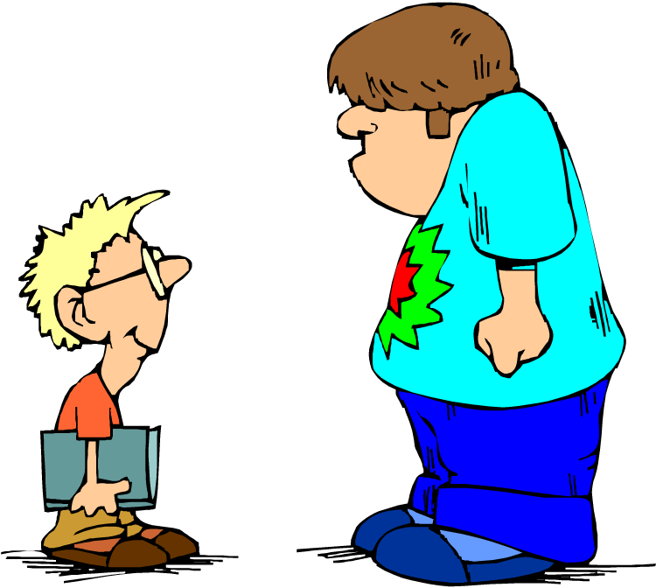



is
am
am
am
Hello! My name_____Carl. I____from Australia. I 13 years old. and I a student at a secondary school.My father____a teacher and my mother____a nurse.My father____45 years old and my mother____42. We live in the city center.Our house a small flat but it new and modern.My grandparents live with us.They retired. This boy Peter.He my best friend.He a student at highschool. He 15 years old. His parents lawyers.Their office on Curry Street.They live in the city center.Their house very big and it has got a big garden.We always together after school.
is
is
is
is
is
is
are
is
is
is
is
are
is
is
are

Slide 6
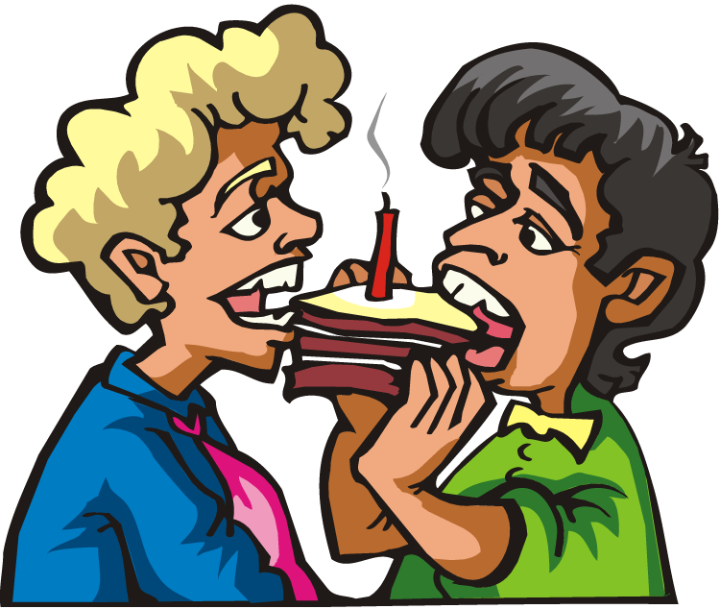
are
are
are
These____ Michael and Joseph.They____ twin brothers.They are 16 years old.They _both short and slim.They____ in the same class.They ____always together.They____from London.Their favourite football team____Liverpool and their favourite singer Madonna. Michael's hair ____ blonde and wavy but Joseph's hair is dark and straight.Michael____good at Mathematics and Joseph____good at Physics. They____both interested in seeing new places and camping.Their house ____ in the country. It ____ a small cottage. Their father a bus driver and their mother ____a shop assistant. They____very happy together.
are
are
are
is
is
is
is
is
are
is
is
is
is
are

Slide 7

WHAT DOES HE/SHE LOOK LİKE?
(O NASIL BİRİDİR?)

Slide 8

Short
Kısa
My father is short.
( Benim babam kısa.)

Slide 9
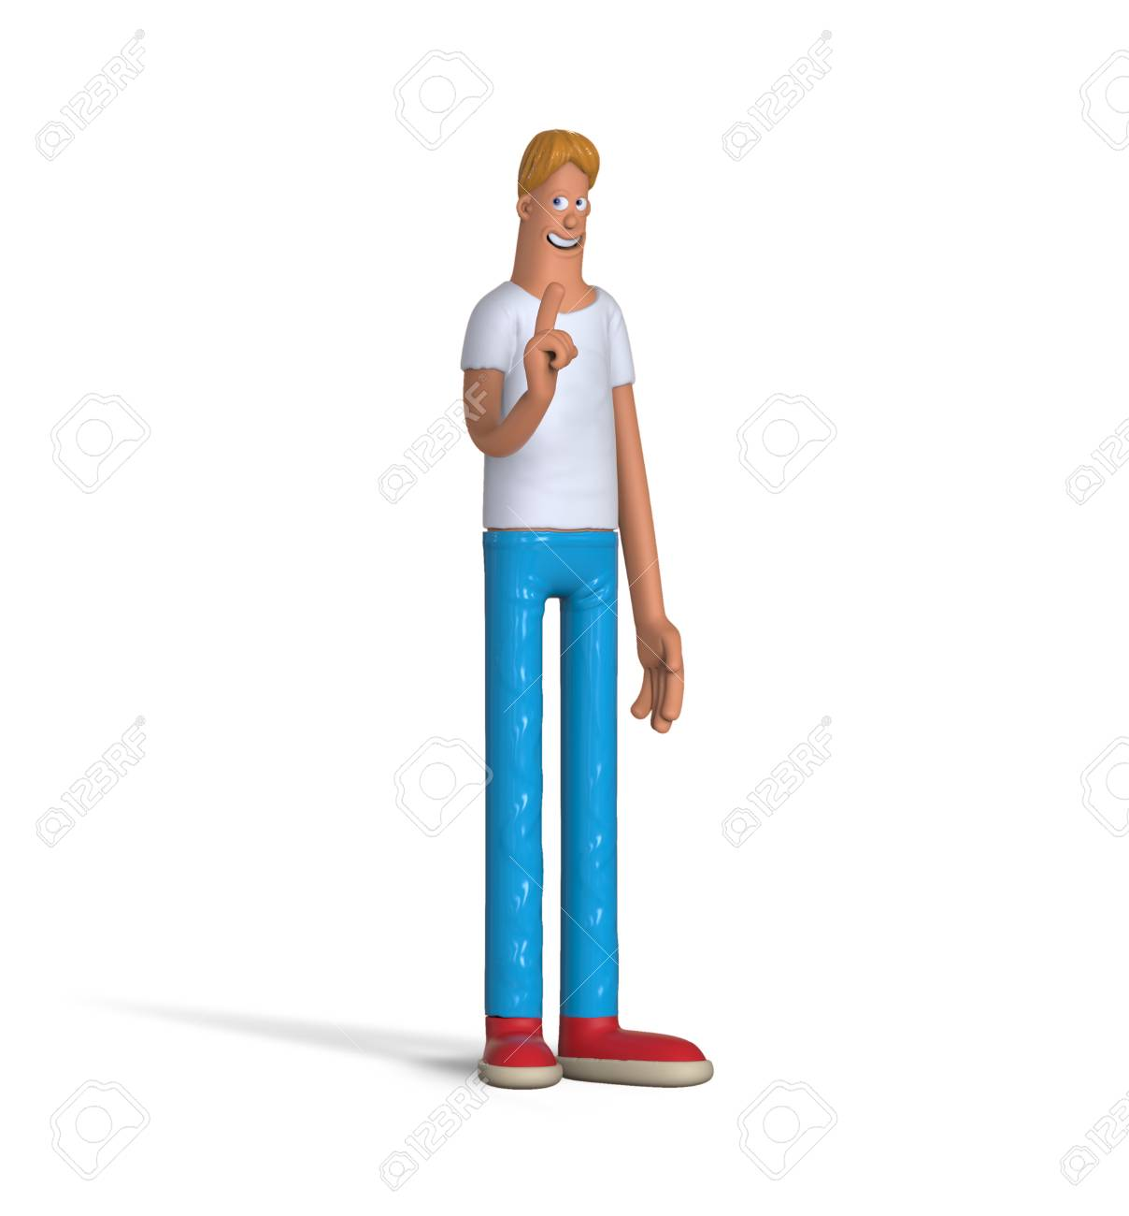
Tall
Uzun
My brother is very tall and a good basketball player.
( Benim erkek kardeşim çok uzun ve iyi bir basketbolcu.)

Slide 10
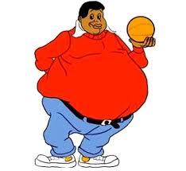
Plump
Tombul
He is plump because he loves eating junk food very much.
( O tombul çünkü abur cubur yemeyi çok seviyor.)

Slide 11
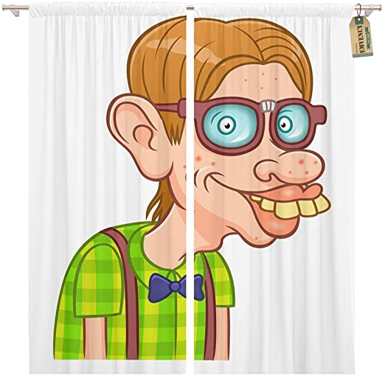
Ugly
Çirkin
He is ugly.
O çirkin.

Slide 12
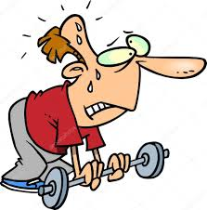
Weak
Güçsüz
My sister never has breakfast and she is too weak.
( Kız kardeşim asla kahvaltı yapmaz ve çok güçsüz.)

Slide 13
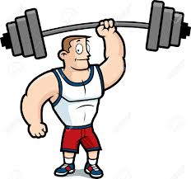
strong
güçlü
He is strong.
O güçlü.

Slide 14
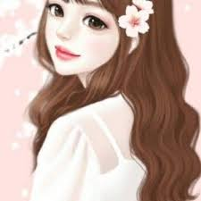
Beautiful
Güzel
She has got beautiful eyes.
( O güzel gözlere sahip.)

Slide 15
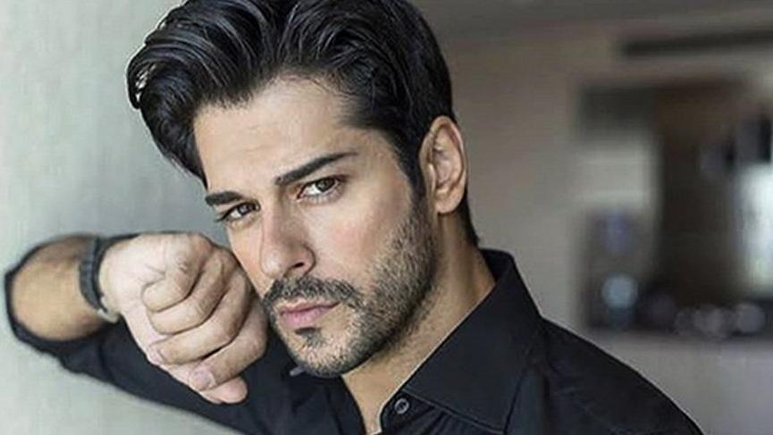
Handsome
Yakışıklı
Burak Özçivit is handsome.
( Burak Özçivit yakışıklıdır.)

Slide 16
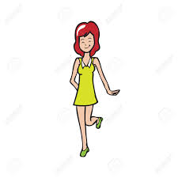
Thin /Slim
Zayıf
Ayla is slim and tall.
( Ayla zayıf ve uzun.)

Slide 17
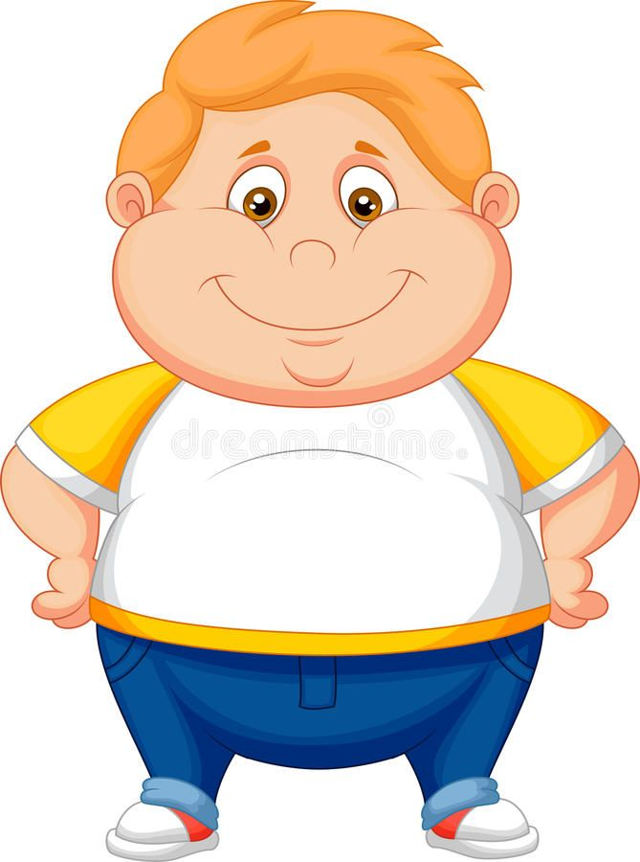
Fat
Şişman
I’m fat because I never walk or do exercise.
( Ben şişmanım çünkü asla yürümem ya da spor yapmam.)

Slide 18
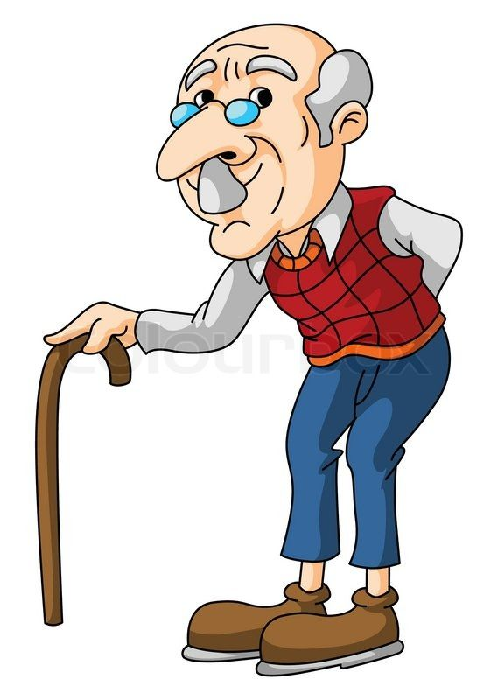
Old
Yaşlı
My grandfather is 85. He is old.
( Büyükbabam 85 yaşında. O yaşlı.)

Slide 19
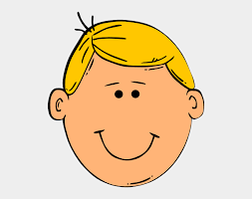
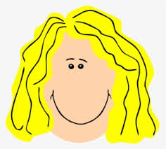
Blond/Blonde
Sarışın
He has short blond hair.
She has long blonde hair.
(Onun sarı uzun saçları var.)
( Onun sarı kısa saçı var.)

Slide 20
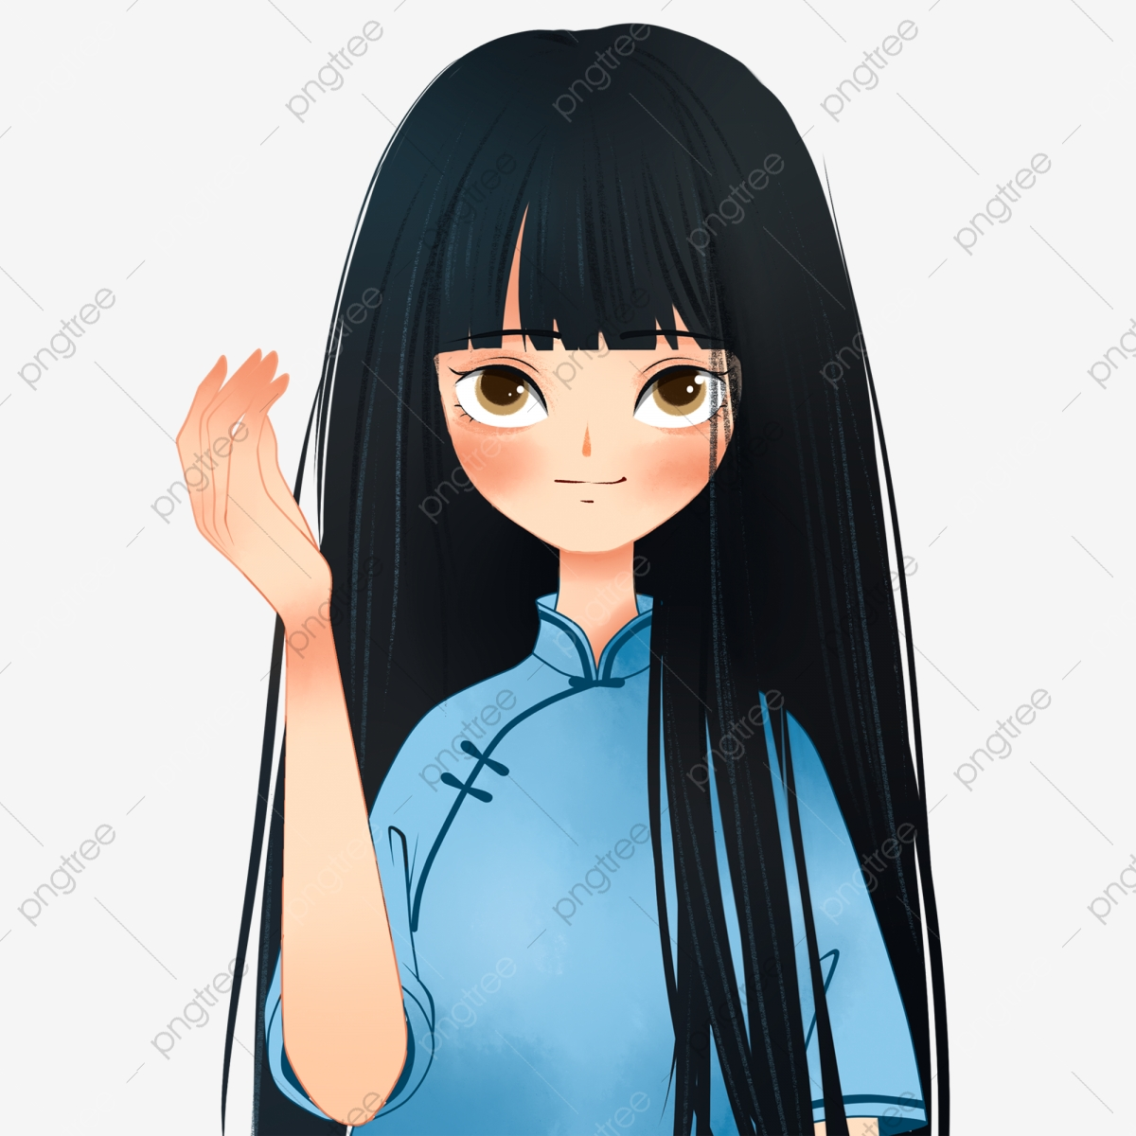
Straight
Düz
I have got long straight hair.
(Ben uzun düz saça sahibim.)

Slide 21
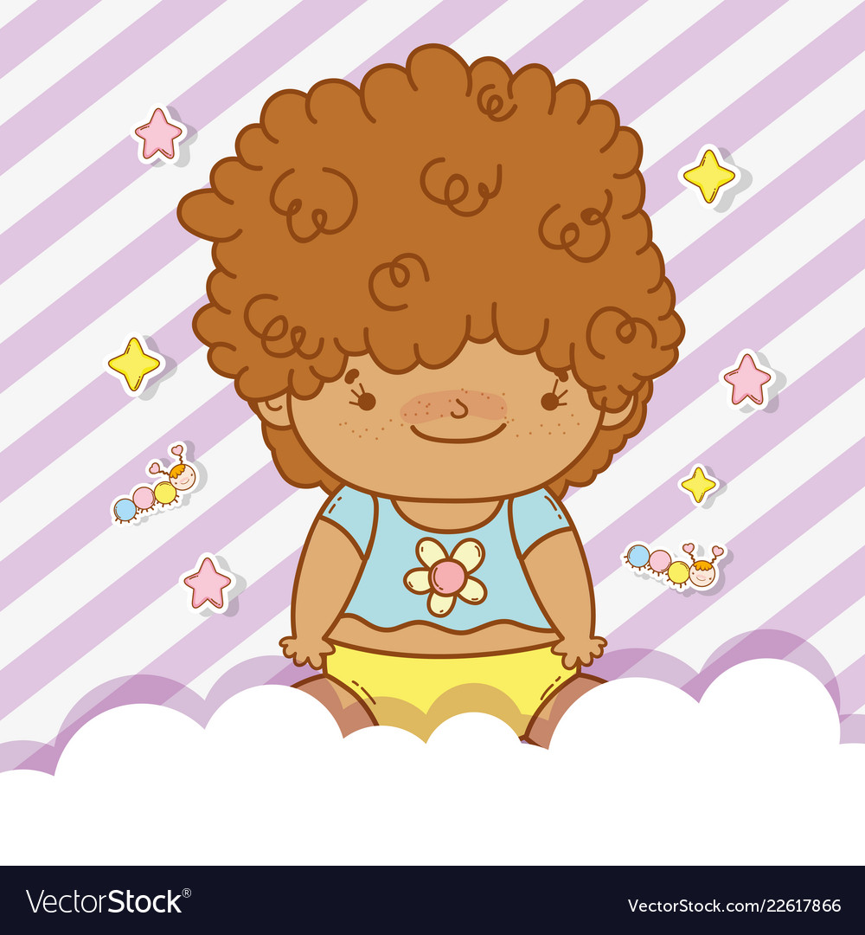
Curly
Kıvırcık
The baby has long curly hair.
( Bebeğin uzun kıvırcık saçı var.)

Slide 22
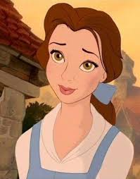
Hazel
Ela
My mother has hazel eyes.
( Annemin gözleri ela.)

Slide 23

Bald
Kel
My uncle is bald.
( Benim amcam kel.)

Slide 24
WHAT IS HE/SHE LIKE?
( O NASIL BİRİDİR? )
KİŞİNİN KİŞİLİĞİNİ SORAR.

Slide 25
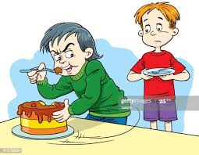
Selfish
Bencil
Samet is a selfish child. He never shares.
(Samet bencil bir çocuk. Asla paylaşmaz.)

Slide 26
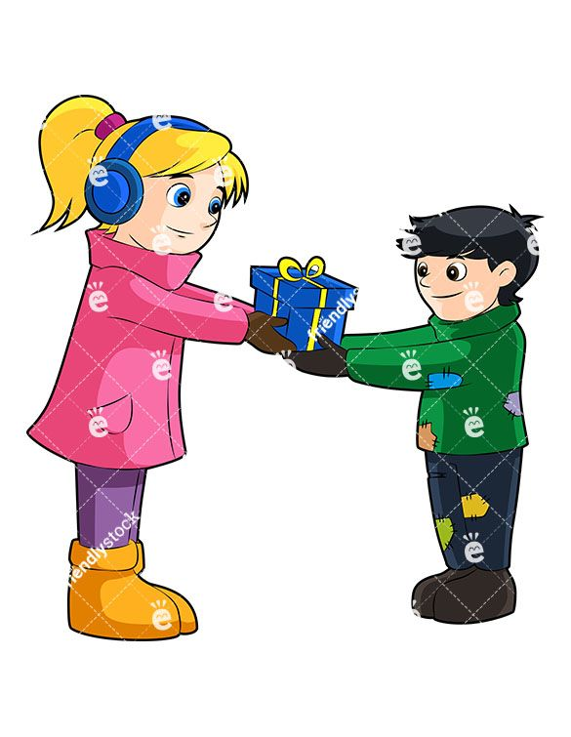
Generous
Cömert
Zeynep is generous. She always buys presents for children.
Zeynep cömerttir. O her zaman çocuklara hediyeler alır.)

Slide 27

Shy
Utangaç
My sister is very shy and she doesn’t talk in a group.
Benim kızkardeşim çok çekingen ve toplulukta hiç konuşmaz.

Slide 28
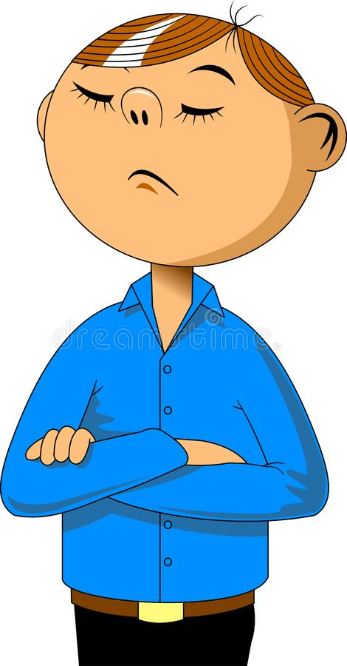
Stubborn
İnatçı
I think Tom is a stubborn man.
Bence Tom inatçı bir adam.

Slide 29
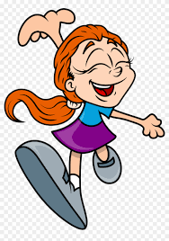
Cheerful
Neşeli
She is always cheerful and smiling
O her zaman neşeli ve güler yüzlüdür.

Slide 30

Cute
Sevimli
Owls are cute.
Baykuşlar sevimlidir.

Slide 31
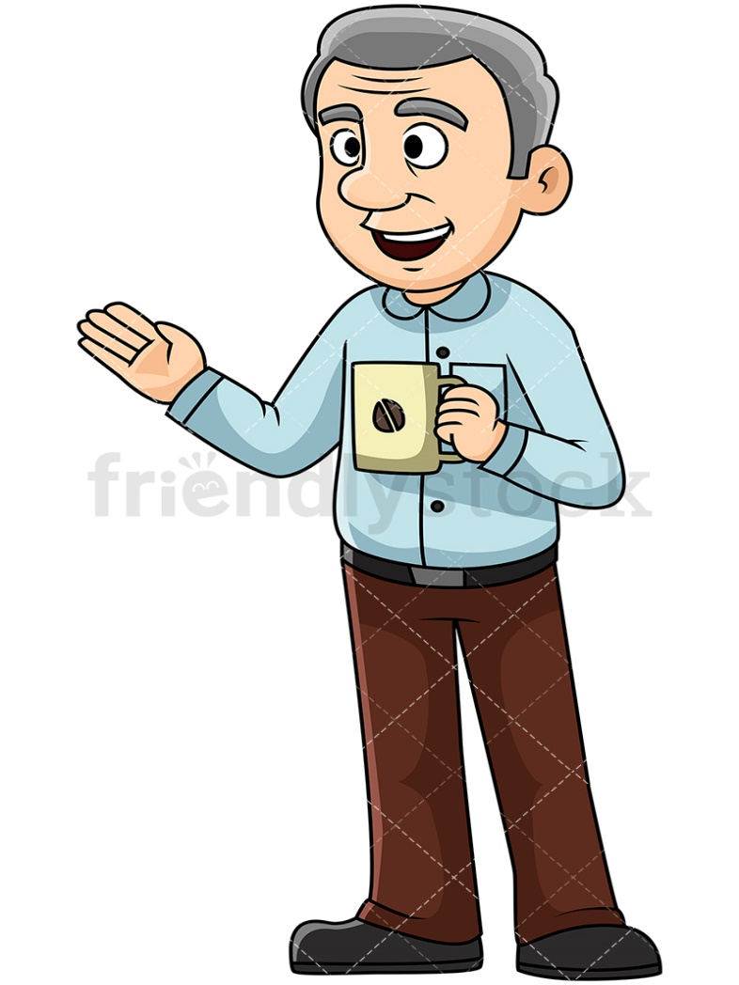
Easy going
Uysal
My father is an easygoing person in almost everything he does
Benim babam neredeyse yaptığı her şeyde uyumlu bir insandır.

Slide 32

Friendly
Cana yakın, samimi
Turkish people are very friendly
Türkler cana yakındır

Slide 33

Funny
Komik
What a funny man!
Ne komik bir adam!

Slide 34

Hardworking
Çalışkan
She's smart and hardworking.
O zeki ve çalışkandır.

Slide 35
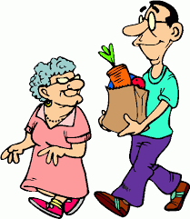
Helpful
Yardımsever
Jack is very helpful. He always helps old people.
Jack çok yardımseverdir. O herzaman yaşlı insanlara yardım eder..

Slide 36
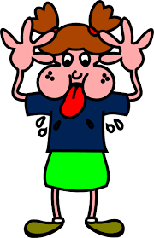
Rude
Kaba
Don't be rude.
Kaba olmayın.

Slide 37
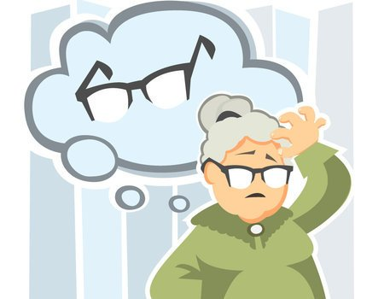
Forgetful
Unutgan
My grandmother was gradually becoming forgetful.
Büyükannem giderek unutkan oluyor.

Slide 38
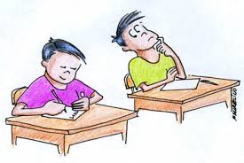
Dishonest
Dürüst olmayan
He's lazy and dishonest
O tembel ve dürüst değil.

Slide 39

Honest
Dürüst
The boy is very honest.
Çocuk çok dürüst.

Slide 40

Lovely
Hoş, güzel
She looks very lovely.
O çok hoş görünüyor.

Slide 41
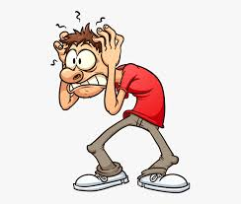
Nervous
Sinirli, gergin
You seem a little nervous.
Biraz sinirli görünüyorsun.

Slide 42

Outgoing
Cana yakın,sempatik
She is very outgoing so she has got a lot of friends
O çok cana yakın böylece çok arkadaşı vardır.

Slide 43

Punctual
Dakik
Paul is punctual like a clock
Paul saat gibi dakiktir.

Slide 44

Quiet
Sessiz, sakin
The boys were quiet.
Çocuklar sakindi.

Slide 45
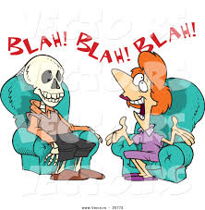
Talkative
Konuşkan
Mary is a talkative woman, isn’t she?
Mary konuşkan bir kadın, değil mi?

Slide 46
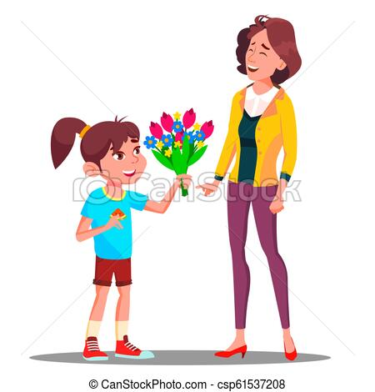
Thoughtful
Düşünceli
My daughter is always thoughtful.
Kızım herzaman düşüncelidir.

Slide 47

Smart
Zeki, akıllı
You are a smart student.
Sen akıllı bir öğrencisin.

Slide 48
MATCH THEM
D
1.HONEST
A.He always breaks something.
E
2.STUBBORN
B.He can solve difficult problems.
3.PUNCTUAL
F
C.He never thinks of other people.
4.CLUMSY
A
D.He never tells lie.
5.SELFISH
C
E.He never changes his mind.
6.FORGETFUL
G
F.He goes everywhere on time.
B
7.SMART
G.He can’t remember things easliy.

Slide 49
8.SHY
D
H. He always helps others.
J
I.He always makes jokes.
9.RUDE
10.FUNNY
I
J.He never says ‘thank you’ or ‘please’.
11.OUTGOING
O
K.He does his homework regulary.
12.GENEROUS
N
L.He always tells lie.
K
M.He can’t make friends easliy.
13.HARDWORKING
14.DISHONEST
L
N.He gives Money or presents to others.
15.HELPFUL
H
O.He likes metting new people.

